Slide 1
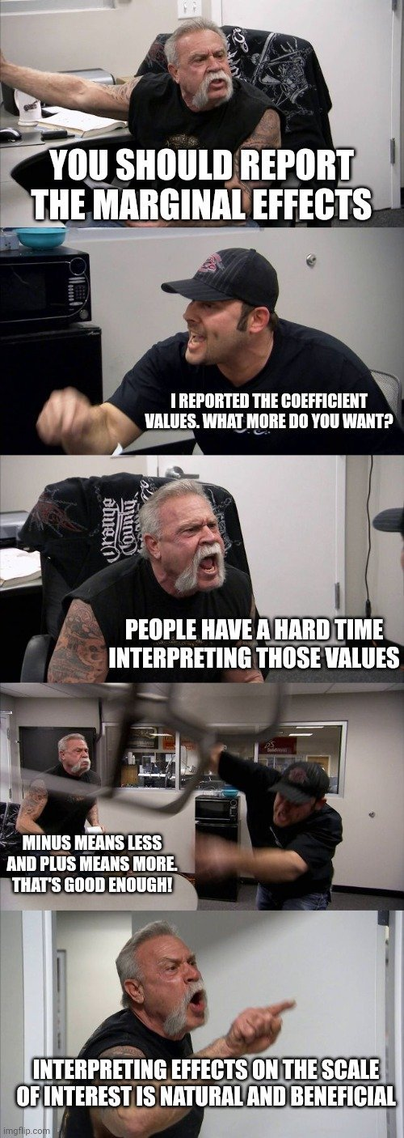
announcements
Problem Set 8 is due today
Drill will be happening this week ... maybe
Next Monday is a day off
Problem Set 7’s answer key is done, but grading is not

Slide 2
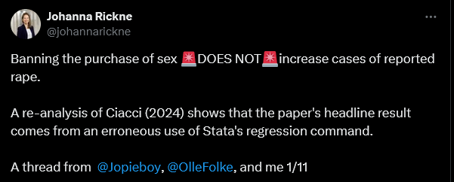
sometimes data analysts make mistakes

Slide 3
mediation analysis: wrap-up
April 1, 2024

Slide 4
thinking about mediation
complexities of third-variable control &
other considerations

Slide 5
mediation: what we think is happening
if one variable influences another through an intervening variable, the intervening variable is typically called a mediator
M
X
Y

Slide 6
confounds: equivalent mathematically
con
X
Y

Slide 7
an example of a (probable?) confound
intelligence
education
income

Slide 8
colliders: similar mathematically
coll
X
Y

Slide 9
an example of collider bias
imagine you are interested in the relationship between intelligence (indexed by IQ) and conscientiousness
you find a large sample of college students and find ... r = -.37
what?!
http://www.the100.ci/2017/03/14/that-one-weird-third-variable-problem-nobody-ever-mentions-conditioning-on-a-collider/

Slide 10
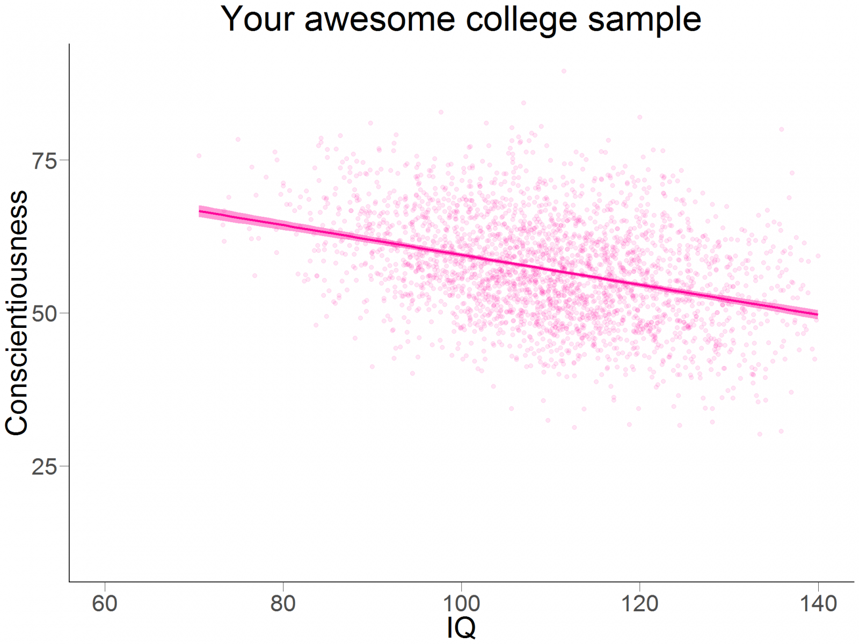

Slide 11
what’s going on?
college students tend to be higher IQ that the general population; they also tend to be higher with respect to conscientiousness
that is, both of these variables are predictors of college-student membership; they “collide”
so selecting from the college-student population “conditions on a collider”, creating a (strange) relationship that doesn’t exist in the whole population

Slide 12
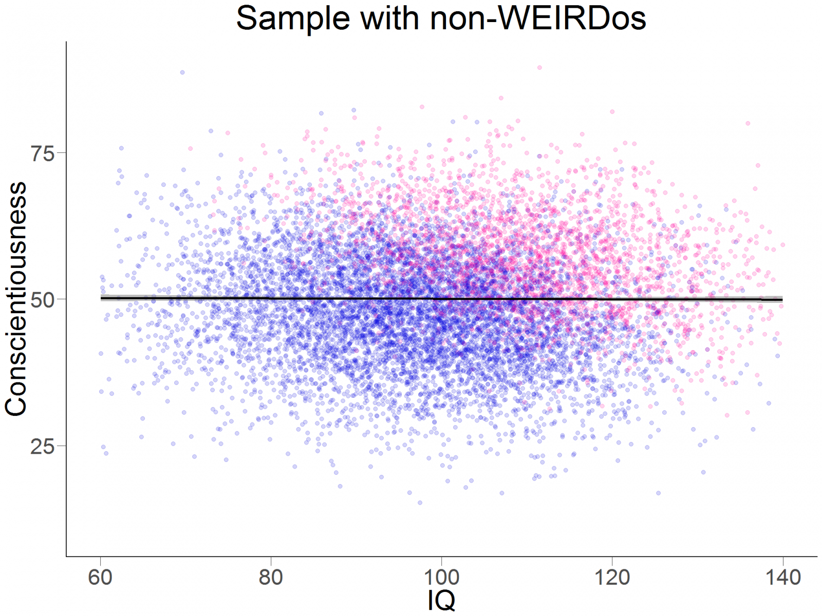

Slide 13
third-variable patterns (problems?), cataloged, probably not completely
confounds
colliders
suppressors
mediators
covariates
https://www.ncbi.nlm.nih.gov/pmc/articles/PMC2819361/
https://www.ncbi.nlm.nih.gov/pubmed/28575894

Slide 14
mediation extensions

Slide 15
moderated mediation (Soane et al., 2013, Human Resource Mgmt)
employee engagement
meaningfulness
absence

Slide 16
moderated mediation (Soane et al., 2013, Human Resource Mgmt)
well-being
employee engagement
meaningfulness
absence

Slide 17
mediated moderation (Christ et al., 2010, PSPB)
mixed vs segregated areas
extended contact
prejudice

Slide 18
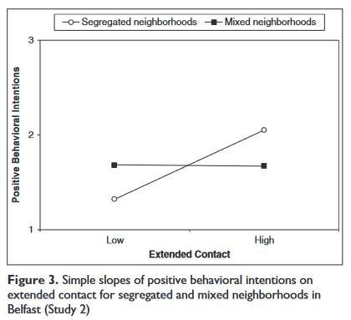

Slide 19
mediated moderation (Christ et al., 2010, PSPB)
mixed vs segregated areas
direct contact
extended contact
prejudice

Slide 20
non-independence in data
introduction to non-independence,
its consequences,
and repeated-measures designs

Slide 21
assumptions made in modeling
these are about residuals! (not about predictors)
they’re normally distributed
they have constant variance (homoscedasticity)
they are independent of one another

Slide 22
independence?
independence means that any one individual’s residual can’t be used to estimate another’s
when is this violated?
usually it’s a feature of the research design
common situations
repeated-measures studies
longitudinal studies
naturally-clustered data (e.g., students in classrooms)
research with dyads or group interactions

Slide 23
types of nonindependence
positive nonindependence
scores (residuals) are positively related
negative nonindependence
scores (residuals) are negatively related

Slide 24
positive nonindependence (an example)
if we ask couples to rate satisfaction with their relationship, we’d likely see high scores paired with high scores and low scores with low scores
one person’s score predicts the other’s
couple | partner 1 | partner 2
a | 1 | 1
b | 4 | 3
c | 6 | 7
d | 5 | 6

Slide 25
negative nonindependence (an example)
if we ask couples to estimate how much housework each person does, we’d likely see high scores paired with low scores and vice versa
one person’s score predicts the other’s
couple | partner 1 | partner 2
a | 30% | 80%
b | 40% | 75%
c | 70% | 40%
d | 20% | 100%

Slide 26
consequences of nonindependence
this depends on the type (positive or negative)
and on how nonindependence fits within the design
it can in some circumstances increase Type I errors, and in others it can increase Type II errors

