Slide 1
intro to multilevel modeling
April 17, 2024

Slide 2
What is this about?
Imagine we are interested in the extent to which a pre-test (X; mean-centered!) predicts standardized math test scores (Y) in 5th graders.
We collect data from one classroom and find:
$${\hat{Y}}_{i}=β_{0}+β_{1}X_{i}$$
$${\hat{Y}}_{i}=70+0.2X_{i}$$

Slide 3
A complication
Imagine that we collected more data for a second classroom and found this:
$${\hat{Y}}_{i}=60+0.2X_{i}$$
Different intercept (maybe the class has a different overall level of ability)

Slide 4
What should we do?
Three options, from least to most complex:
Combine the data across classes and ignore that they come from different classes
Acknowledge that the data come from different classes and include classrooms as a part of our regression model
Multilevel modeling

Slide 5

Option 1
Collapsing across classes
This gives us:
$${\hat{Y}}_{i}=65+0.2X_{i}$$

Slide 6
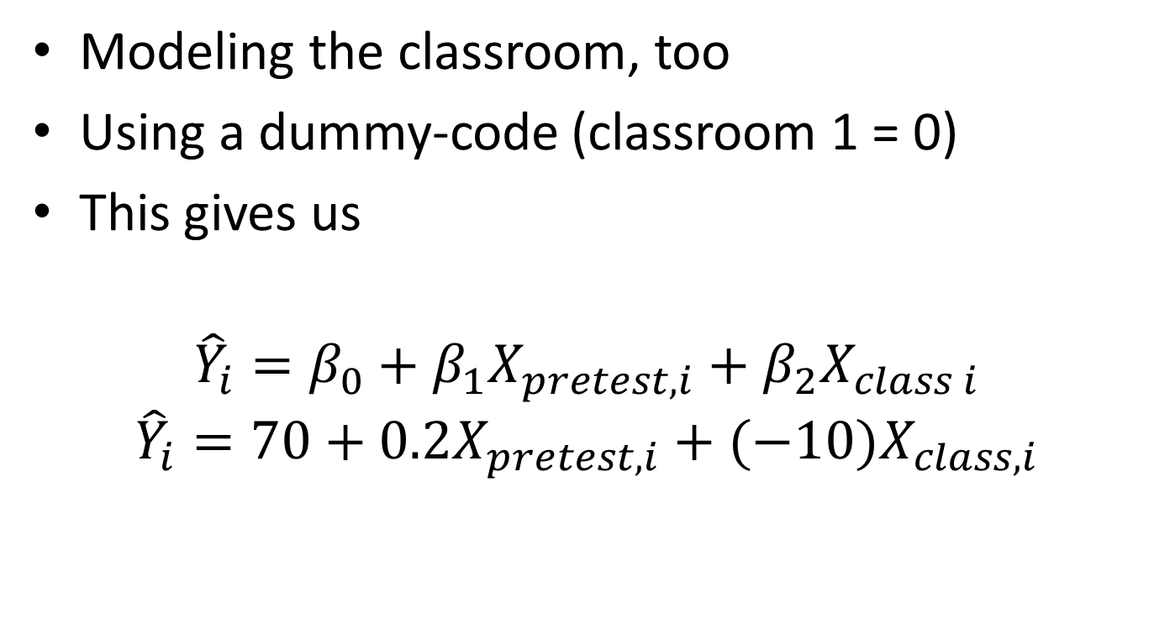
Option 2
Modeling the classroom, too
Using a dummy-code (classroom 1 = 0)
This gives us
$${\hat{Y}}_{i}=β_{0}+β_{1}X_{pretest,i}+β_{2}X_{class i}$$
$${\hat{Y}}_{i}=70+0.2X_{pretest,i}+(−10)X_{class, i}$$

Slide 7
Option 3
Modeling not only the effect of the pretest at the subject level
Also modeling the differences in classrooms
$${\hat{Y}}_{i}={\hat{β}}_{0,j}+β_{1}X_{pretest,i}+e_{i}$$
$${\hat{β}}_{0,j}=γ_{0}+u_{j}$$

Slide 8
Option 3
Modeling not only the effect of the pretest at the subject level
Also modeling the differences in classrooms
$${\hat{Y}}_{i}={\hat{β}}_{0,j}+β_{1}X_{pretest,i}+e_{i}$$
$${\hat{β}}_{0,j}=γ_{0}+u_{j}$$
This is called a random-intercept model, and can be presented as one equation
$${\hat{Y}}_{i}=[γ_{0}+β_{1}X_{pretest,i}]+[u_{j}+e_{i}]$$

Slide 9
What’s up with the names?
You’ll hear many names for the same (or similar analyses)
linear mixed effects models; mixed linear models; linear mixed models
hierarchical linear modeling (HLM)
general linear mixed model
mixed models
nested growth curves
random effects modeling
random coefficient modeling
covariance components models

Slide 10
What’s “mixed” about these models?
They include a mix of fixed-effects and random-effects variables
Fixed-effects variables
non-randomly selected
no desire to generalize to other levels
repeatable
get slope estimates
Random-effects variables
randomly selected
wish to generalize to other levels
not repeatable
get variance estimates

Slide 11
What is multilevel data?
Data that are somehow grouped in a way that leads to non-independent observations
That is, residuals at a/some low level(s) are correlated
Some examples:
in educational research, students are nested within classrooms (& schools, districts, etc.)
in political science, legislators are nested within parties (& states, houses of Congress)
in public-health policy research, respondents are nested within cities, counties, etc.

Slide 12
What is multilevel data?
More examples:
A clinical psychology student here did a dissertation examining the client-therapist alliance, and got data from many clients who shared therapists
In repeated-measures designs, multiple observations are made from the same person
In dyad-based research, the two subjects in the dyad provide related observations

Slide 13
Some diagrams of multilevel data: students (within conditions) within schools
School A
School B
student
student
student
student
student
student
student
student

Slide 14
Some diagrams of multilevel data: observations (within conditions) within subjects
Subject A
Subject B
condition 1
condition 2
condition 1
condition 2
condition1
condition 2
condition 1
condition 2

Slide 15
Why does this matter?
regression (ANOVA is regression) assumes that residuals (unexplained influences on scores) are independent
if they aren’t, this can inflate the Type 1 or Type 2 error rate
theoretically, ignoring the ways in which data are grouped ignores that context (however it’s defined) matters
practically, some of the higher-level grouping variables may be of interest themselves
ecological fallacy (high-level relationships may mis-estimate low-level relationships)
atomistic fallacy (low-level relationships may not scale up)

Slide 16
yet more introduction to MLM

Slide 17
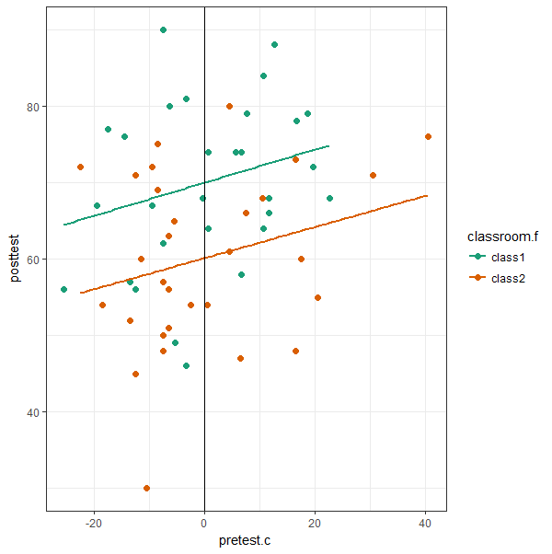
exploring the twoclassrooms data # Section 1
things to notice:
classes have similar slopes
class1 has an intercept of 70
class2 has an intercept of 60
think of intercepts as DV means (when predictors are centered)

Slide 18
separate regressions # Section 2
class 1 regression equation (rounded)
$$\hat{Y}=70+0.2∗pretest$$
class 2 regression equation (rounded)
$$\hat{Y}=60+0.2∗pretest$$

Slide 19
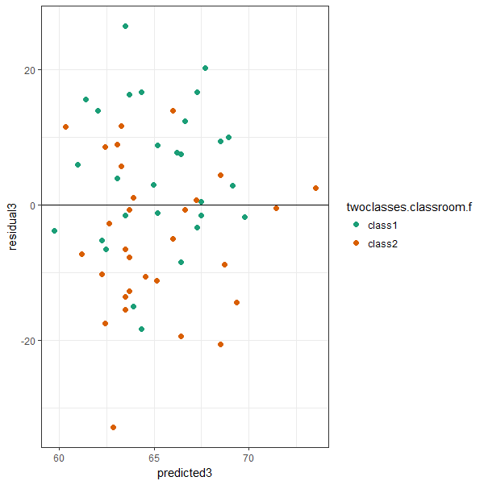
analysis option: collapsing across classrooms # Section 3
R² = .055; s_{resid} = 11.9
$\hat{Y}=65+0.2∗pretest$
intercept between 60 & 70
pro: n = 60 better than n = 30
con: independence assumption is in bad shape
residuals are clustered (class1 mostly > 0, class2 mostly < 0)
residuals M_{class1} = 4.9
residuals M_{class2} = -4.9

Slide 20
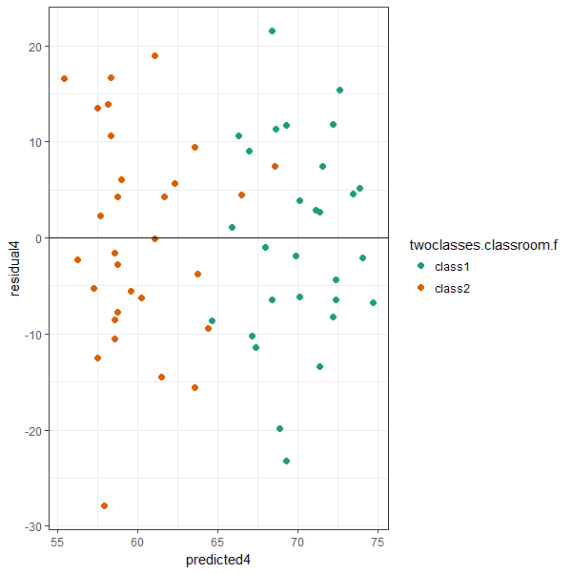
analysis option: modeling classrooms as a predictor # Section 4
R² = .22; s_{resid} = 10.9
$\hat{Y}=70+0.2pre+−10class$
intercept represents class1
class slope represents class2 difference from class1
pro: independence of residuals is in good shape
residuals not clustered
residuals M_{class1} = 0
residuals M_{class2} = 0
con: scaling up (e.g., to 30 classes) costs parameters (which we probably don’t care about)

Slide 21
How to run a multilevel model using lmer() in the lme4 package
lmer(data = twoclasses,
posttest ~ (1 | classroom.d) + pretest.c )

Slide 22
How to run a multilevel model using lmer() in the lme4 package
lmer(data = twoclasses,
posttest ~ (1 | classroom.d) + pretest.c )

Slide 23
How to run a multilevel model using lmer() in the lme4 package
lmer(data = twoclasses,
posttest ~ (1 | classroom.d) + pretest.c )
This indicates that the intercept (1) varies from classroom to classroom

Slide 24
How to run a multilevel model using lmer() in the lme4 package
lmer(data = twoclasses,
posttest ~ (1 | classroom.d) + pretest.c )

Slide 25
Parsing part of the summary() of an lmer() call
Random effects:
Groups Name Variance Std.Dev.
classroom.d (Intercept) 44.72 6.688
Residual 118.52 10.887
Number of obs: 60, groups: classroom.d, 2
Fixed effects:
Estimate Std. Error t value
(Intercept) 65.0333 4.9333 13.182
pretest.c 0.2089 0.1036 2.017

Slide 26
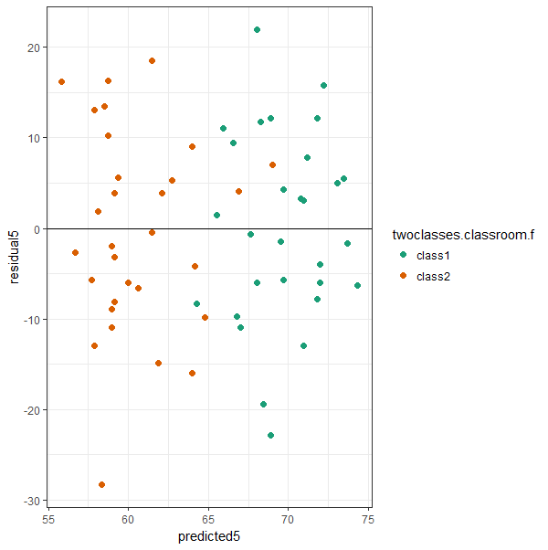
Analysis option: multilevel modeling # Section 5
R² = complicated; s_{resid} = 10.9
$\hat{Y}=65+0.2pre$
var(classroom) = 44.7
intercept represents grand mean
variance represents classroom mean (intercept) differences
residuals nearly identical to using classroom as a predictor
pro: scaling up (e.g., to 30 classes) costs no parameters

