Slide 1
a little more multilevel modeling
April 22, 2024

Slide 2
two classrooms data
one predictor (X, a pretest), mean-centered
one outcome (Y, a standardized test)
one class scores 10 points higher than average than the other
the X-Y relationship in the two classes is the same

Slide 3
Option 3
Modeling not only the effect of the pretest at the subject level
Also modeling the differences in classrooms
$${\hat{Y}}_{i}={\hat{β}}_{0,j}+β_{1}X_{pretest,i}+e_{i}$$
$${\hat{β}}_{0,j}=γ_{0}+u_{j}$$
This is called a random-intercept model, and can be presented as one equation
$${\hat{Y}}_{i}=[γ_{0}+β_{1}X_{pretest,i}]+[u_{j}+e_{i}]$$

Slide 4
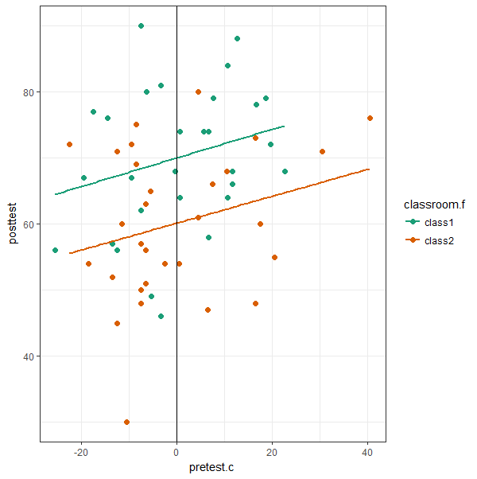
exploring the twoclassrooms data # Section 1
things to notice:
classes have similar slopes
class1 has an intercept of 70
class2 has an intercept of 60
think of intercepts as DV means (when predictors are centered)

Slide 5
separate regressions # Section 2
class 1 regression equation (rounded)
$$\hat{Y}=70+0.2∗pretest$$
class 2 regression equation (rounded)
$$\hat{Y}=60+0.2∗pretest$$

Slide 6
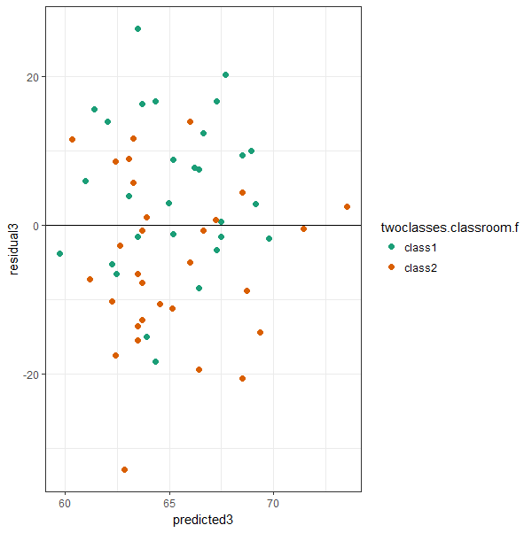
analysis option: collapsing across classrooms # Section 3
R² = .055; s_{resid} = 11.9
$\hat{Y}=65+0.2∗pretest$
intercept between 60 & 70
pro: n = 60 better than n = 30
con: independence assumption is in bad shape
residuals are clustered (class1 mostly > 0, class2 mostly < 0)
residuals M_{class1} = 4.9
residuals M_{class2} = -4.9

Slide 7
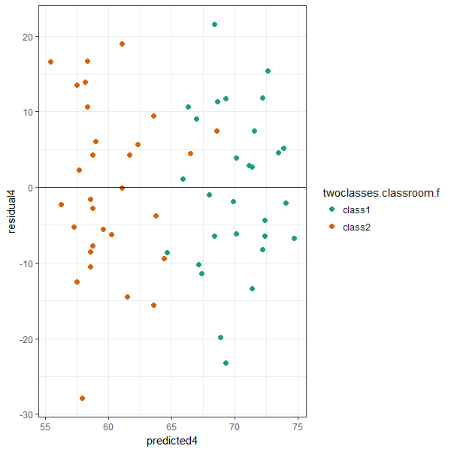
analysis option: modeling classrooms as a predictor # Section 4
R² = .22; s_{resid} = 10.9
$\hat{Y}=70+0.2pre+−10class$
intercept represents class1
class slope represents class2 difference from class1
pro: independence of residuals is in good shape
residuals not clustered
residuals M_{class1} = 0
residuals M_{class2} = 0
con: scaling up (e.g., to 30 classes) costs parameters (which we probably don’t care about)

Slide 8
How to run a multilevel model using lmer() in the lme4 package
lmer(data = twoclasses,
posttest ~ (1 | classroom.d) + pretest.c )

Slide 9
Parsing part of the summary() of an lmer() call
Random effects:
Groups Name Variance Std.Dev.
classroom.d (Intercept) 44.72 6.688
Residual 118.52 10.887
Number of obs: 60, groups: classroom.d, 2
Fixed effects:
Estimate Std. Error t value
(Intercept) 65.0333 4.9333 13.182
pretest.c 0.2089 0.1036 2.017

Slide 10
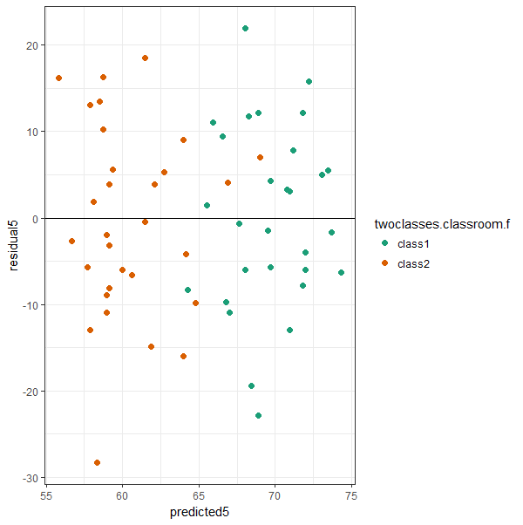
Analysis option: multilevel modeling # Section 5
R² = complicated; s_{resid} = 10.9
$\hat{Y}=65+0.2pre$
var(classroom) = 44.7
intercept represents grand mean
variance represents classroom mean (intercept) differences
residuals nearly identical to using classroom as a predictor
pro: scaling up (e.g., to 30 classes) costs no parameters

Slide 11
scaling up to 30 classes

Slide 12
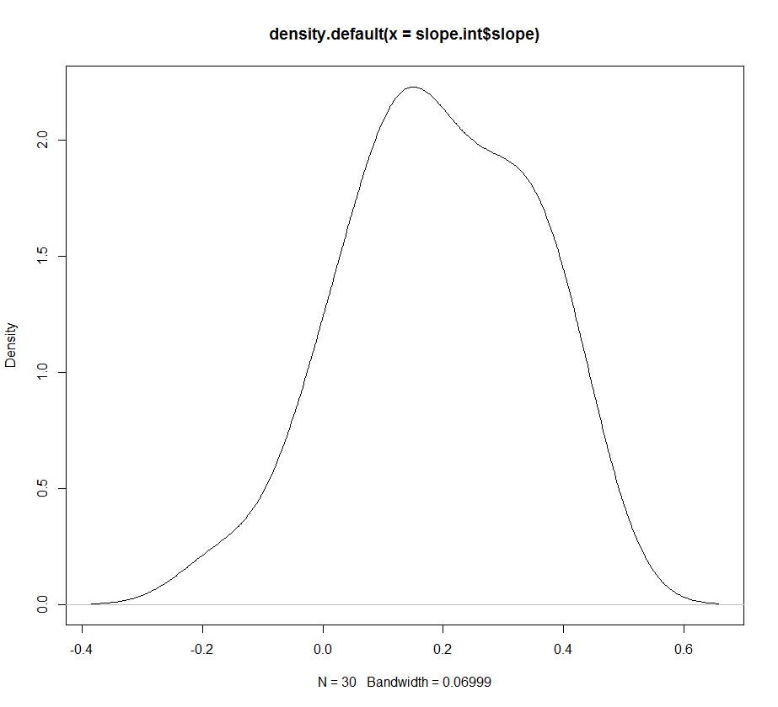
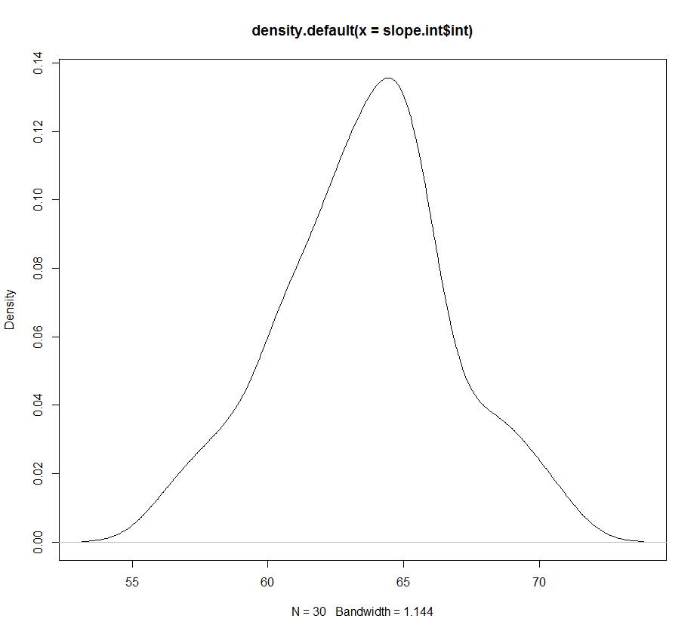
30 (!) separate regressions # Section 6
30 regression equations
class1: $\hat{Y}=66.0+(0.40)pretest$
class2: $\hat{Y}=70.4+(−0.06)pretest$
class3: $\hat{Y}=60.4+(0.25)pretest$
...
all slopes: M = 0.19, SD = 0.15
all intercepts: M = 63.6, SD = 3.17

Slide 13
Analysis option: modeling classrooms as a predictor # Section 7
$\hat{Y}=65.9+0.2pre+\left(−2.4\right)class10+\left(2.4\right)class11+…$
intercept represents class1
each class now has a slope; there are 29 slopes
we can add each slope to the intercept to find one for each class
do we care about each intercept?
if not, why not just model how much variability there is in them?

Slide 14
Analysis option: MLM # Section 8
Random effects:
Groups Name Variance Std.Dev.
class.id (Intercept) 4.517 2.125
Residual 148.925 12.203
Number of obs: 822, groups: class.id, 30
Fixed effects:
Estimate Std. Error t value
(Intercept) 63.58769 0.57648 110.30
pretest.c 0.20042 0.03509 5.71
$$\hat{Y}=63.6+0.2pre$$
intercept represents everyone’s mean
variability in intercepts
var = 4.52 (SD = 2.15)
one slope for everyone (we’re assuming it’s fixed for everyone, so we get no estimate of variability)

Slide 15
the model we’re estimating
$$Y_{ij}={[γ}_{00}+β_{1}X_{ij}]+[u_{0j}+e_{ij}]$$
Translated
(Y) each student’s posttest score (is a function of) =
(γ) the grand mean of all scores +
(X) the student’s pretest score (times slope) +
(u) the student’s classroom’s residual +
(e) the student’s residual

Slide 16
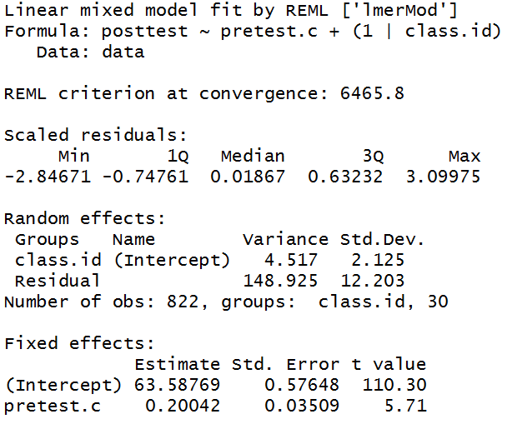
lmer output (for 30 classes)

