Slide 1
logistic regression
a gentle introduction
April 24, 2024

Slide 2
why is logistic regression needed?
with a categorical outcome, a regular linear model will fail in several ways
(we’ll focus here on binary outcomes)
assumptions of normality and homoscedacity will typically be violated
the linear model will make nonsensical predictions
the relationship between predictors and the outcome will quite likely be nonlinear

Slide 3
some (real? fake?) data
diagnosis of breast cancer tumors as malignant or benign
outcome: malignant, benign (really it’s probability of being malignant or benign)
predictor: mean radius of tumor

Slide 4
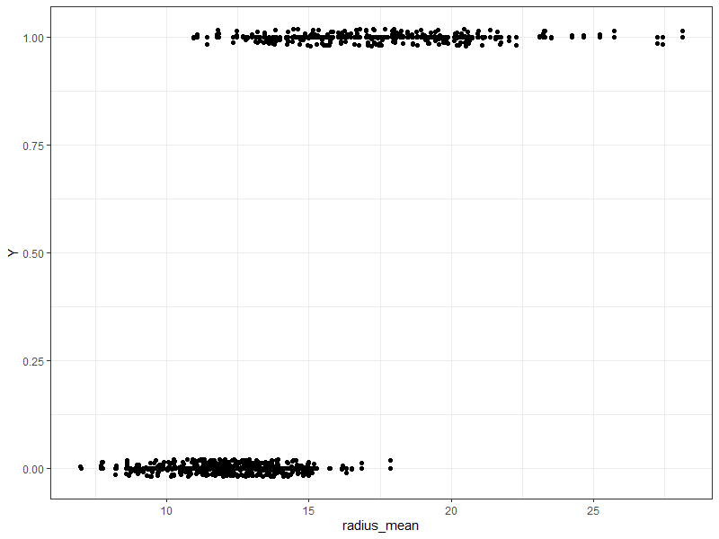

Slide 5
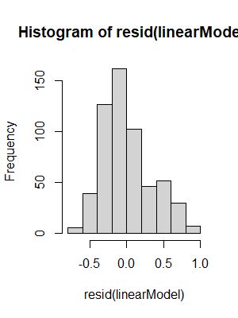
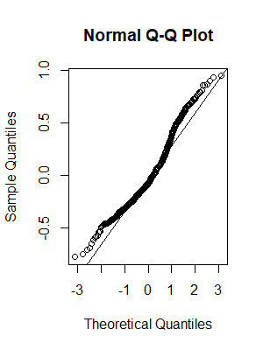
linear model assumptions: normality

Slide 6
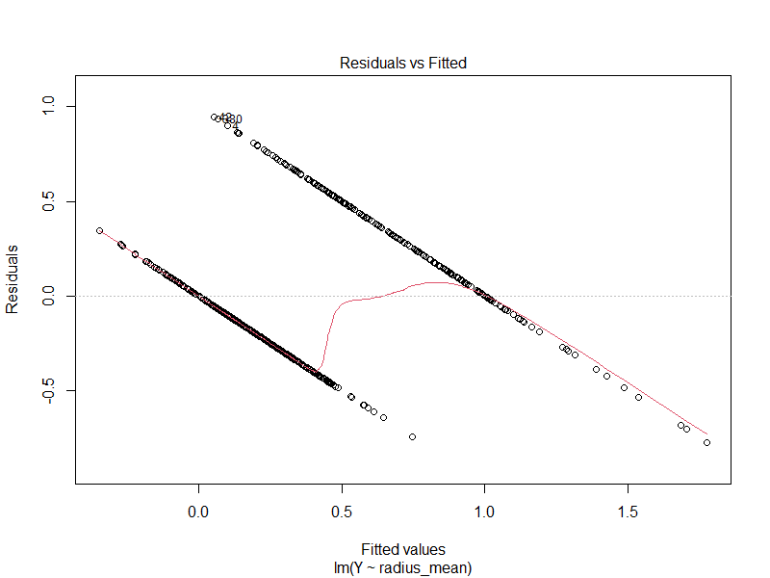
linear model assumptions: homoscedasticity

Slide 7
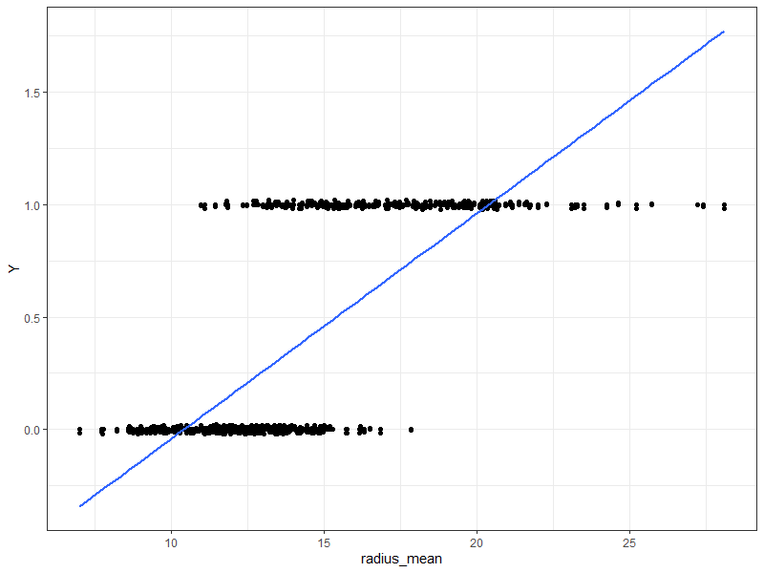
nonsensical predictions

Slide 8
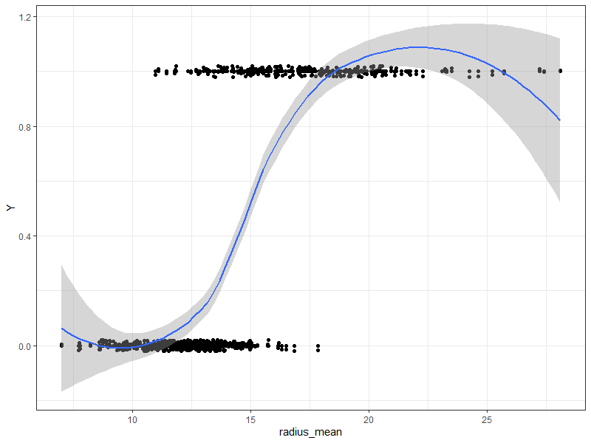
nonlinearity

Slide 9
a little more about nonlinearity
imagine we want to predict whether someone will buy a house based on household income
the predicted change in the outcome is not constant per unit increase in the predictor; that is, it depends on the value of the predictor
income | p(buy)
$40K
$50K
$60K
$70K
$80K
$90K
...
$340K
$350K
$360K
$370K

Slide 10
so what will we do?
we’ll transform the outcome from probability first to odds, and then we’ll take the logarithm of the odds
we’ll take this in two steps to talk about why

Slide 11
odds
odds are the ratio of the probability of an event happening to it not happening
that is
$$odds=\frac{p(A)}{p(\sim A)}=\frac{p(A)}{1−p(A)}$$

Slide 12
some examples
if p = .5, odds = .5 / .5 = 1
if p = .25, odds = .25 / .75 = .333
if p = .75, odds = .75 / .25 = 3
p > .5 → odds > 1
p < .5 → odds < 1

Slide 13
odds have no upper bound, but they do have a lower bound
p = .99 → odds = .99 / .01 = 99
p = .999 → odds = .999 / .001 = 999
p = .01 → odds = .01 / .99 = .0101...
p = .001 → odds = .001 / .999 = .001001...

Slide 14
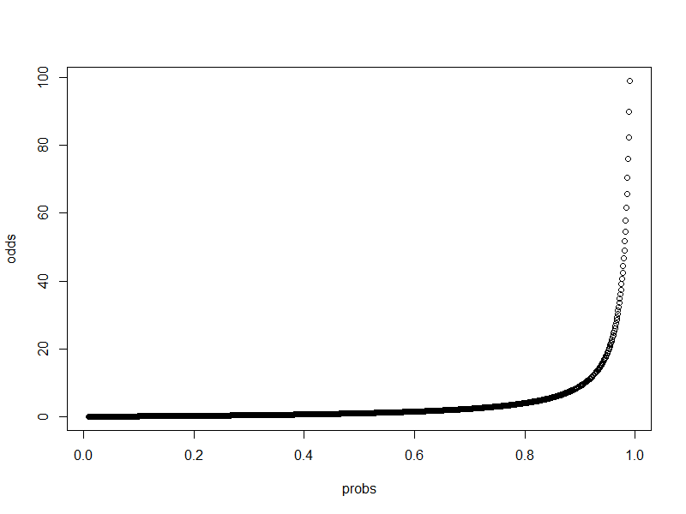

Slide 15
logarithms
the logarithm of a number is the power to which some “base” must be raised to equal the number
for example, the base 10 logarithm of 100 is 2 because
10^{X} = 100 → X = 2
this would be written as log₁₀(100) = 2

Slide 16
natural logarithms
natural logarithms (typically denoted ln) are logarithms with e as a base
e ≈ 2.718
if we take the natural logarithm of odds, some useful things occur

Slide 17
log(odds)
there is no lower or upper bound
p = .5 → log(odds) = 0
p > .5 → log(odds) > 0
p < .5 → log(odds) < 0
and they’re symmetric

Slide 18
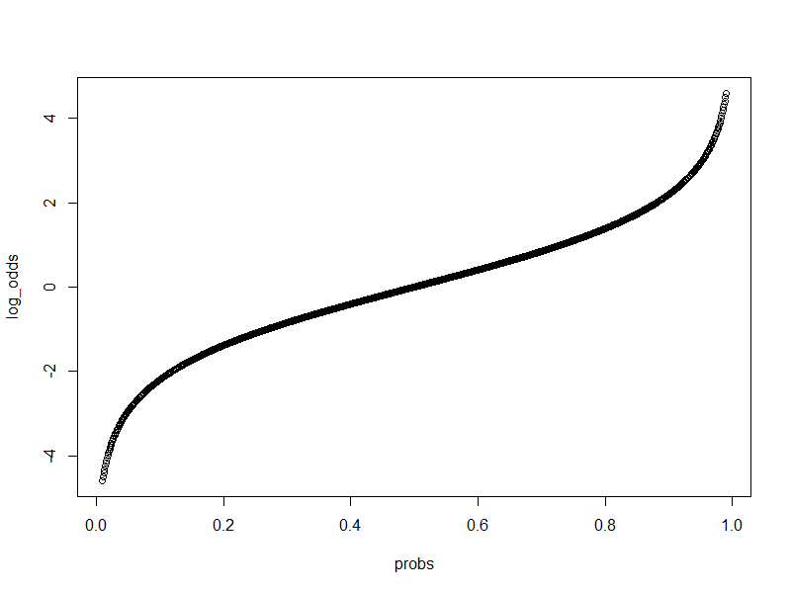
log(odds)

Slide 19
the logit function
the logit function converts probabilities to logits by taking their odds and finding the natural log
$$logit p=\ln{\frac{p}{1−p}}$$
if we convert our outcome to logits and fit a regular linear model, we are doing logistic regression

Slide 20
the model and its summary
glm(Y ~ radius_mean.c, d, family = “binomial”)
Coefficients:
Estimate Std. Error z value Pr(>|z|)
(Intercept) -0.64406 0.13998 -4.601 4.2e-06 ***
radius_mean.c 1.03359 0.09311 11.101 < 2e-16 ***
these parameter estimates are interpretable as usual
however, they are in logits, which are not very intuitive

Slide 21
improving interpretability by exponentiation
if we exponentiate (i.e., undo the logarithms) the parameter estimates, we can interpret them as odds
exp(coef(m))
(Intercept) radius_mean.c
0.525156 2.811136
the intercept is the predicted odds of a tumor being malignant at the mean of radius_mean
the slope is the increase in odds for every one unit increase in the radius_mean
this latter value is not additive! it’s multiplicative!

Slide 22
multiplicative interpretation
if the odds of a tumor being malignant at the mean of the predictor are predicted to be 0.525
at one unit higher (than the mean), the odds are predicted to be
0.525 × 2.81 = 1.48
at another unit higher, the odds are predicted to be
1.48 × 2.81 = 4.15
at one unit lower than the mean, the odds are predicted to be
0.524 / 2.81 = 0.187

Slide 23
interpreting (predicted) odds
odds = 0.525 → 0.525 less likely to be malignant than benign
odds = 1.48 → 1.48x more likely to be malignant than benign

Slide 24
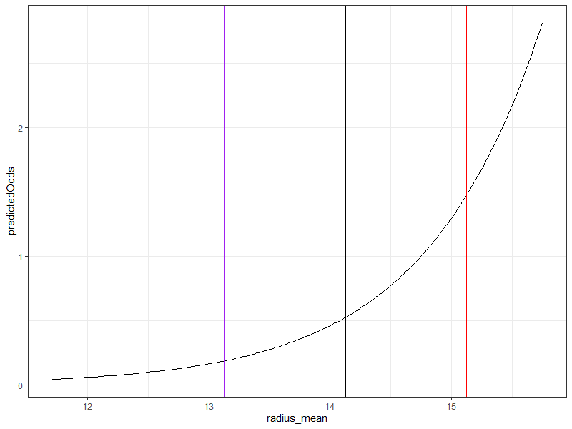
predicted odds, graphed

