Slide 1
categorical predictors (part 5: “post-tests”)
February 12, 2024

Slide 2
review
both contrast codes and dummy codes provide ways to compare groups using single-df contrasts
why single df? because each comparison is about a single parameter
some (most?) software defaults to dummy-coding
whatever codes you use, F for the whole model (all of the predictors combined) will be the same

Slide 3
“model F” is the same regardless of coding
 | D1 | D2
I | 1 | 0
R | 0 | 1
C | 0 | 0
 | strange1 | strange2
I | 2 | 3
R | 7 | 11
C | 1 | 4
F(2, 27) = 6.3
F(2, 27) = 6.3
Why?
Whatever values are assigned to groups, model F is based on
Model A: $\hat{Y}=b_{0}+b_{1}X_{1}+b_{2}X_{2}$
Model C: $\hat{Y}=b_{0}+0{ X}_{1}+0 X_{2}$

Slide 4
pairwise comparisons
very often the contrasts of interest in a one-factor study are simply comparisons between all possible pairs of groups
this is clunky to execute using orthogonal contrasts (or dummy coding)
it requires redoing analyses multiple times (and in some cases generating irrelevant contrasts)
the pairwise.t.test function is handy for executing only pairwise comparisons
it comes with an argument that allows one to control Type I errors ...

Slide 5
controlling Type I error rates
if each hypothesis test one does comes with a .05 error rate ...
... doing many hypothesis tests leads to a familywise error rate of > .05
FWER = the probability of at least one Type I error in a family of contrasts
important digression: what is a family?
is it all the hypothesis tests you do in your career?
is it all the hypothesis tests you do in one manuscript?
is it all the hypothesis tests you do for one model?

Slide 6
controlling Type I error rates
use the Bonferroni (or Dunn-Bonferroni) procedure if your contrasts are planned
if c = the number of contrasts you’ll perform
use an alpha level of .05/c to decide significance
e.g., if you’re doing 5 contrasts
$$α={.05}/5=.01$$
alternatively, take each p and multiply it by c, and then compare to α (probably .05)

Slide 7
controlling the “false discovery rate”
the Bonferroni procedure is designed to minimize the probability of at least one Type I error occurring
other procedures are designed to minimize the proportion of Type I errors that occur (the “false discovery rate”)
a simple one is the Benjamini-Hochberg procedure

Slide 8
BH procedure
for any family of contrasts
find p-values for contrasts
rank the p-values from p₁ to p_{K} (small to large)
if p_{K} < FWER, all are significant
if not, check if p_{K – 1} < FWER / 2; all remaining significant
if not, check if p_{K – 2} < FWER / 3; etc.

Slide 9
controlling Type I error rates
for unplanned (post-hoc, data-snooping) contrasts, use Scheffe’s procedure
it’s the method of last resort

Slide 10
writing about results
Three pairwise comparisons were executed by orthogonal contrasts. To control the Type I error rate, a Bonferroni-corrected α = .05/3 = .017 was used. The imagery group (M = 12) had significantly better memory than the control group (M = 6), t(27) = 3.48, p = .001. The rhyme group (M = 10) had non-significantly better memory than the control group (M = 6), t(27) = 2.32, p = .03. The imagery and rhyme groups also did not differ significantly, t(27) = 1.16, p = .26.
Notes:
adjusting alpha vs adjusting p-values

Slide 11
or ...
Three pairwise comparisons were executed by orthogonal contrasts. To control the Type I error rate, Bonferroni-corrected p-values were used with α = .05. The imagery group (M = 12) had significantly better memory than the control group (M = 6), t(27) = 3.48, p = .005. The rhyme group (M = 10) had non-significantly better memory than the control group (M = 6), t(27) = 2.32, p = .085. The imagery and rhyme groups also did not differ significantly, t(27) = 1.16, p = .77.
Notes:
adjusting alpha vs adjusting p-values

Slide 12
a little theory
(time permitting)

Slide 13
reminders about SSE and SSR
in a design with three groups, Model A is
$$Y_{ij}=β_{0}+β_{1}X_{1}+β_{2}X_{2}+ε_{ij}$$
we can express predicted scores as follows
${\hat{Y}}_{ij}=b_{0}+b_{1}X_{1}+b_{2}X_{2}$ or ${\hat{Y}}_{ij}={\overline{Y}}_{.j}$
and we can express (estimates of) residuals
$$e_{ij}=Y_{ij}−{\overline{Y}}_{.j}$$
and SSE(A) is
$$SSE(A)=\sum{{(Y_{ij}−{\overline{Y}}_{.j})}^{2}}$$

Slide 14
reminders about SSE and SSR
in a design with three groups, Model C (for the usual ANOVA) is
$$Y_{ij}=β_{0}+0X_{1}+0X_{2}+ε_{ij}$$
we can express predicted scores as follows
${\hat{Y}}_{ij}=b_{0}$ or ${\hat{Y}}_{ij}={\overline{Y}}_{..}$
and we can express (estimates of) residuals
$$e_{ij}=Y_{ij}−{\overline{Y}}_{..}$$
and SSE(C) thus is
$$SSE(C)=\sum{{\left(Y_{ij}−{\overline{Y}}_{..}\right)}^{2}}$$

Slide 15
reminders about SSE and SSR
if we compare Model A to Model C, we get SSR
$$SSR=SSE\left(C\right)−SSE(A)$$
SSR is the reduction (improvement) in SSE
it can be re-expressed as follows
$$SSR=\sum{n_{j}{({\overline{Y}}_{.j}−{\overline{Y}}_{..})}^{2}}$$
or (less formally, but more clearly, I hope)
$$SSR=\sum{n_{group}{({\overline{Y}}_{group}−{\overline{Y}}_{overall})}^{2}}$$

Slide 16
these SS values have aliases in the context of ANOVA
$$SSR={SS}_{between}$$
$$SSE\left(A\right)={SS}_{within}$$
$$SSE\left(C\right)={SS}_{total}$$
SS_{between} is a measure of differences between groups, with sample size playing a role
Why do group means differ?
real differences + noise
SS_{within} is a measure of differences within groups
Why do scores within groups differ?
noise

Slide 17
now MSs
the df associated with SSs can be used to calculate MS values, as follows
$${MS}_{between}={{SS}_{between}}/{k−1}$$
$${MS}_{within}={{SS}_{within}}/{n−k}$$

Slide 18
finally the F-ratio
$$F=\frac{{MS}_{between}}{{MS}_{within}}$$

Slide 19

what contributes to the F-ratio?
formally
$$F=\frac{{E(MS}_{between})}{{E(MS}_{within})}=\frac{σ_{e}^{2}+nθ_{groups}^{2}}{σ_{e}^{2} }$$
what?!

Slide 20
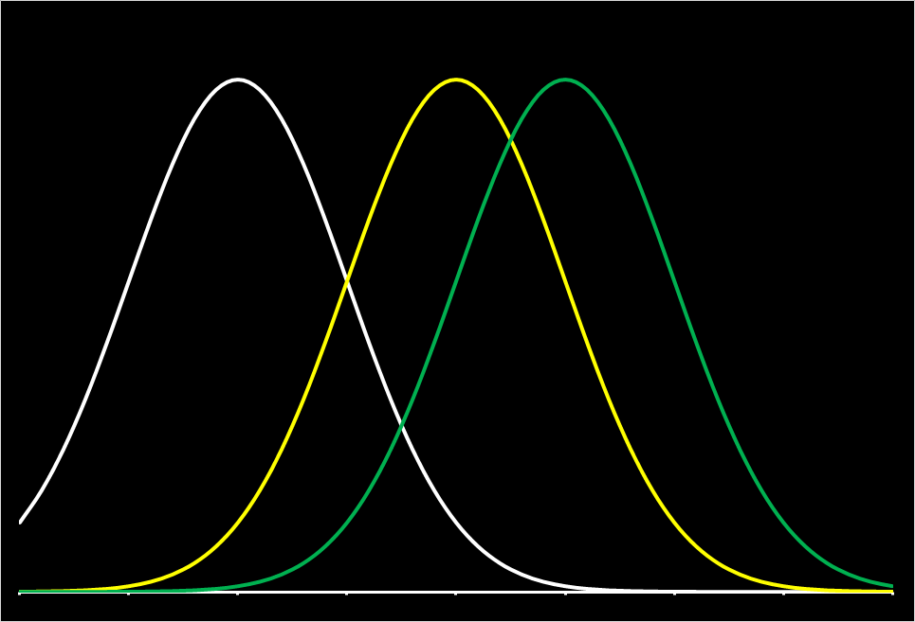
$$μ1$$
$$μ2$$
$$μ3$$
$θ_{groups}^{2}$ is the variance of µ₁, µ₂, and µ₃

Slide 21
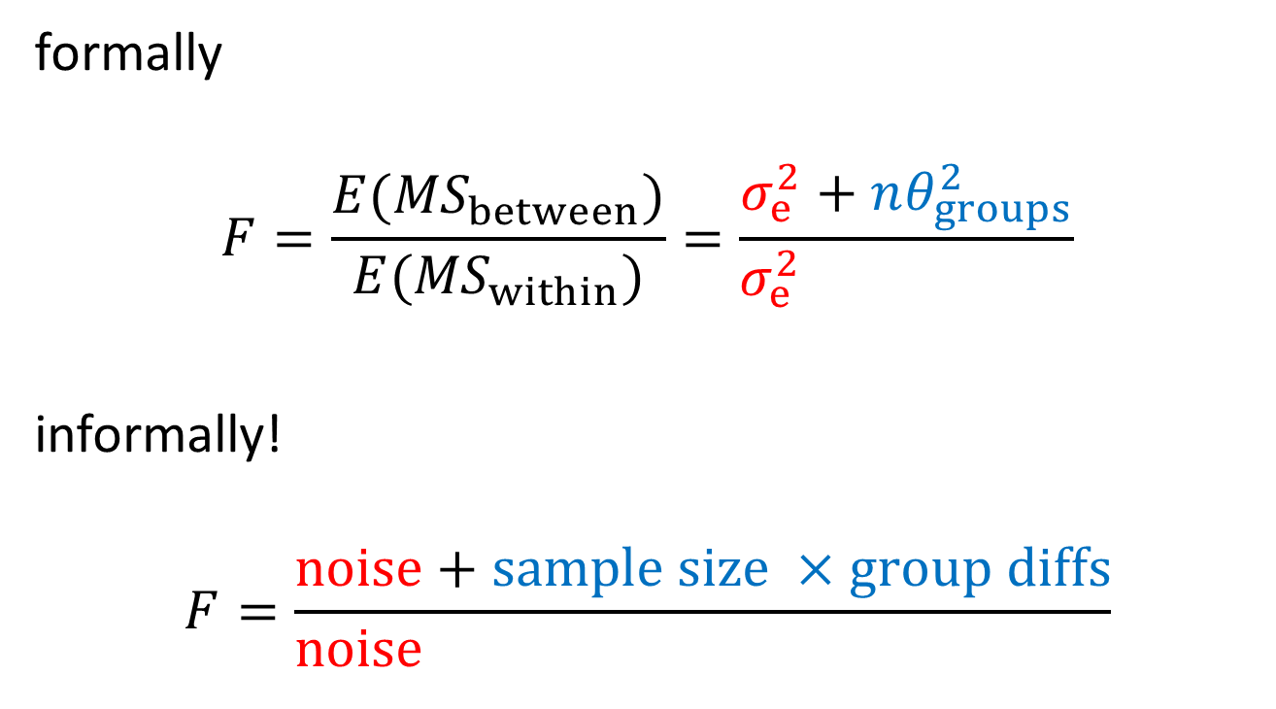
what contributes to the F-ratio?
formally
$$F=\frac{{E(MS}_{between})}{{E(MS}_{within})}=\frac{σ_{e}^{2}+nθ_{groups}^{2}}{σ_{e}^{2} }$$
informally!
$$F=\frac{noise+sample size ×group diffs}{noise+sample size ×group diffs}$$

Slide 22
why does this matter?
$$F=\frac{noise+sample size ×group diffs}{noise+sample size ×group diffs}$$
if noise is minimized, power goes up
if sample size is increased, power goes up
if groups are more different, power goes up
this also is how an F-ratio is constructed: if there are no group diffs (it’s 0), the numerator and denominator are both noise and F is expected to equal 1

