Slide 1
categorical predictors (the end, sort of)
February 14, 2024

Slide 2
writing about results
Three pairwise comparisons were executed by orthogonal contrasts. To control the Type I error rate, a Bonferroni-corrected α = .05/3 = .017 was used. The imagery group (M = 12) had significantly better memory than the control group (M = 6), t(27) = 3.48, p = .001. The rhyme group (M = 10) had non-significantly better memory than the control group (M = 6), t(27) = 2.32, p = .03. The imagery and rhyme groups also did not differ significantly, t(27) = 1.16, p = .26.
Notes:
adjusting alpha vs adjusting p-values

Slide 3
or ...
Three pairwise comparisons were executed by orthogonal contrasts. To control the Type I error rate, Bonferroni-corrected p-values were used with α = .05. The imagery group (M = 12) had significantly better memory than the control group (M = 6), t(27) = 3.48, p = .005. The rhyme group (M = 10) had non-significantly better memory than the control group (M = 6), t(27) = 2.32, p = .085. The imagery and rhyme groups also did not differ significantly, t(27) = 1.16, p = .77.
Notes:
adjusting alpha vs adjusting p-values

Slide 4
a little theory

Slide 5
reminders about SSE and SSR
in a design with three groups, Model A is
$$Y_{ij}=β_{0}+β_{1}X_{1}+β_{2}X_{2}+ε_{ij}$$
we can express predicted scores as follows
${\hat{Y}}_{ij}=b_{0}+b_{1}X_{1}+b_{2}X_{2}$ or ${\hat{Y}}_{ij}={\overline{Y}}_{.j}$
and we can express (estimates of) residuals
$$e_{ij}=Y_{ij}−{\overline{Y}}_{.j}$$
and SSE(A) is
$$SSE(A)=\sum{{(Y_{ij}−{\overline{Y}}_{.j})}^{2}}$$

Slide 6
reminders about SSE and SSR
in a design with three groups, Model C (for the usual ANOVA) is
$$Y_{ij}=β_{0}+0X_{1}+0X_{2}+ε_{ij}$$
we can express predicted scores as follows
${\hat{Y}}_{ij}=b_{0}$ or ${\hat{Y}}_{ij}={\overline{Y}}_{..}$
and we can express (estimates of) residuals
$$e_{ij}=Y_{ij}−{\overline{Y}}_{..}$$
and SSE(C) thus is
$$SSE(C)=\sum{{\left(Y_{ij}−{\overline{Y}}_{..}\right)}^{2}}$$

Slide 7
reminders about SSE and SSR
if we compare Model A to Model C, we get SSR
$$SSR=SSE\left(C\right)−SSE(A)$$
SSR is the reduction (improvement) in SSE
it can be re-expressed as follows
$$SSR=\sum{n_{j}{({\overline{Y}}_{.j}−{\overline{Y}}_{..})}^{2}}$$
or (less formally, but more clearly, I hope)
$$SSR=\sum{n_{group}{({\overline{Y}}_{group}−{\overline{Y}}_{overall})}^{2}}$$

Slide 8
these SS values have aliases in the context of ANOVA
$$SSR={SS}_{between}$$
$$SSE\left(A\right)={SS}_{within}$$
$$SSE\left(C\right)={SS}_{total}$$
SS_{between} is a measure of differences between groups, with sample size playing a role
Why do group means differ?
real differences + noise
SS_{within} is a measure of differences within groups
Why do scores within groups differ?
noise

Slide 9
now MSs
the df associated with SSs can be used to calculate MS values, as follows
$${MS}_{between}={{SS}_{between}}/{k−1}$$
$${MS}_{within}={{SS}_{within}}/{n−k}$$

Slide 10
finally the F-ratio
$$F=\frac{{MS}_{between}}{{MS}_{within}}$$

Slide 11

what contributes to the F-ratio?
formally
$$F=\frac{{E(MS}_{between})}{{E(MS}_{within})}=\frac{σ_{e}^{2}+nθ_{groups}^{2}}{σ_{e}^{2} }$$
what?!

Slide 12
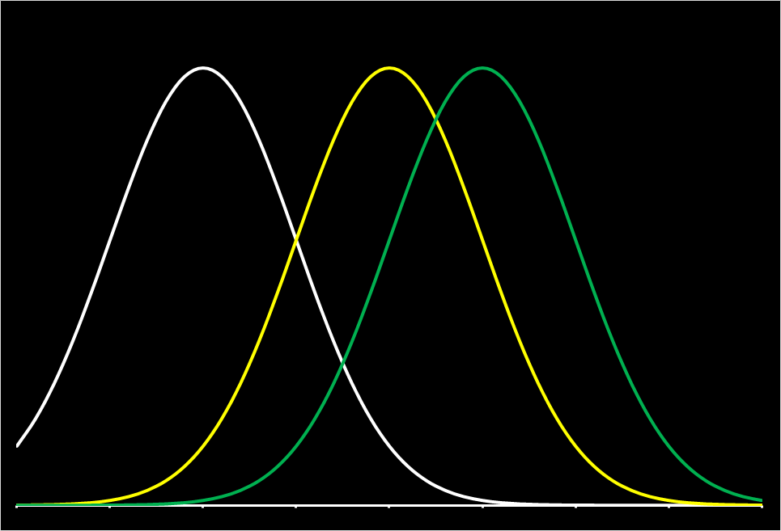
$$μ1$$
$$μ2$$
$$μ3$$
$θ_{groups}^{2}$ is the variance of µ₁, µ₂, and µ₃

Slide 13
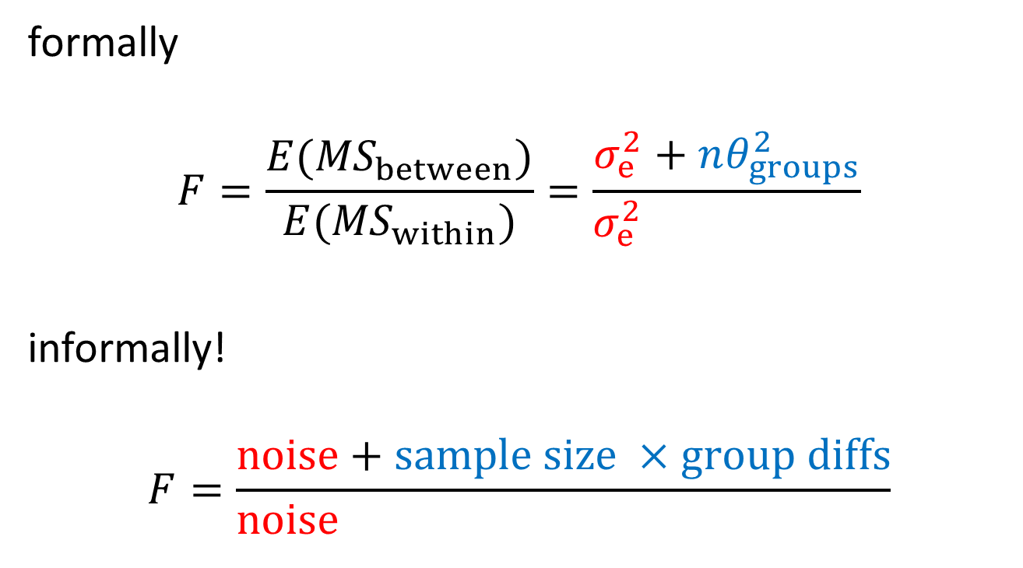
what contributes to the F-ratio?
formally
$$F=\frac{{E(MS}_{between})}{{E(MS}_{within})}=\frac{σ_{e}^{2}+nθ_{groups}^{2}}{σ_{e}^{2} }$$
informally!
$$F=\frac{noise+sample size ×group diffs}{noise+sample size ×group diffs}$$

Slide 14
why does this matter?
$$F=\frac{noise+sample size ×group diffs}{noise+sample size ×group diffs}$$
if noise is minimized, power goes up
if sample size is increased, power goes up
if groups are more different, power goes up
this also is how an F-ratio is constructed: if there are no group diffs (it’s 0), the numerator and denominator are both noise and F is expected to equal 1

Slide 15
power analysis
for three or more groups, you have choices to make
one (sub-optimal) choice is to power the ANOVA
you’ll probably use f² to do this
better is to power particular contrasts, whether they be pairwise comparisons of more complex comparisons
you can use f² here as well
for pairwise comparisons, you can use Cohen’s d (in G*Power, at least)
effect sizes can be converted (see here)
there are lots of resources and packages (e.g., Superpower)

Slide 16
recommendations
read widely in your field to know what is standard now
are ANOVAs still being done with post-tests?
are models being fit with some sort of coding?
if you do not create your own predictors, make sure you know what your software is using

