Slide 1
things to know
PS 3 grading is done
PS 4’s answer key is still in the works
PS 5 will be assigned this evening and due on Monday
Drill is on for tomorrow
There is a script available for today
April 8 will be skipped
there is way more in the slides than I can cover today

Slide 2
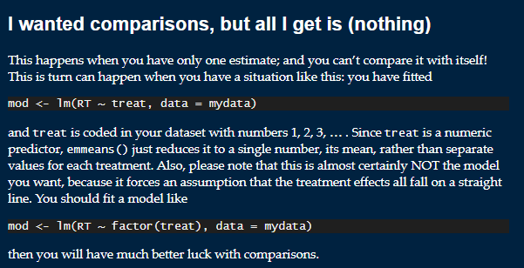
a note about emmeans
this is a widely-used package in R for the kinds of designs we’ve been talking about
it has the following amusing note, early in its FAQ

Slide 3
multi-factor designs (part 2)
February 21, 2024

Slide 4
review
a factorial design with two factors has
main effects (the effect of one factor ignoring the other)
an interaction effect (whether the effect of one factor depends on the value of the other)
we can analyze a 2 × 2 design with
ANOVA
(when we move to bigger designs, ANOVA will leave us wanting)
contrast codes for the main effects
dummy codes for the simple effects/slopes
Notes:
Dummy codes in a moment!

Slide 5
reminder of the design, results
 |  | meat
 |  | none | some
PB | none | M = 2.1, s² = 3.2 | M = 6.0, s² = 4.2 | M = 4.05
 | some | M = 6.9, s² = 4.8 | M = 1.1, s² = 2.5 | M = 4.0
 |  | M = 4.5 | M = 3.55

Slide 6
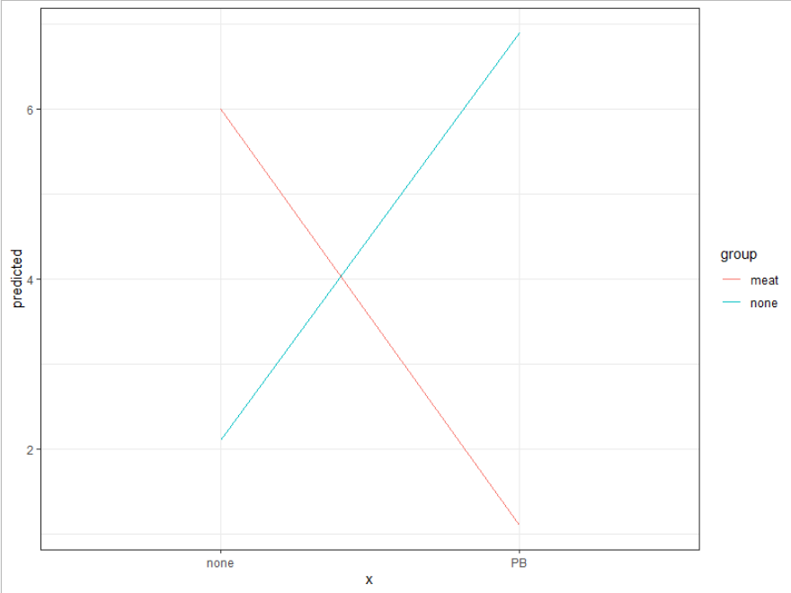

Slide 7
linear model results (dummy codes vs contrast codes)
Dummy Estimate SE t Pr(>F)
(Intercept) 2.1000 0.6071 3.459 0.00141 **
meatD 3.9000 0.8586 4.542 6.03e-05 ***
PBD 4.8000 0.8586 5.590 2.45e-06 ***
meatD:PBD -9.7000 1.2143 -7.988 1.74e-09 ***
Contrast Estimate SE t Pr(>F)
(Intercept) 4.0250 0.3036 13.259 2.02e-15 ***
meatC -0.9500 0.6071 -1.565 0.126
PBC -0.0500 0.6071 -0.082 0.935
int -9.7000 1.2143 -7.988 1.74e-09 **

Slide 8
reference-reference mean
summary(lm(tastiness ~ meatD*PBD, d), t = F)
Estimate SE t Pr(>F)
(Intercept) 2.1000 0.6071 3.459 0.00141
meatD 3.9000 0.8586 20.63 6.03e-05 ***
PBD 4.8000 0.8586 31.25 2.45e-06 ***
meatD:PBD -9.7000 1.2143 63.81 1.74e-09 ***
 |  | meat
 |  | none | some
PB | none | M = 2.1 | M = 6.0
 | some | M = 6.9 | M = 1.1

Slide 9
simple slope/effect
summary(lm(tastiness ~ meatD*PBD, d), t = F)
Estimate SE t Pr(>F)
meatD 3.9000 0.8586 4.542 6.03e-05
 |  | meat
 |  | none | some
PB | none | M = 2.1 | M = 6.0
 | some | M = 6.9 | M = 1.1

Slide 10
simple slope/effect
summary(lm(tastiness ~ meatD*PBD, d), t = F)
Estimate SE t Pr(>F)
PBD 4.8000 0.8586 5.590 2.45e-06
 |  | meat
 |  | none | some
PB | none | M = 2.1 | M = 6.0
 | some | M = 6.9 | M = 1.1

Slide 11
interaction effect
summary(lm(tastiness ~ meatD*PBD, d), t = F)
Estimate SE t Pr(>F)
meatD:PBD -9.7000 1.2143 -7.988 1.74e-09
 |  | meat
 |  | none | some
PB | none | M = 2.1 | M = 6.0
 | some | M = 6.9 | M = 1.1

Slide 12
practical advice
which should we use?
it depends on what you want to know!

Slide 13
what do we want to know?
 |  | meat
 |  | none | some
PB | none | M = 2.1, s² = 3.2 | M = 6.0, s² = 4.2 | M = 4.05
 | some | M = 6.9, s² = 4.8 | M = 1.1, s² = 2.5 | M = 4.0
 |  | M = 4.5 | M = 3.55
if simple slopes/effects, use carefully-chosen dummy codes

Slide 14
what do we want to know?
 |  | meat
 |  | none | some
PB | none | M = 2.1, s² = 3.2 | M = 6.0, s² = 4.2 | M = 4.05
 | some | M = 6.9, s² = 4.8 | M = 1.1, s² = 2.5 | M = 4.0
 |  | M = 4.5 | M = 3.55
if main effects, use carefully chosen contrast codes (or the usual ANOVA)

Slide 15
what do we want to know?
 |  | meat
 |  | none | some
PB | none | M = 2.1, s² = 3.2 | M = 6.0, s² = 4.2 | M = 4.05
 | some | M = 6.9, s² = 4.8 | M = 1.1, s² = 2.5 | M = 4.0
 |  | M = 4.5 | M = 3.55
if the interaction, it doesn’t matter much

Slide 16
what is an interaction?
 |  | meat
 |  | none | some
PB | none | M = 2.1, s² = 3.2 | M = 6.0, s² = 4.2 | M = 4.05
 | some | M = 6.9, s² = 4.8 | M = 1.1, s² = 2.5 | M = 4.0
 |  | M = 4.5 | M = 3.55
when the effect of one variable changes across values of another variable
here, the effect of PB is to increase tastiness when there is no meat
but the effect of PB is to reduce tastiness when there is meat

Slide 17
notice that the interaction is really a contrast between simple slopes
 |  | meat
 |  | none | some
PB | none | M = 2.1, s² = 3.2 | M = 6.0, s² = 4.2 | M = 4.05
 | some | M = 6.9, s² = 4.8 | M = 1.1, s² = 2.5 | M = 4.0
 |  | M = 4.5 | M = 3.55
this simple slope is 6.9 – 2.1 = +4.8
this simple slope is 1.1 – 6.0 = -4.9
the contrast between the simple slopes is 4.8 – (-4.9) = -9.7

Slide 18
another way to think about this design
we have a four-group design, which can be depicted as follows
no PB no meat | no PB some meat | some PB no meat | some PB some meat
2.1 | 6.9 | 6.0 | 1.1

Slide 19
another way to think about this design
we could analyze this design using the method of subsets
no PB no meat | no PB some meat | some PB no meat | some PB some meat
2.1 | 6.9 | 6.0 | 1.1
3/4 | -1/4 | -1/4 | -1/4
0 | 1/3 | 1/3 | -2/3
0 | 1/2 | -1/2 | 0

Slide 20
another way to think about this design
this would answer some interesting questions, but would not test the interaction (nor any main effects)
no PB no meat | no PB some meat | some PB no meat | some PB some meat
2.1 | 6.9 | 6.0 | 1.1
3/4 | -1/4 | -1/4 | -1/4
0 | 1/3 | 1/3 | -2/3
0 | 1/2 | -1/2 | 0

Slide 21
another way to think about this design
contrast codes result in a different set of contrasts
no PB no meat | no PB some meat | some PB no meat | some PB some meat
2.1 | 6.9 | 6.0 | 1.1
-1/2 | -1/2 | +1/2 | +1/2
-1/2 | +1/2 | -1/2 | +1/2
+1/4 | -1/4 | -1/4 | +1/4

Slide 22
interim summary
despite the factorial nature of this design, it’s just a four-group design
any three orthogonal contrasts can be used to analyze it
but if we are interested in specific questions – including the interaction – we need to carefully choose our contrasts
contrast or dummy coding main effects (and creating a product term) will allow us to answer the questions of interest

Slide 23
larger two-factor designs
Factor A: sentence (normal/intact vs scrambled)
Factor B: presentation rate (300, 450, 600 wpm)
DV = % correct detection of a word
this is a 2 (sentence) × 3 (rate) design
there are six groups
ultimately, no matter how we create them, we’ll need five contrast codes

Slide 24
the results (cell, marginal, overall means)
 | 300 | 450 | 600
intact | 64 | 60 | 44 | 56
scrambled | 54 | 50 | 46 | 50
 | 59 | 55 | 45 | 53

Slide 25
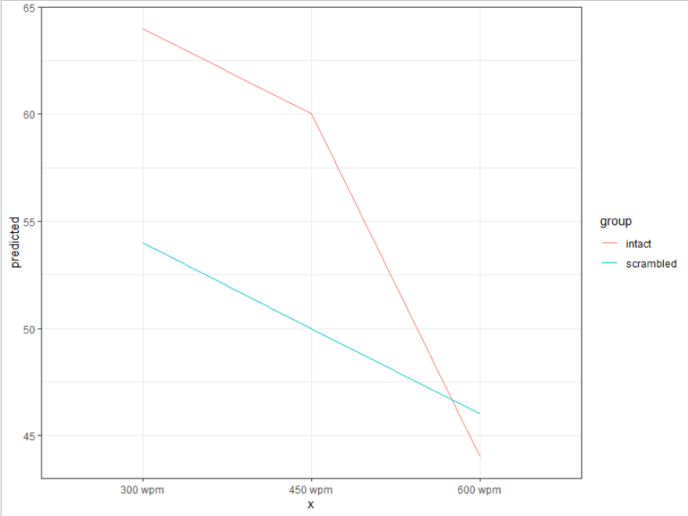
results, plotted

Slide 26
how to analyze?
let’s generate contrast codes for each factor, ignoring the other factor
for the sentence factor, there’s no decision to be made
with two levels, we’ll use +1/2 and -1/2

Slide 27
filling in some codes
 | intact 300 | intact 450 | intact 600 | scr 300 | scr 450 | scr 600
T | +1/2 | +1/2 | +1/2 | -1/2 | -1/2 | -1/2

Slide 28
how to analyze?
let’s generate contrast codes for each factor, ignoring the other factor
for the rate factor, the researcher thought something interest would happen at the very-high rate relative to the other two
R1: 300, 450 vs 600
the other contrast is the only one leftover
R2: 300 vs 450

Slide 29
filling in some codes: multiply to get interactions
 | intact 300 | intact 450 | intact 600 | scr 300 | scr 450 | scr 600
T | +1/2 | +1/2 | +1/2 | -1/2 | -1/2 | -1/2
R1 | +1/3 | +1/3 | -2/3 | +1/3 | +1/3 | -2/3
R2 | +1/2 | -1/2 | 0 | +1/2 | -1/2 | 0
T*R1 | +1/6 | +1/6 | -2/6 | -1/6 | -1/6 | +2/6
T*R2 | +1/4 | -1/4 | 0 | -1/4 | +1/4 | 0

Slide 30
what do we get?
Estimate SE t Pr(>|t|)
(Intercept) 53 0.99 53.62 < 2e-16
T 6 1.98 3.03 0.00412
R1 12 2.10 5.72 9.95e-07
R2 4 2.42 1.65 0.10600
TR1 12 4.19 2.86 0.00655
TR2 0 4.84 0.00 1.00000
 | 300 | 450 | 600
intact | 64 | 60 | 44 | 56
scrambled | 54 | 50 | 46 | 50
 | 59 | 55 | 45 | 53

