Slide 1
things to know
PS 4’s grading is ongoing
PS 5 is due now
Next Monday I will do a review and try to generate a useful in-class set of exercises
We won’t meet next Wednesday
Exam 1 will be available on March 6, due March 11

Slide 2
multi-factor designs: larger designs
February 26, 2024

Slide 3
larger two-factor designs
Factor A: sentence (normal/intact vs scrambled)
Factor B: presentation rate (300, 450, 600 wpm)
DV = % correct detection of a word
this is a 2 (sentence) × 3 (rate) design
there are six groups
ultimately, no matter how we create them, we’ll need five contrast codes

Slide 4
the results (cell, marginal, overall means)
 | 300 | 450 | 600
intact | 64 | 60 | 44 | 56
scrambled | 54 | 50 | 46 | 50
 | 59 | 55 | 45 | 53

Slide 5
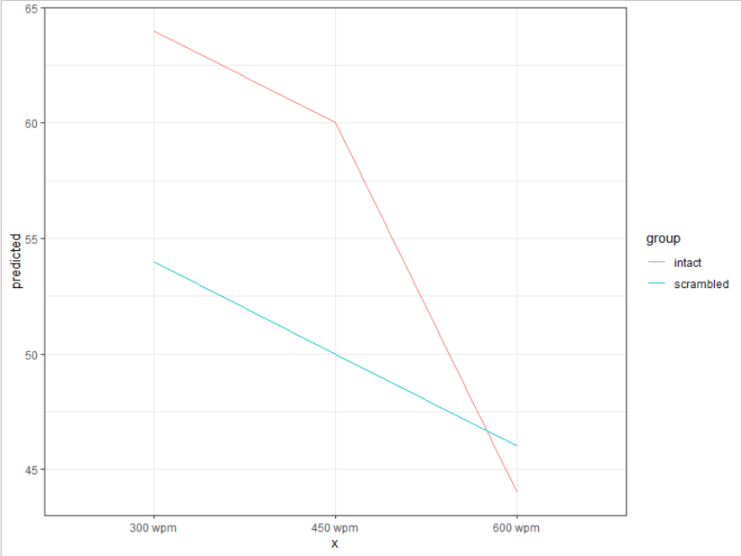
results, plotted

Slide 6
how to analyze?
let’s generate contrast codes for each factor, ignoring the other factor
for the sentence factor, there’s no decision to be made
with two levels, we’ll use +1/2 and -1/2

Slide 7
filling in some codes
 | intact 300 | intact 450 | intact 600 | scr 300 | scr 450 | scr 600
T | +1/2 | +1/2 | +1/2 | -1/2 | -1/2 | -1/2

Slide 8
how to analyze?
let’s generate contrast codes for each factor, ignoring the other factor
for the rate factor, the researcher thought something interest would happen at the very-high rate relative to the other two
R1: 300, 450 vs 600
the other contrast is the only one leftover
R2: 300 vs 450

Slide 9
filling in some codes
 | intact 300 | intact 450 | intact 600 | scr 300 | scr 450 | scr 600
T | +1/2 | +1/2 | +1/2 | -1/2 | -1/2 | -1/2
R1 | 1/3 | 1/3 | -2/3 | 1/3 | 1/3 | -2/3

Slide 10
filling in some codes
 | intact 300 | intact 450 | intact 600 | scr 300 | scr 450 | scr 600
T | +1/2 | +1/2 | +1/2 | -1/2 | -1/2 | -1/2
R1 | +1/3 | +1/3 | -2/3 | +1/3 | +1/3 | -2/3
R2 | +1/2 | -1/2 | 0 | +1/2 | -1/2 | 0

Slide 11
filling in some codes: multiply to get interactions
 | intact 300 | intact 450 | intact 600 | scr 300 | scr 450 | scr 600
T | +1/2 | +1/2 | +1/2 | -1/2 | -1/2 | -1/2
R1 | +1/3 | +1/3 | -2/3 | +1/3 | +1/3 | -2/3
R2 | +1/2 | -1/2 | 0 | +1/2 | -1/2 | 0
T*R1 | +1/6 | +1/6 | -2/6 | -1/6 | -1/6 | +2/6

Slide 12
filling in some codes: multiply to get interactions
 | intact 300 | intact 450 | intact 600 | scr 300 | scr 450 | scr 600
T | +1/2 | +1/2 | +1/2 | -1/2 | -1/2 | -1/2
R1 | +1/3 | +1/3 | -2/3 | +1/3 | +1/3 | -2/3
R2 | +1/2 | -1/2 | 0 | +1/2 | -1/2 | 0
T*R1 | +1/6 | +1/6 | -2/6 | -1/6 | -1/6 | +2/6

Slide 13
filling in some codes: multiply to get interactions
 | intact 300 | intact 450 | intact 600 | scr 300 | scr 450 | scr 600
T | +1/2 | +1/2 | +1/2 | -1/2 | -1/2 | -1/2
R1 | +1/3 | +1/3 | -2/3 | +1/3 | +1/3 | -2/3
R2 | +1/2 | -1/2 | 0 | +1/2 | -1/2 | 0
T*R1 | +1/6 | +1/6 | -2/6 | -1/6 | -1/6 | +2/6
T*R2 | +1/4 | -1/4 | 0 | -1/4 | +1/4 | 0

Slide 14
what do we get?
Estimate SE t Pr(>|t|)
(Intercept) 53 0.99 53.62 < 2e-16
T 6 1.98 3.03 0.00412
R1 12 2.10 5.72 9.95e-07
R2 4 2.42 1.65 0.10600
TR1 12 4.19 2.86 0.00655
TR2 0 4.84 0.00 1.00000
 | 300 | 450 | 600
intact | 64 | 60 | 44 | 56
scrambled | 54 | 50 | 46 | 50
 | 59 | 55 | 45 | 53

Slide 15
a write-up of this model
Intact text led to significantly higher performance than scrambled text, t(42) = 3.04, p = .004.
Slower presentation rates (300 & 450 wpm) led to significantly higher performance than 600 wpm, t(42) = 5.72, p < .001, but there was no significant difference between the former two, t(42) = 1.65, p = .11.
The advantage for the slower presentation rates over 600 wpm was significantly larger for intact than for scrambled text, t(42) = 2.86, p = .007.
There was no significant difference in the 300 vs 450 wpm contrast between intact and scrambled test, t(42) = 0, p = 1.

Slide 16
the conventional ANOVA results
> summary(aov(dv ~ text*wpm, scrambled))
Df Sum Sq Mean Sq F value Pr(>F)
text 1 432 432.0 9.210 0.00412
wpm 2 1664 832.0 17.738 2.6e-06
text:wpm 2 384 192.0 4.093 0.02376
Residuals 42 1970 46.9
Post-tests for significant main effects with >1 df (main effect contrasts) are common
Post-tests for significant interactions (simple effects tests & interaction contrasts) are common

Slide 17
multiply by common denominators to simplify
 | i3 | i4 | i6 | s3 | s4 | s6
T | +1 | +1 | +1 | -1 | -1 | -1
R1 | +1 | +1 | -2 | +1 | +1 | -2
R2 | +1 | -1 | 0 | +1 | -1 | 0
T*R1 | +1 | +1 | -2 | -1 | -1 | +2
T*R2 | +1 | -1 | 0 | -1 | +1 | 0

Slide 18
what is Model A/Model C? for variable R1 (300, 450 vs 600)
Model A
$$Y=β_{0}+β_{1}T+β_{2}R1+β_{3}R2+β_{4}TR1+β_{5}TR2$$
Model C
$$Y=β_{0}+β_{1}T+0R1+β_{3}R2+β_{4}TR1+β_{5}TR2$$
$$Y=β_{0}+β_{1}T+β_{2}R1+β_{3}R2+β_{4}TR1+β_{5}TR2$$
$$H_{0}: β_{2}=0$$

Slide 19
what is Model A/Model C? for variable TR1
Model A
$$Y=β_{0}+β_{1}T+β_{2}R1+β_{3}R2+β_{4}TR1+β_{5}TR2$$
Model C
$$Y=β_{0}+β_{1}T+β_{2}R1+β_{3}R2+0TR1+β_{5}TR2$$
$$Y=β_{0}+β_{1}T+β_{2}R1+β_{3}R2+β_{4}TR1+β_{5}TR2$$

Slide 20
other versions of Model C
Model A
$$Y=β_{0}+β_{1}T+β_{2}R1+β_{3}R2+β_{4}TR1+β_{5}TR2$$
Model C for the typical ANOVA main effect of text
$$Y=β_{0}+β_{1}T+β_{2}R1+β_{3}R2+β_{4}TR1+β_{5}TR2$$
PRE gives R² for text (often reported as $η_{p}^{2}$)

Slide 21
other versions of Model C
Model A
$$Y=β_{0}+β_{1}T+β_{2}R1+β_{3}R2+β_{4}TR1+β_{5}TR2$$
Model C for the typical ANOVA main effect of rate/wpm
$$Y=β_{0}+β_{1}T+β_{2}R1+β_{3}R2+β_{4}TR1+β_{5}TR2$$
PRE gives R² for rate (often reported as $η_{p}^{2}$)

Slide 22
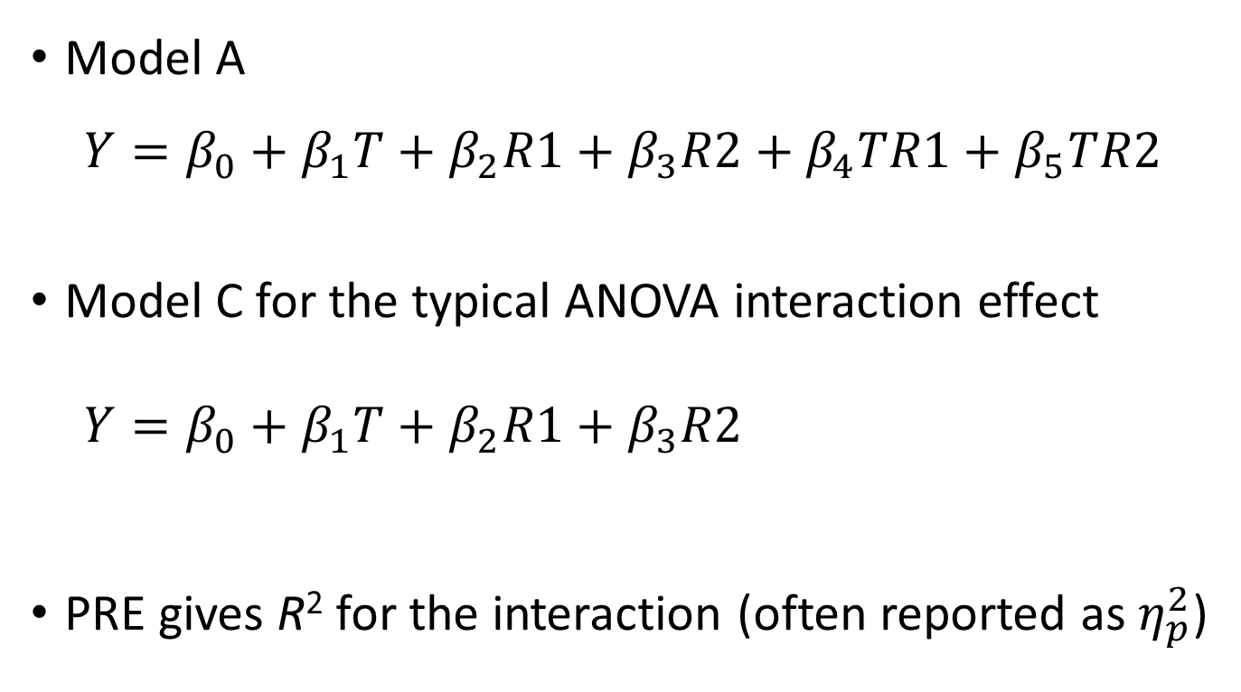
other versions of Model C
Model A
$$Y=β_{0}+β_{1}T+β_{2}R1+β_{3}R2+β_{4}TR1+β_{5}TR2$$
Model C for the typical ANOVA interaction effect
$$Y=β_{0}+β_{1}T+β_{2}R1+β_{3}R2+β_{4}TR1+β_{5}TR2$$
PRE gives R² for the interaction (often reported as $η_{p}^{2}$)

Slide 23
other versions of Model C
Model A
$$Y=β_{0}+β_{1}T+β_{2}R1+β_{3}R2+β_{4}TR1+β_{5}TR2$$
Model C for the whole model
$$Y=β_{0}+β_{1}T+β_{2}R1+β_{3}R2+β_{4}TR1+β_{5}TR2$$
PRE gives R² for the whole model

Slide 24
the typical ANOVA

Slide 25
using single-df orthogonal contrasts

Slide 26
dealing with 3+ factors
for each factor, generate a set of orthogonal contrast codes
for the two-factor interactions, multiply all pairs of contrasts (across factors, but not within)
for the three-factor interactions, multiply all triads of contrasts (across factors, but not within)
etc.
model as usual
but be aware that most people can’t think very clearly about interactions among three factors (and more than that ...🤕)

Slide 27
general advice
the overall ANOVA will usually leave you needing follow-up tests in many cases
let your substantive questions dictate the analyses you execute
be aware of the costs and benefits of using orthogonal contrast codes vs other possibilities (e.g., dummy codes)
use cell means to help you interpret what your slopes are about
alternatively, you can interpret slopes as we did with continuous predictors; this may be easier with dummy codes than with orthogonal contrasts

