Slide 1
things
PS 4’s grading is still ongoing (I spent a lot of time making new graphs); I am sorry
PS 5’s answer key is still in the works
PS 6 this evening → Monday
drill tomorrow
next Monday we’ll meet for a review
we won’t meet next Wednesday
Exam 1 will be available on March 6, due March 11

Slide 2
multi-factor designs: wrapping up
February 28, 2024

Slide 3
contrast codes for a 2 x 3 design (previously introduced)
 | intact 300 | intact 450 | intact 600 | scr 300 | scr 450 | scr 600
T | +1/2 | +1/2 | +1/2 | -1/2 | -1/2 | -1/2
R1 | +1/3 | +1/3 | -2/3 | +1/3 | +1/3 | -2/3
R2 | +1/2 | -1/2 | 0 | +1/2 | -1/2 | 0
T*R1 | +1/6 | +1/6 | -2/6 | -1/6 | -1/6 | +2/6
T*R2 | +1/4 | -1/4 | 0 | -1/4 | +1/4 | 0

Slide 4
different summaries, same design
Estimate SE t Pr(>|t|)
(Intercept) 53 0.99 53.62 < 2e-16
T 6 1.98 3.03 0.00412
R1 12 2.10 5.72 9.95e-07
R2 4 2.42 1.65 0.10600
TR1 12 4.19 2.86 0.00655
TR2 0 4.84 0.00 1.00000
Df Sum Sq Mean Sq F value Pr(>F)
text 1 432 432.0 9.210 0.00412
wpm 2 1664 832.0 17.738 2.6e-06
text:wpm 2 384 192.0 4.093 0.02376
Residuals 42 1970 46.9

Slide 5
what is Model A/Model C? for variable R1 (300, 450 vs 600)
Model A
$$Y=β_{0}+β_{1}T+β_{2}R1+β_{3}R2+β_{4}TR1+β_{5}TR2$$
Model C
$$Y=β_{0}+β_{1}T+0R1+β_{3}R2+β_{4}TR1+β_{5}TR2$$
$$Y=β_{0}+β_{1}T+β_{2}R1+β_{3}R2+β_{4}TR1+β_{5}TR2$$
$$H_{0}: β_{2}=0$$

Slide 6
what is Model A/Model C? for variable TR1
Model A
$$Y=β_{0}+β_{1}T+β_{2}R1+β_{3}R2+β_{4}TR1+β_{5}TR2$$
Model C
$$Y=β_{0}+β_{1}T+β_{2}R1+β_{3}R2+0TR1+β_{5}TR2$$
$$Y=β_{0}+β_{1}T+β_{2}R1+β_{3}R2+β_{4}TR1+β_{5}TR2$$

Slide 7
other versions of Model C
Model A
$$Y=β_{0}+β_{1}T+β_{2}R1+β_{3}R2+β_{4}TR1+β_{5}TR2$$
Model C for the typical ANOVA main effect of text
$$Y=β_{0}+β_{1}T+β_{2}R1+β_{3}R2+β_{4}TR1+β_{5}TR2$$
PRE gives R² for text (often reported as $η_{p}^{2}$)

Slide 8
other versions of Model C
Model A
$$Y=β_{0}+β_{1}T+β_{2}R1+β_{3}R2+β_{4}TR1+β_{5}TR2$$
Model C for the typical ANOVA main effect of rate/wpm
$$Y=β_{0}+β_{1}T+β_{2}R1+β_{3}R2+β_{4}TR1+β_{5}TR2$$
PRE gives R² for rate (often reported as $η_{p}^{2}$)

Slide 9
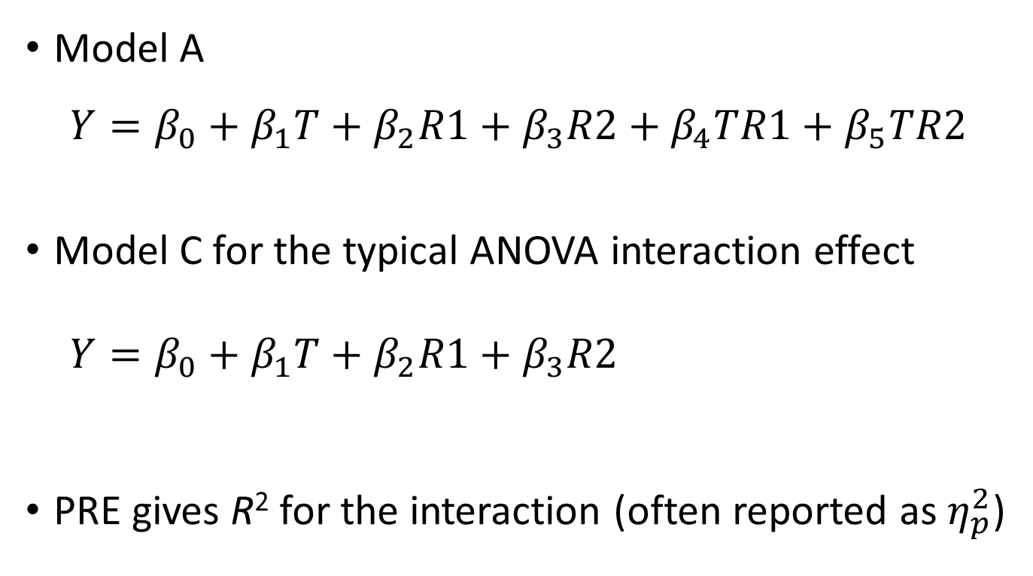
other versions of Model C
Model A
$$Y=β_{0}+β_{1}T+β_{2}R1+β_{3}R2+β_{4}TR1+β_{5}TR2$$
Model C for the typical ANOVA interaction effect
$$Y=β_{0}+β_{1}T+β_{2}R1+β_{3}R2+β_{4}TR1+β_{5}TR2$$
PRE gives R² for the interaction (often reported as $η_{p}^{2}$)

Slide 10
other versions of Model C
Model A
$$Y=β_{0}+β_{1}T+β_{2}R1+β_{3}R2+β_{4}TR1+β_{5}TR2$$
Model C for the whole model
$$Y=β_{0}+β_{1}T+β_{2}R1+β_{3}R2+β_{4}TR1+β_{5}TR2$$
PRE gives R² for the whole model

Slide 11
the typical ANOVA

Slide 12
using single-df orthogonal contrasts

Slide 13
3+ factors

Slide 14
a design (based on real research)
to understand factors related to eating behavior
DV: amount of ice cream eaten
Factor A: good vs bad ice cream
Factor B: empty vs full stomach
Factor C: average vs overweight participants

Slide 15
results (g of ice cream eaten)
 | bad |  |  | good
 | empty | full |  | empty | full
over | 70 | 60 |  | 240 | 220
average | 50 | 10 |  | 150 | 90

Slide 16
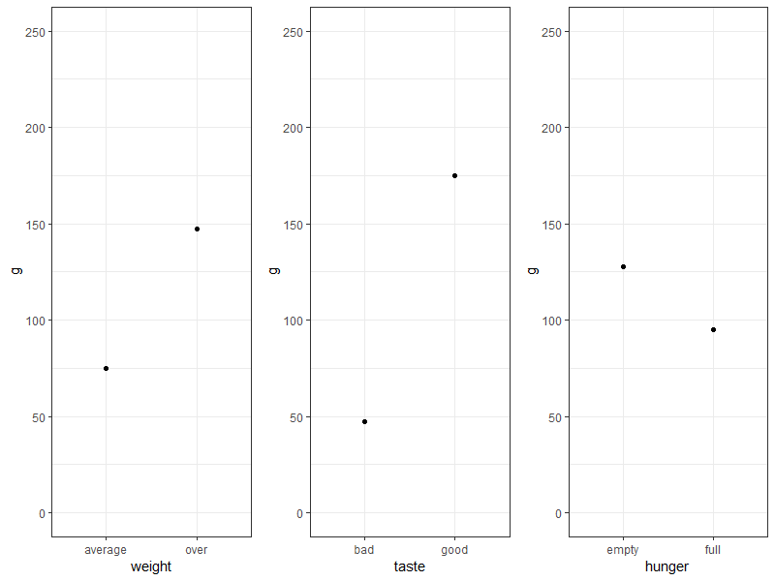
main effects

Slide 17
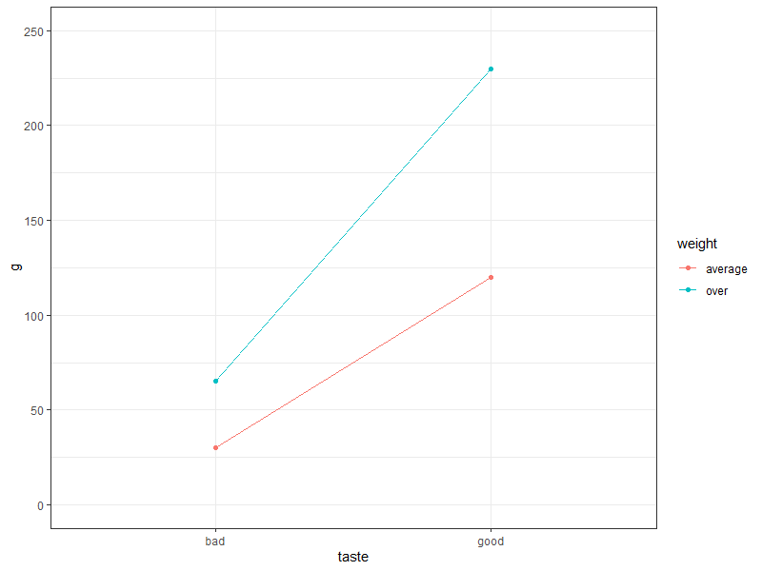
weight x taste

Slide 18
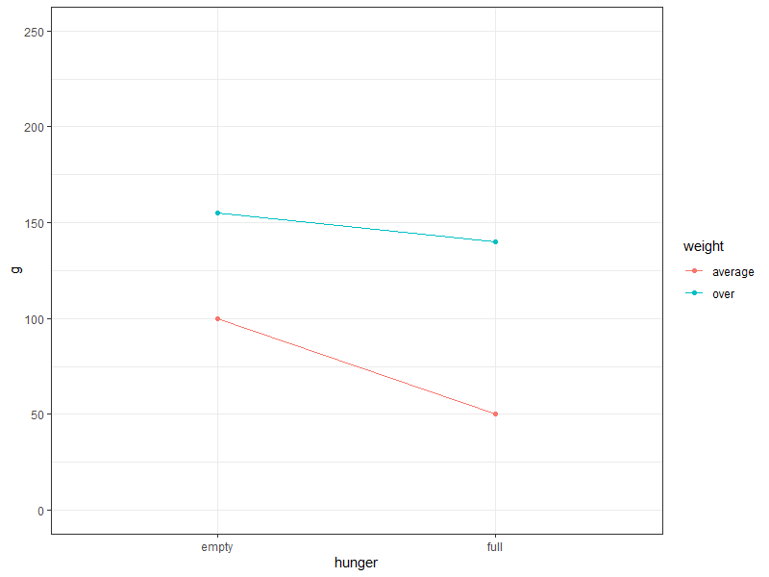
hunger x weight

Slide 19
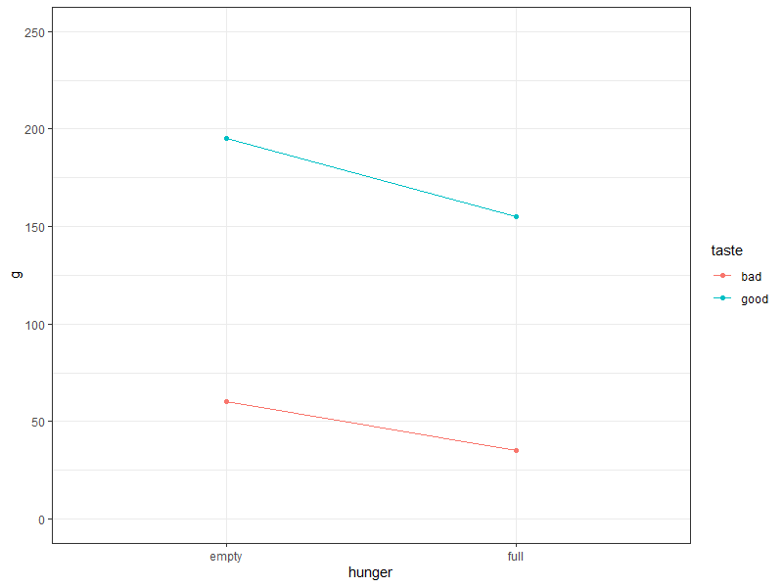
hunger x taste

Slide 20
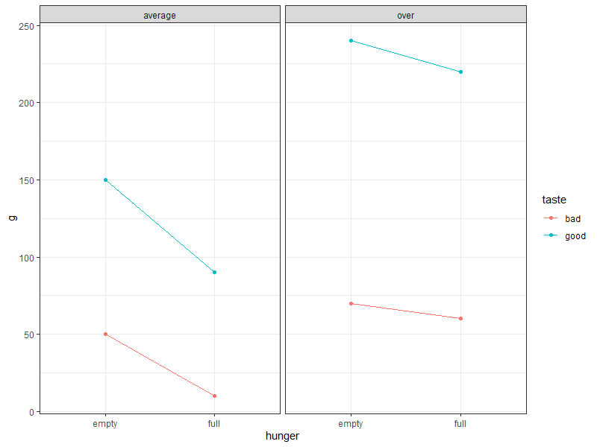
three-factor interaction

Slide 21
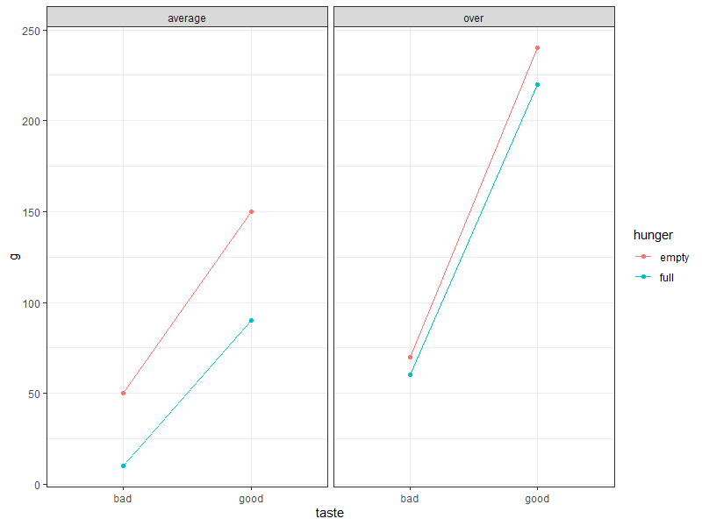
three-factor interaction

Slide 22
in a three-factor design
main effects are interpretable as usual
two-factor interactions can be decomposed (probed, explained, etc.) with simple-effects tests
three-factor interactions can be decomposed via simple-effect and/or simple-interaction tests
but be aware that most people can’t think very clearly about interactions among three factors (and more than that ...🤕)
all of the problems (i.e., the need for post-tests) that arise with >1 df effects apply here, but are potentially more complicated

Slide 23
general advice
the overall ANOVA will usually leave you needing follow-up tests in many cases
let your substantive questions dictate the analyses you execute
be aware of the costs and benefits of using orthogonal contrast codes vs other possibilities (e.g., dummy codes)
use cell means to help you interpret what your slopes are about
alternatively, you can interpret slopes as we did with continuous predictors; this may be easier with dummy codes than with orthogonal contrasts

