Slide 1
announcements
Problem Set 2 is due right about now
Problem Set 2’s answer key will be available tomorrow(ish)
Problem Set 3 will be assigned on Wednesday and due next Monday

Slide 2
categorical predictors (part 3: ANOVA)
February 5, 2024

Slide 3
getting ready for >2 groups
the first lesson to learn: creating one X won’t suffice
let’s try
I have a data set with 3 groups, and I assigned values of X = 1, 2, and 3 to them, respectively

Slide 4
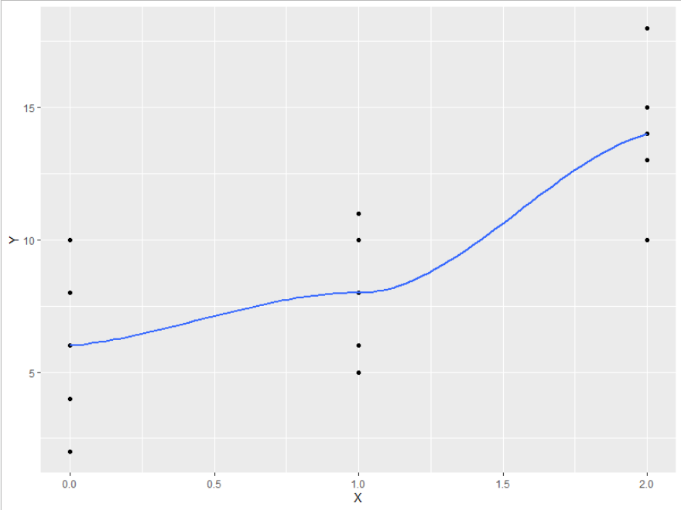

Slide 5
using one X for >2 groups will usually induce nonlinearity
we will need m – 1 new variables to numerically code our m groups
the numbers we choose to indicate group membership will depend on what we want our slopes to tell us (among other constraints)

Slide 6
we need more Xs
if we have m groups, we need m – 1 predictors (Xs), no more, no less
the predictors could (should?) be contrast codes
$$\sum{λ_{k}=0}$$
we want contrasts to be orthogonal (independent)

Slide 7
orthogonality
defined mathematically (for contrast codes; will not work for dummy codes)
$$\sum{λ_{1k}λ_{2k}=0}$$
what?!
let’s look at some Xs for a three-group design and check for orthogonality

Slide 8
three (m = 3) groups → two Xs, with the value of $λ$ assigned to each
group | $$λ_{1}$$ | $$λ_{2}$$ | $$λ_{1}λ_{2}$$
A | 1 | 0
B | 0 | 1
C | -1 | -1

Slide 9
three (m = 3) groups → two Xs, with the value of $λ$ assigned to each
group | $$λ_{1}$$ | $$λ_{2}$$ | $$λ_{1}λ_{2}$$
A | 2 | 0
B | -1 | 1
C | -1 | -1

Slide 10
how to choose contrast codes?
initially, let predictions dictate what’s of interest
then, let mathematical constraints fill in the rest, as needed

Slide 11
a concrete example
in a (hypothetical) study designed to test different memory strategies, participants were randomly assigned to learn a list of words using one of three strategies: form a mental image; find a rhyme; or just to study the list; after study & a delay, they’re given a recall test
the data are in today’s script; the main results are
group M
1 control 6
2 image 12
3 rhyme 10

Slide 12
what predictions might we want to test?
is using a strategy of any kind better than not using one?
which strategy works better?
is imagery better than nothing?
is rhyming better than nothing?
each prediction corresponds to a contrast we could do
we can only include two (no more, no less), and we’d like them to be orthogonal

Slide 13
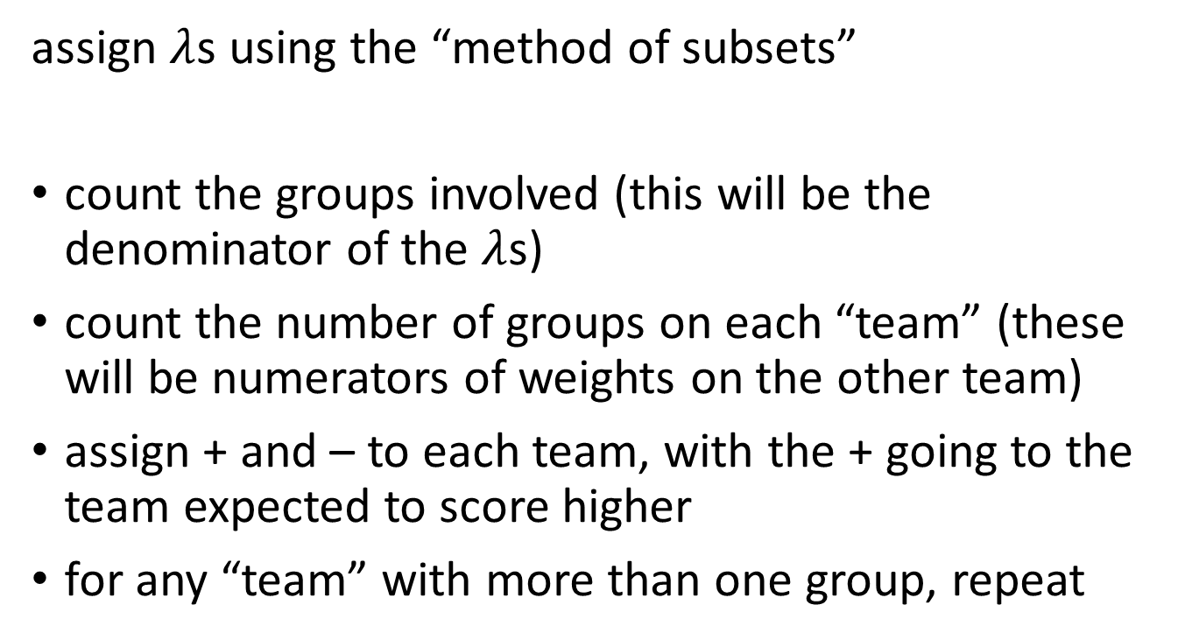
let’s test predictions 1 & 2
assign $λ$s using the “method of subsets”
count the groups involved (this will be the denominator of the $λ$s)
count the number of groups on each “team” (these will be numerators of weights on the other team)
assign + and – to each team, with the + going to the team expected to score higher
for any “team” with more than one group, repeat

Slide 14
group | $$λ_{1}$$ | $$λ_{2}$$ | $$λ_{1}λ_{2}$$
image
rhyme
control

Slide 15
what do we get?
Estimate Std. Error t value Pr(>|t|)
(Intercept) 9.3333 0.7045 13.248 2.49e-13
X1 5.0000 1.4944 3.346 0.00242
X2 2.0000 1.7256 1.159 0.25660

Slide 16

what are the predicted scores?
$$\hat{memory}=b_{0}+b_{1}X_{1}+b_{2}X_{2}$$
$${\hat{memory}}_{image}=9.33+5(\frac{1}{3})+2(\frac{1}{2})$$
$${\hat{memory}}_{image}=12$$

Slide 17
what is Model C?
Model A
$$\hat{memory}=b_{0}+b_{1}X_{1}+b_{2}X_{2}$$
Model C for X₁
$$\hat{memory}=b_{0}+0X_{1}+b_{2}X_{2}$$
Model C for X₂
$$\hat{memory}=b_{0}+b_{1}X_{1}+0X_{2}$$

Slide 18
let’s focus on b₁
$$H_{0}: β_{1}=0$$
this could be rewritten as
$$H_{0}:\frac{1}{3}μ_{image}+\frac{1}{3}μ_{rhyme}+\left(−\frac{2}{3}\right)μ_{control}=0$$
$$H_{0}:\frac{1}{3}μ_{image}+\frac{1}{3}μ_{rhyme}=\frac{2}{3}μ_{control}$$
$$H_{0}:μ_{image}+μ_{rhyme}=2μ_{control}$$
$$H_{0}:\frac{μ_{image}+μ_{rhyme}}{2}=μ_{control}$$

Slide 19
a different Model C
Model A
$$\hat{memory}=b_{0}+b_{1}X_{1}+b_{2}X_{2}$$
Model C
$$\hat{memory}=b_{0}+0X_{1}+0X_{2}$$
this is Model C if one does a typical ANOVA
crucially, PA – PC > 1; this is undesirable for drawing specific conclusions

Slide 20
why is orthogonality important? it forces tolerance = 1
Y
X2
X1

Slide 21
nonorthogonality → tolerance < 1
Y
X2
X1

Slide 22
what happens if contrasts are not orthogonal?
group | $$λ_{1}$$ | $$λ_{2}$$
image | +1/3 | +½
rhyme | +1/3 | 0
control | -2/3 | -½

Slide 23
some parameters are not what they’re expected to be ...
Estimate Std. Error t value Pr(>|t|)
(Intercept) 8.000 1.349 5.930 2.54e-06
badX1 6.000 1.726 3.477 0.00173
badX2 4.000 3.451 1.159 0.25660

Slide 24
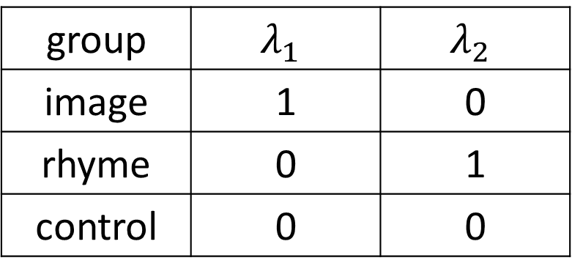
what happens if we use dummy codes?
group | $$λ_{1}$$ | $$λ_{2}$$
image | 1 | 0
rhyme | 0 | 1
control | 0 | 0

Slide 25
what is the intercept? what are the slopes?
Estimate Std. Error t value Pr(>|t|)
(Intercept) 6.000 1.220 4.917 3.8e-05
D1 6.000 1.726 3.477 0.00173
D2 4.000 1.726 2.318 0.02827
Note that even though dummy codes are not orthogonal (for linear algebra reasons that I don’t fully understand), the slopes are what we want them to be

