Slide 1
categorical predictors (part 4: ANOVA)
February 7, 2024

Slide 2
a concrete example
in a (hypothetical) study designed to test different memory strategies, participants were randomly assigned to learn a list of words using one of three strategies: form a mental image; find a rhyme; or just to study the list; after study & a delay, they’re given a recall test
the main results are
group M
1 control 6
2 image 12
3 rhyme 10

Slide 3
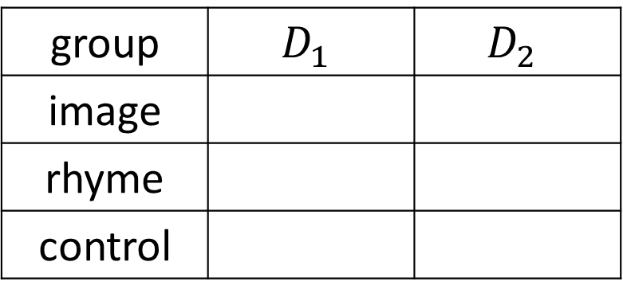
what happens if we use dummy codes?
group | $$D_{1}$$ | $$D_{2}$$
image
rhyme
control

Slide 4
what is the intercept? what are the slopes?
> summary(modelDummy)
Estimate Std. Error t value Pr(>|t|)
(Intercept) 6.000 1.220 4.917 3.8e-05
D1 6.000 1.726 3.477 0.00173
D2 4.000 1.726 2.318 0.02827

Slide 5
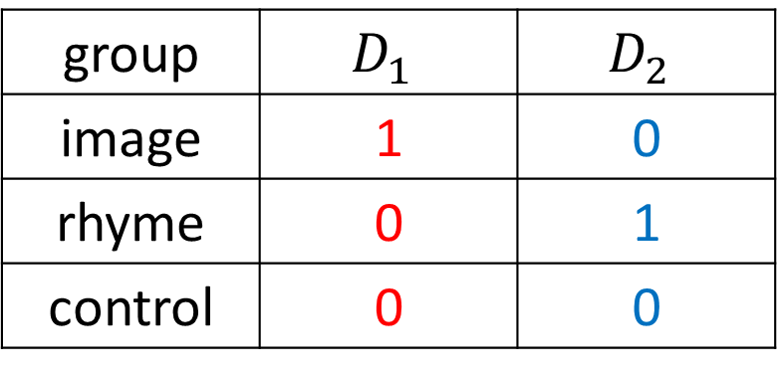
why do dummy code slopes “ignore” a group?
group | $$D_{1}$$ | $$D_{2}$$
image | 1 | 0
rhyme | 0 | 1
control | 0 | 0
slope is M_{rhyme} - M_{control}
slope is M_{image} - M_{control}

Slide 6
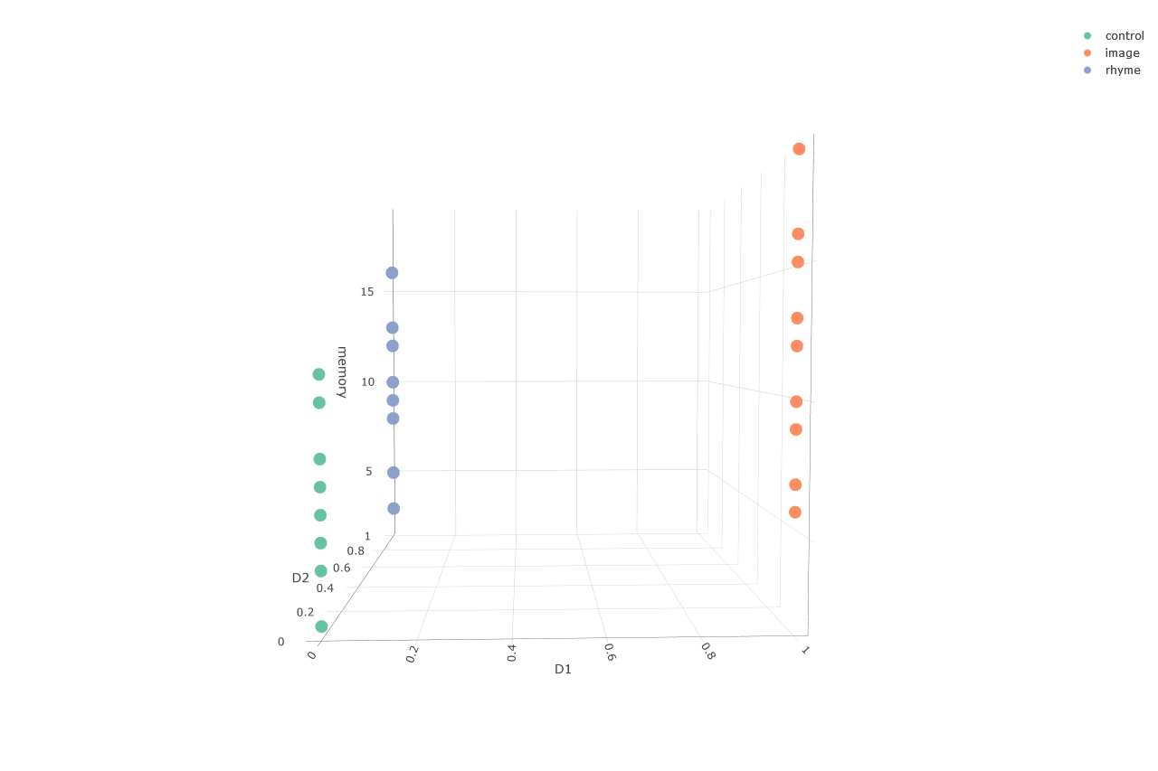

Slide 7
R defaults to dummy codes
the summary of lm(memory ~ group) is
Estimate Std. Error t value Pr(>|t|)
(Intercept) 6.000 1.220 4.917 3.8e-05 ***
groupimage 6.000 1.726 3.477 0.00173 **
grouprhyme 4.000 1.726 2.318 0.02827 *
summary(modelDummy)
Estimate Std. Error t value Pr(>|t|)
(Intercept) 6.000 1.220 4.917 3.8e-05
D1 6.000 1.726 3.477 0.00173
D2 4.000 1.726 2.318 0.02827

Slide 8
“model F” is the same regardless of coding
 | D1 | D2
I | 1 | 0
R | 0 | 1
C | 0 | 0
 | strange1 | strange2
I | 2 | 3
R | 7 | 11
C | 1 | 4
F(2, 27) = 6.3
F(2, 27) = 6.3
Why?
Whatever values are assigned to groups, model F is based on
Model A: $\hat{Y}=b_{0}+b_{1}X_{1}+b_{2}X_{2}$
Model C: $\hat{Y}=b_{0}+0{ X}_{1}+0 X_{2}$

Slide 9
pairwise comparisons
very often the contrasts of interest in a one-factor study are simply comparisons between all possible pairs of groups
this is clunky to execute using orthogonal contrasts
it requires redoing analyses multiple times and ignoring some results
the pairwise.t.test function is handy for executing only pairwise comparisons
it comes with an argument that allows one to control Type I errors ...

Slide 10
controlling Type I error rates
if each hypothesis test one does comes with a .05 error rate ...
... doing many hypothesis tests leads to a familywise error rate of > .05
FWER = the probability of at least one Type I error in a family of contrasts
important digression: what is a family?
is it all the hypothesis tests you do in your career?
is it all the hypothesis tests you do in one manuscript?
is it all the hypothesis tests you do for one model?

Slide 11
controlling Type I error rates
use the Bonferroni (or Dunn-Bonferroni) procedure if your contrasts are planned
if c = the number of contrasts you’ll perform
use an alpha level of .05/c to decide significance
e.g., if you’re doing 5 contrasts
$$α={.05}/5=.01$$
alternatively, take each p and multiply it by c, and then compare to α (probably .05)

Slide 12
controlling the “false discovery rate”
the Bonferroni procedure is designed to minimize the probability of at least one Type I error occurring
other procedures are designed to minimize the proportion of Type I errors that occur (the “false discovery rate”)
a simple one is the Benjamini-Hochberg procedure

Slide 13
BH procedure
for any family of contrasts
find p-values for contrasts
rank the p-values from p₁ to p_{K} (small to large)
if p_{K} < FWER, all are significant
if not, check if p_{K – 1} < FWER / 2; all remaining significant
if not, check if p_{K – 2} < FWER / 3; etc.

Slide 14
controlling Type I error rates
for unplanned (post-hoc, data-snooping) contrasts, use Scheffe’s procedure
it’s the method of last resort

Slide 15
writing about results
Three pairwise comparisons were executed by orthogonal contrasts. To control the Type I error rate, a Bonferroni-corrected α = .05/3 = .017 was used. The imagery group (M = 12) had significantly better memory than the control group (M = 6), t(27) = 3.48, p = .001. The rhyme group (M = 10) had non-significantly better memory than the control group (M = 6), t(27) = 2.32, p = .03. The imagery and rhyme groups also did not differ significantly, t(27) = 1.16, p = .26.
Notes:
adjusting alpha vs adjusting p-values

Slide 16
or ...
Three pairwise comparisons were executed by orthogonal contrasts. To control the Type I error rate, Bonferroni-corrected p-values were used with α = .05. The imagery group (M = 12) had significantly better memory than the control group (M = 6), t(27) = 3.48, p = .005. The rhyme group (M = 10) had non-significantly better memory than the control group (M = 6), t(27) = 2.32, p = .085. The imagery and rhyme groups also did not differ significantly, t(27) = 1.16, p = .77.
Notes:
adjusting alpha vs adjusting p-values

