Slide 1
categorical predictors, part 1: dichotomous predictors
January 29, 2023

Slide 2
things to know
Problem Set 1 is due right about now
The answer key should be done some time tomorrow, and (I hope) grading will be done by class time on Wednesday
There will be drill this week, same place/time as “usual”

Slide 3
today’s punchlines
not all designs will assess the relationship between quantitative predictors and outcomes
categorical predictors can be easily handled using model comparison
in a two-group design, any numbers can be assigned to each group
we’ll ultimately settle on (usually) using +0.5 and -0.5 as the numbers to indicate groups
despite that it will look different, this is an independent-samples t-test

Slide 4
some hypothetical data (based on real research)
music-based training might help elderly people improve balance, walking efficiency, and reduce the risk of falls
a group of 32 senior citizens are randomly assigned to either (n = 16) walk in time to music (responding changing rhythms) for 6 months (once weekly) or to a delayed-intervention control group (n = 16)
the data show that stride-length (the outcome) in the exercise group was M = 23” and in the control group was M = 20”
note the group means and how far apart they are!

Slide 5
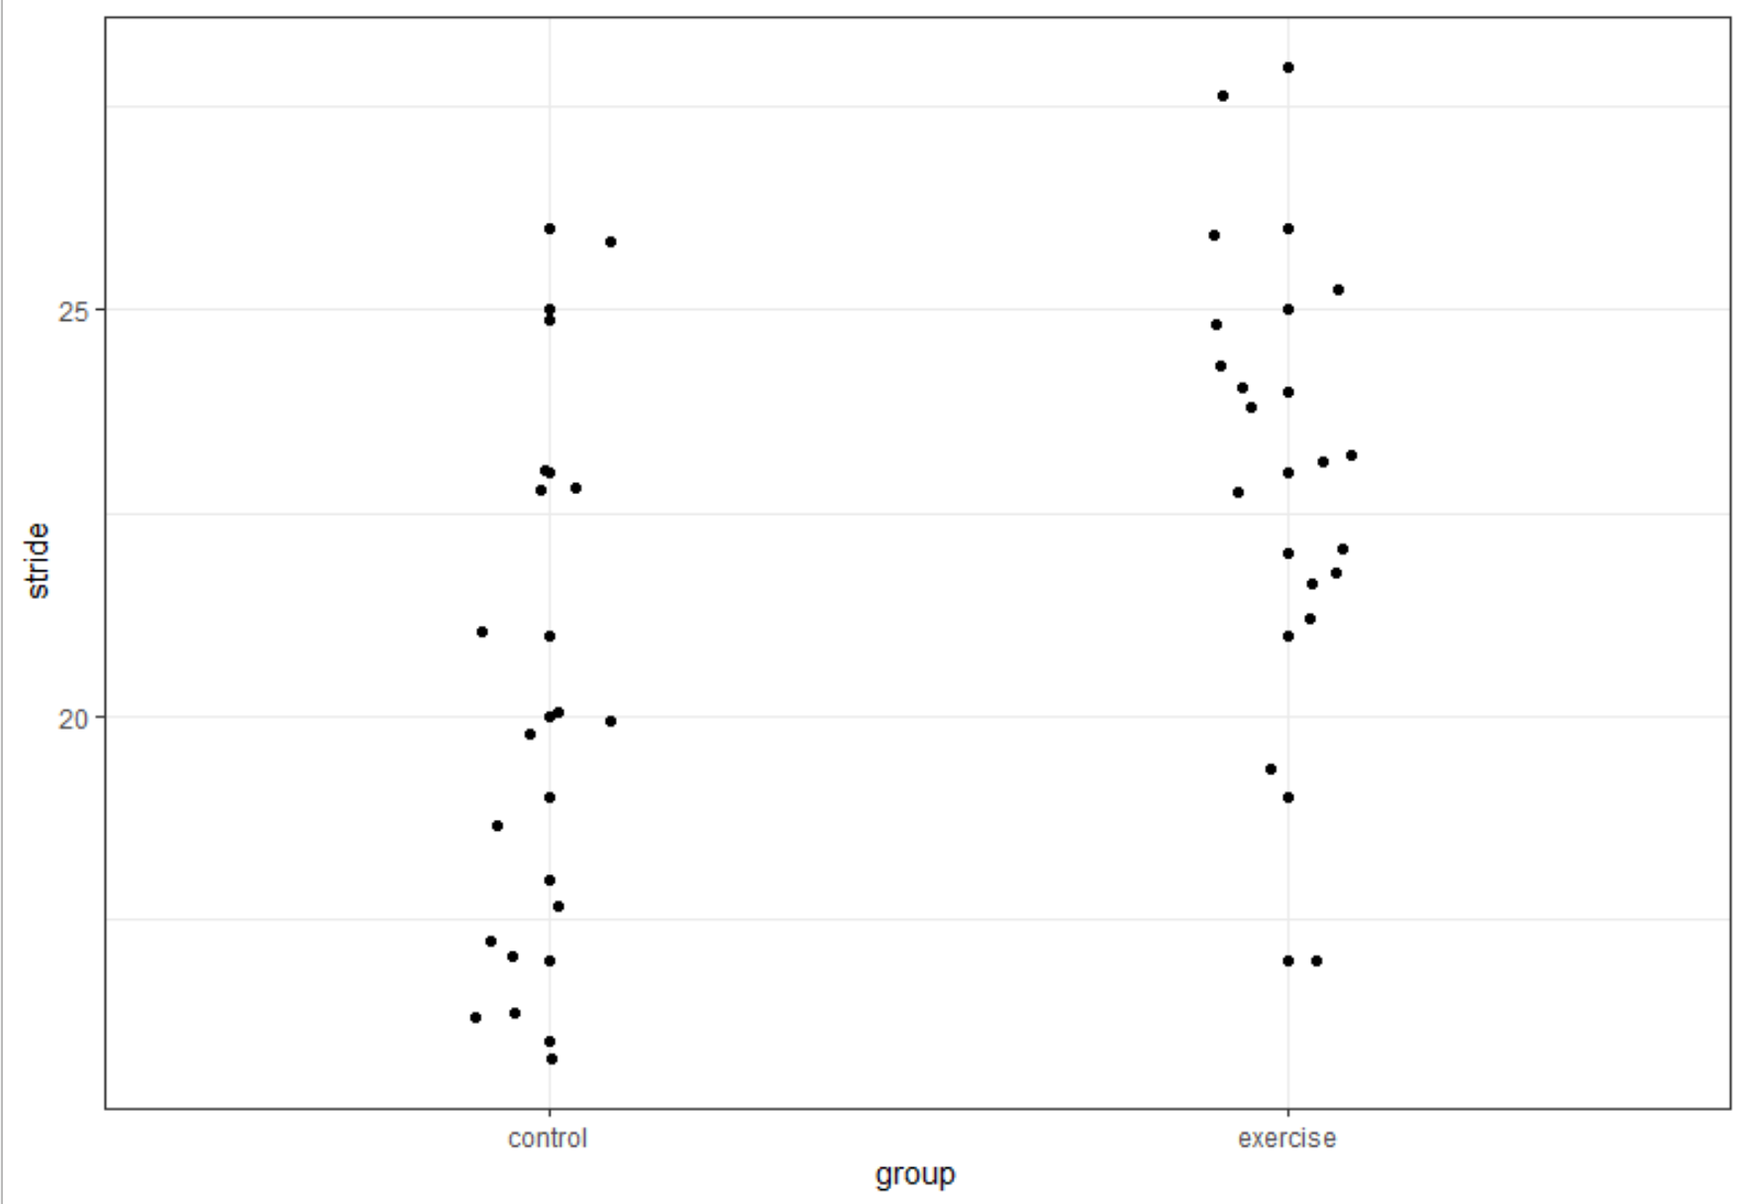

Slide 6
how to analyze?
assign numbers to groups
use the numbers as a predictor just like any other predictor
what numbers?
if all you care about is significance, it doesn’t matter (but please don’t be that person)
let’s start with exercise = 1 and control = 2 and fit the model
stride = b₀ + b₁*X_{group1and2}

Slide 7

the results
b₀ = 26
b₁ = -3
expressed as an equation
$$\hat{stride}=26+(−3)X_{group1and2}$$

Slide 8
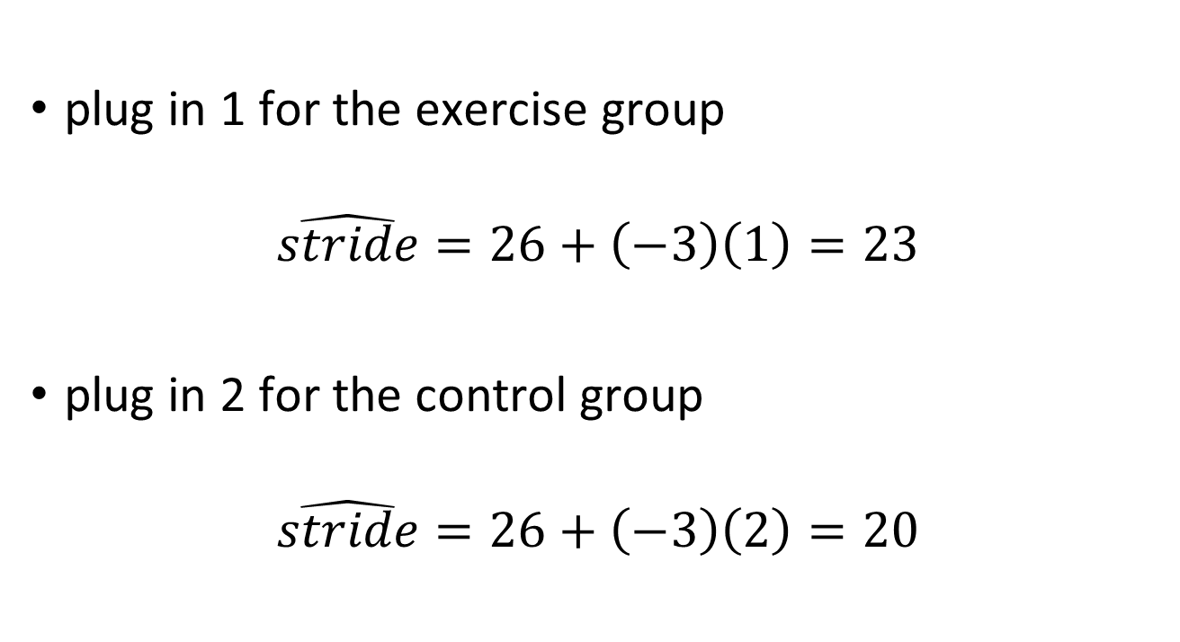
what are predicted stride values?
plug in 1 for the exercise group
$$\hat{stride}=26+\left(−3\right)\left(1\right)=23$$
plug in 2 for the control group
$$\hat{stride}=26+\left(−3\right)\left(2\right)=20$$

Slide 9
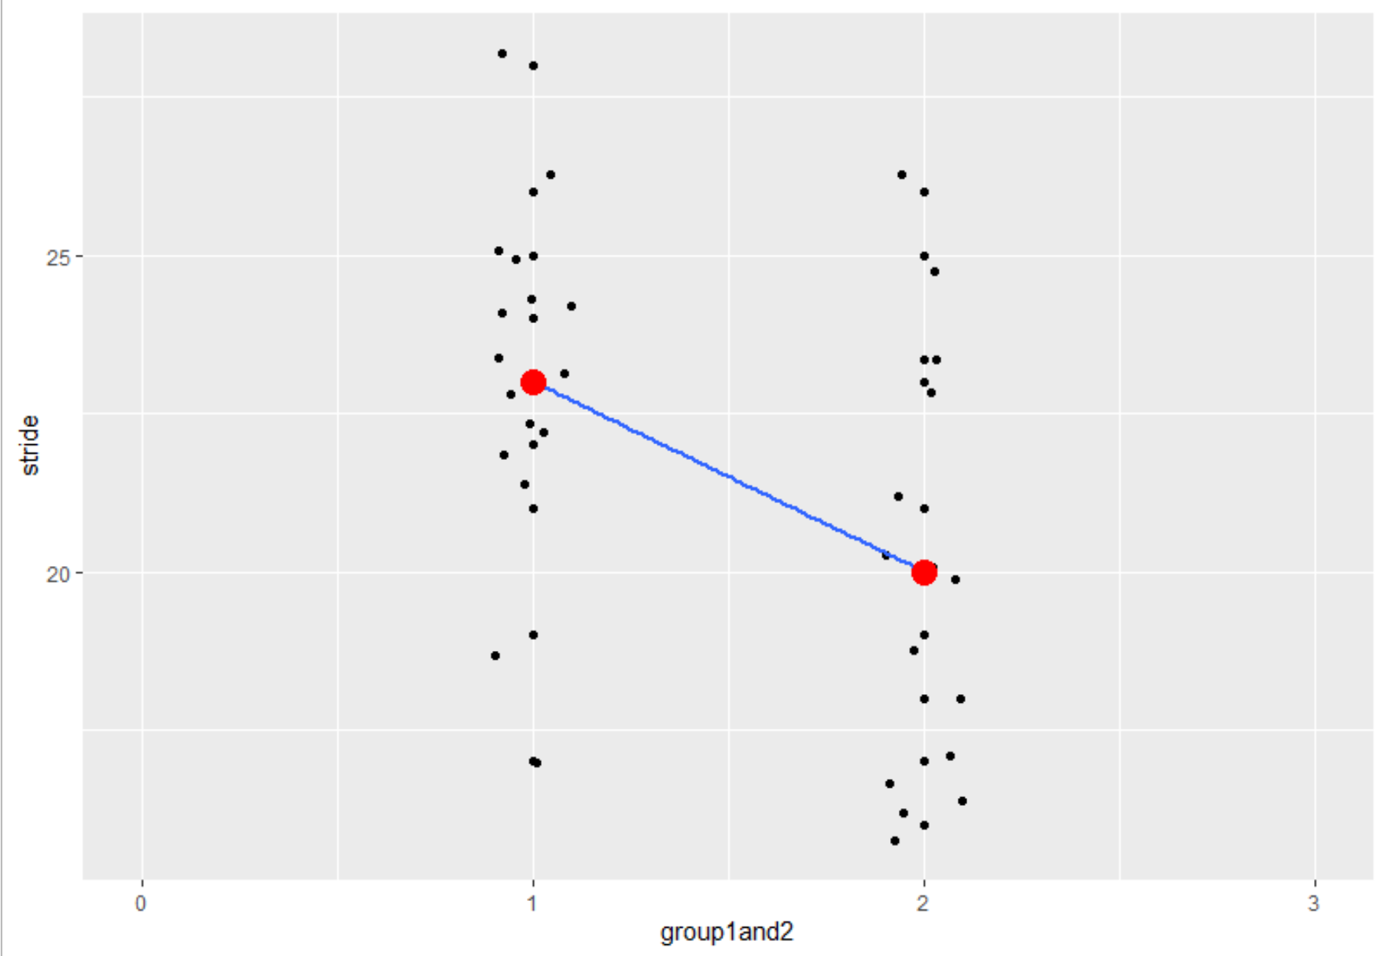
why are group means the predictions?

Slide 10
what is the slope?
same as it ever was
the predicted change as X increases by 1
here, increases by 1 means changing from X = 1 (the exercise group) to X = 2 (the control group)
that is, if one is in the control group, their predicted stride length is -3 relative to the predicted stride length in the exercise group
alternatively, we predict 23” for the exercise group and 20” for the control group

Slide 11
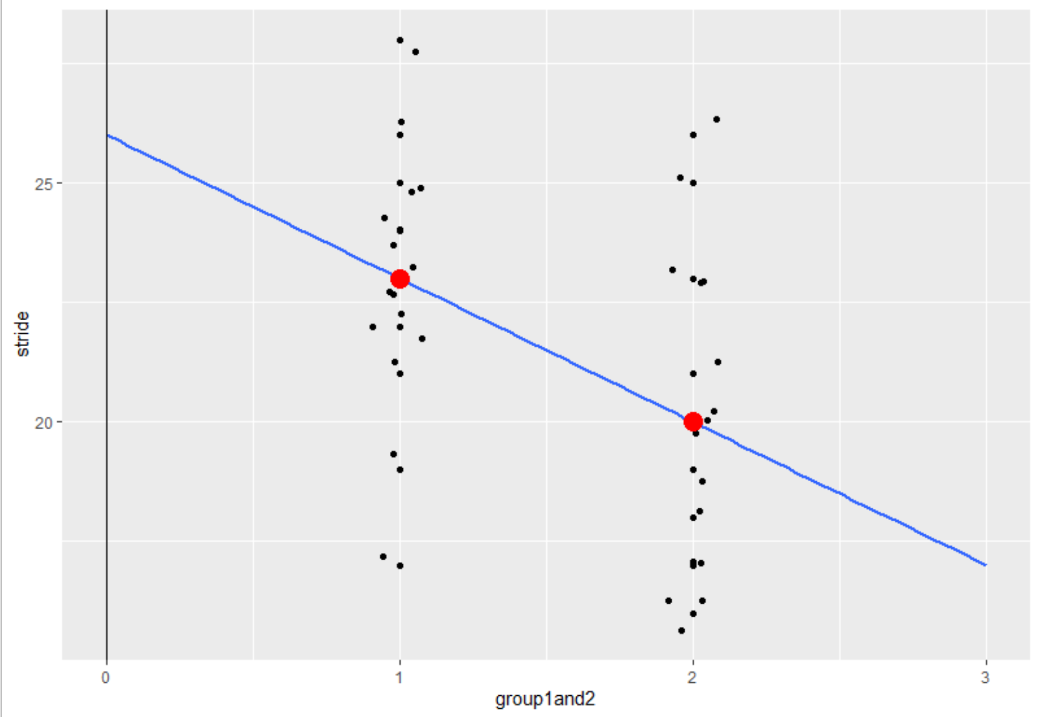
what is the intercept?
it’s meaningless (in this case) because no group has a value of 0

Slide 12
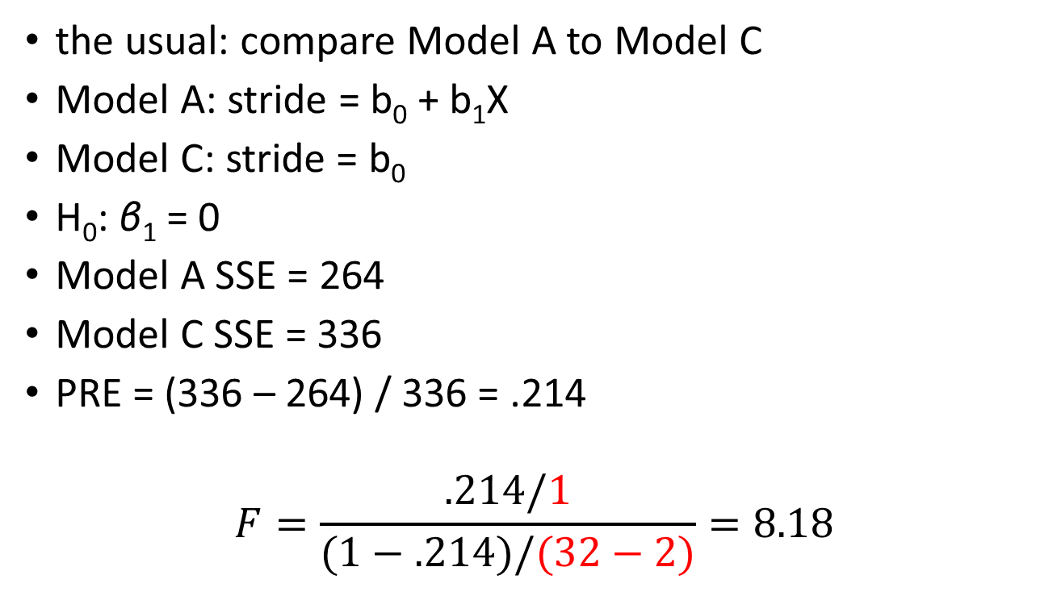
how do we test for significance?
the usual: compare Model A to Model C
Model A: stride = b₀ + b₁X
Model C: stride = b₀
H₀: β₁ = 0
Model A SSE = 264
Model C SSE = 336
PRE = (336 – 264) / 336 = .214
$$F=\frac{.214/1}{(1−.214)/(32−2)}=8.18$$

Slide 13
how do we test for significance?
more easily, just use the t statistic for the slope in the model summary
t² = F
Coefficients:
Estimate SE t Pr(>|t|)
(Intercept) 26.000 1.658 15.68 5.38e-16 ***
group1and2 -3.000 1.049 -2.86 0.00763 **

Slide 14
what’s the conclusion here?
Stride length is significantly longer in the treatment group (M = 23”) than in the control group (M = 20”), F(1, 30) = 8.18, p = .008, R² = .214.

Slide 15
what numbers should we choose to represent (two) groups?
we should use what are often called contrast codes (but I’ve heard these called effect codes, sum codes, and deviation codes; the terminology is wildly inconsistent)
what is this?
contrast codes are those that sum to zero for the groups
if λ_{k} is the value of X assigned to group k, a set of contrast codes is defined as
$$\sum{λ_{k}=0}$$

Slide 16
let’s try a -1 and +1
if you dislike negative numbers, consider assigning +1 to the group with the higher mean
what do we get in a model with ±1?
Coefficients:
Estimate SE t Pr(>|t|)
(Intercept) 21.5000 0.5244 41.00 < 2e-16 ***
contrastCodes 1.5000 0.5244 2.86 0.00763 **
t and p are the same!
the slope is half the difference between group means
the intercept is the overall mean (the grand mean)

Slide 17
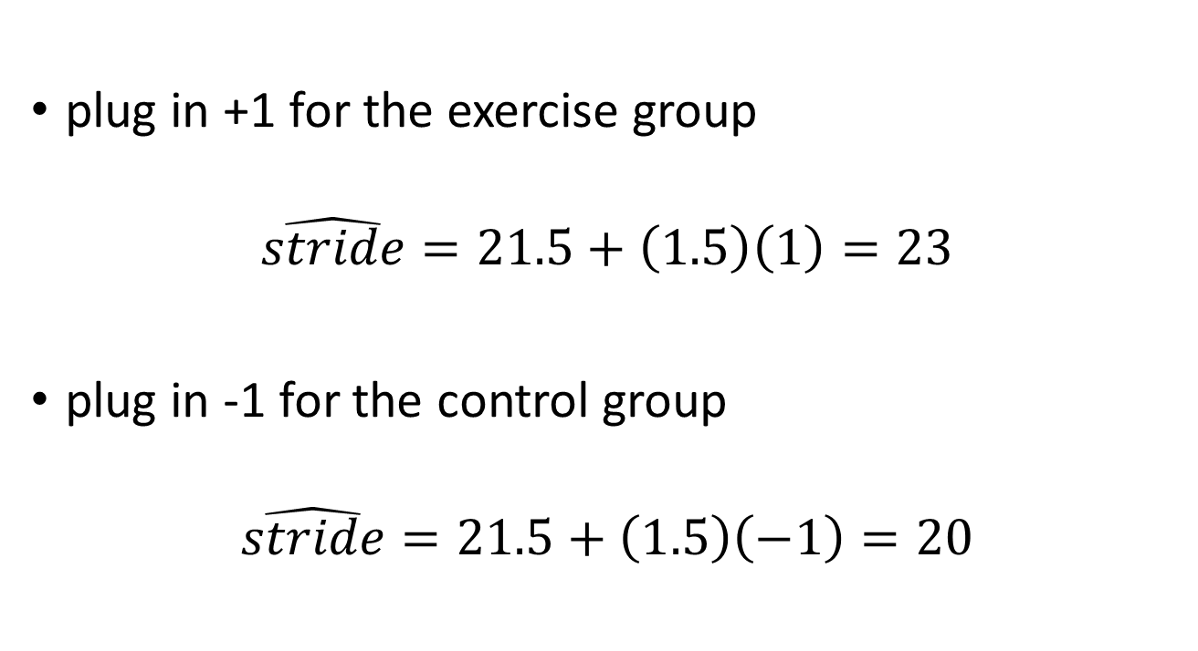
what are predicted stride values?
plug in +1 for the exercise group
$$\hat{stride}=21.5+\left(1.5\right)\left(1\right)=23$$
plug in -1 for the control group
$$\hat{stride}=21.5+\left(1.5\right)\left(−1\right)=20$$

Slide 18
what is the slope?
same as it ever was
the predicted change as X increase by 1
in this case, increases by 1 means changing from X = -1 (the control group) to X = 0 (halfway to the exercise group); this is why the slope is half of the difference between the group means
in general (with a contrast-coded predictor)
$$b_{1}={\sum{λ_{k}\overline{Y}}}/{\sum{λ_{k}^{2}}}$$

Slide 19
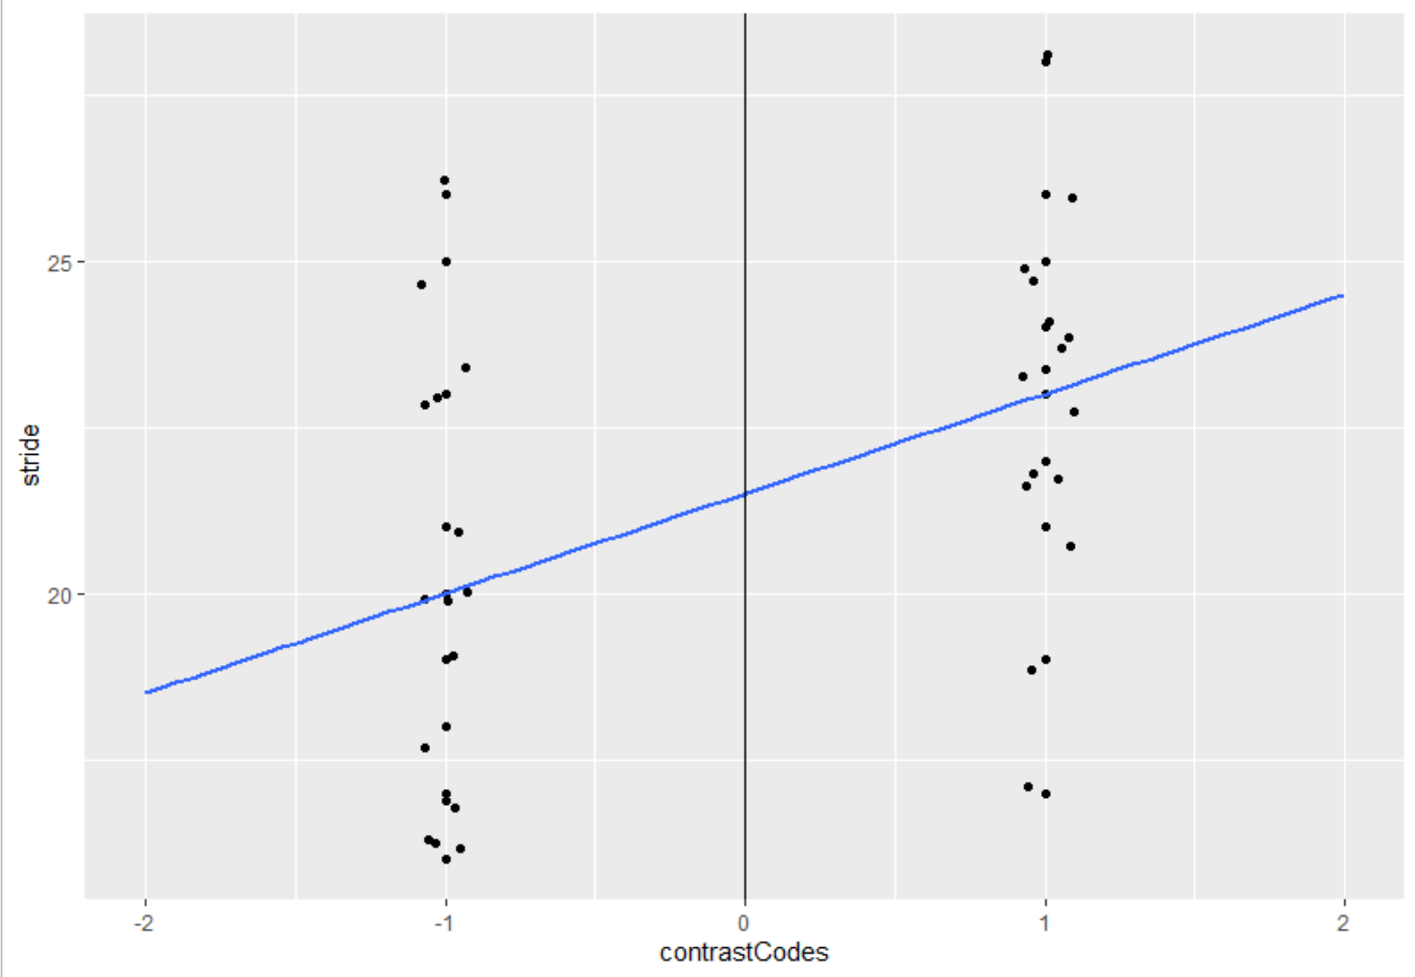
what is the intercept?
it’s the mean of the two group means

