Slide 1
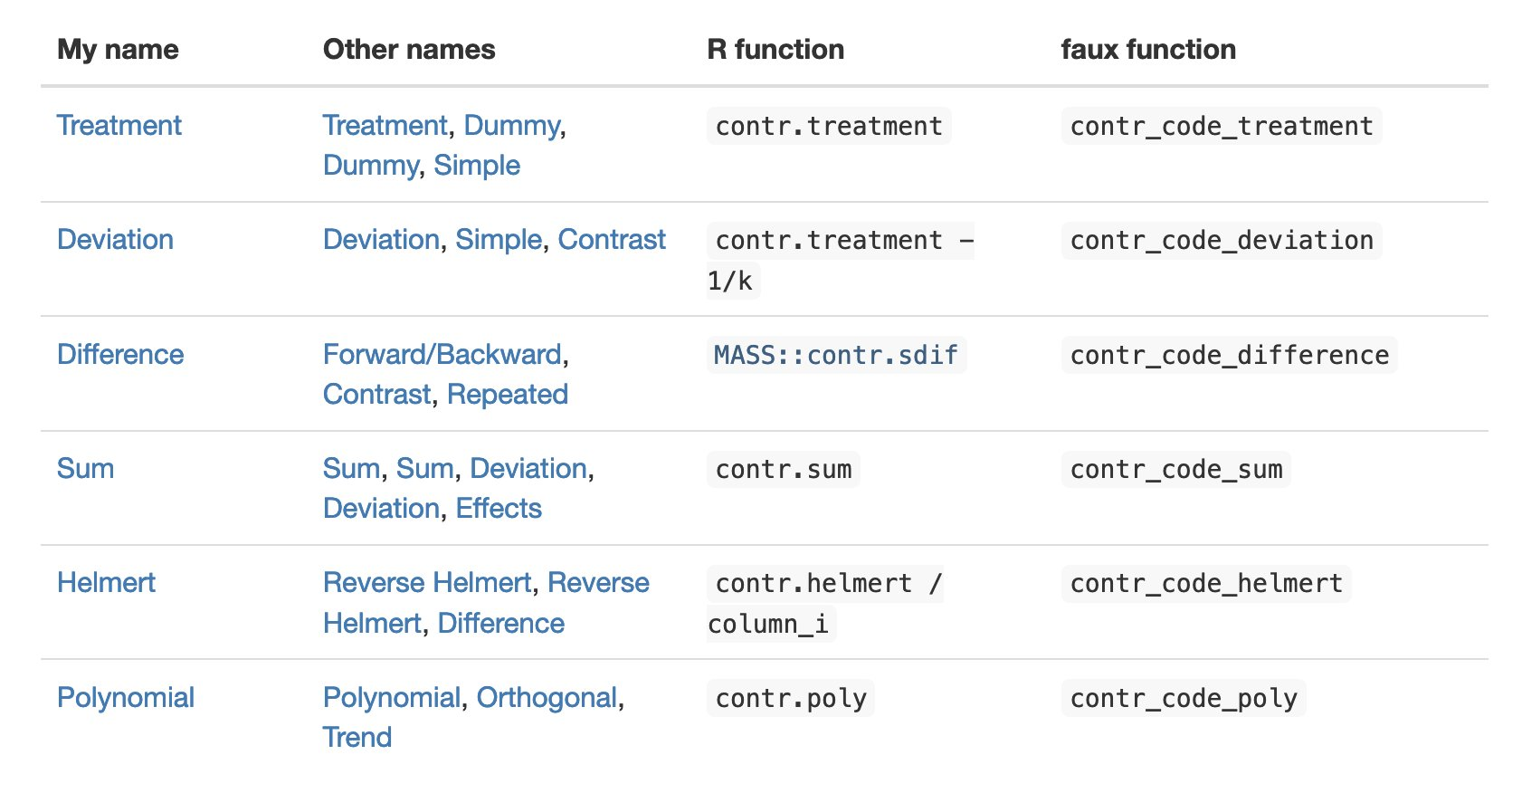
Problem Set 2 will be posted late this afternoon and due on Monday
Problem Set 1 is graded and an answer key is posted (written with optimism at 10:30am)

Slide 2
categorical predictors (part 2: dichotomous predictors, ANOVA, and t-tests)
January 31, 2024

Slide 3
review 1
in a design with two groups, we can create one numeric predictor, X, to indicate group membership
for this single predictor, we estimate one parameter, a slope
the numbers chosen for the groups matter for the interpretation of the slope parameter estimate

Slide 4
review 2
generally, we will prefer contrast codes to indicate group membership
contrast codes are those that sum to zero
for two-group designs, X = ±½ will have some nice benefits for interpretation of the associated slope

Slide 5
what does X = ±½ buy us?
data from Monday (M_{exercise} = 23, M_{control} = 20)
(assign the positive value to higher mean to get a positive slope)
Coefficients:
Estimate SE t Pr(>|t|)
(Intercept) 21.5000 0.5244 41.00 < 2e-16 ***
groupHalfs 3.0000 1.0488 2.86 0.00763 **

Slide 6
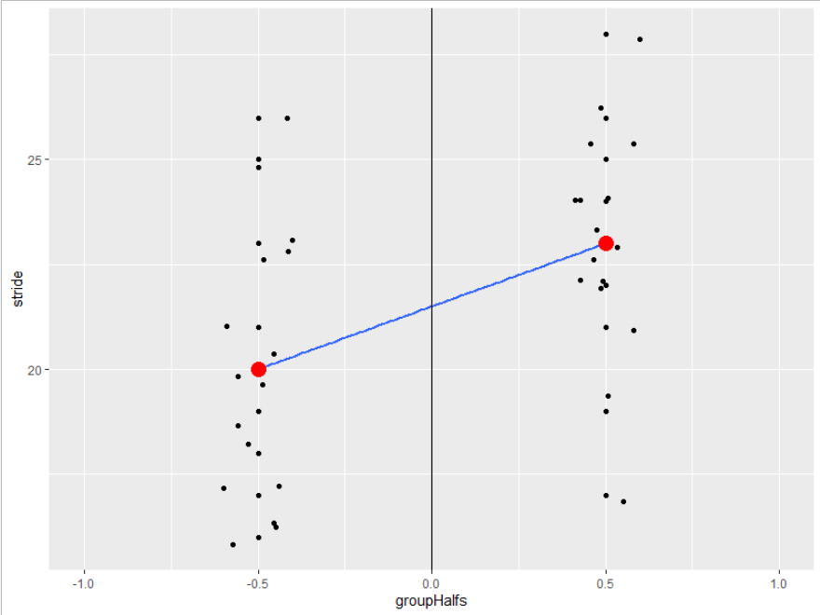

Slide 7
one other common coding scheme: dummy codes
if one group is given a value of X = 0 and the other a value of X = 1, this is called dummy coding
this is R’s default if you don’t create your own X
typically 0 is assigned to a control/comparison/ reference group (but R will assign it alphabetically)
what does dummy-coding buy us?
Estimate SE t Pr(>|t|)
(Intercept) 20.0000 0.7416 26.97 < 2e-16 ***
groupDummy 3.0000 1.0488 2.86 0.00763 **

Slide 8

building an ANOVA summary table
$$SSE\left(C\right)=\sum{{\left(Y_{i}−{\hat{Y}}_{iC}\right)}^{2}}$$
$$SSE\left(C\right)=\sum{{\left(Y_{i}−\overline{Y}\right)}^{2}}$$
often called SS_{total}

Slide 9

building an ANOVA summary table
$$SSE\left(A\right)=\sum{{\left(Y_{i}−{\hat{Y}}_{iA}\right)}^{2}}$$
$$SSE\left(A\right)=\sum{{\left(Y_{i}−{\overline{Y}}_{group}\right)}^{2}}$$
many aliases: SS_{residual}, SS_{within}, SS_{error}

Slide 10
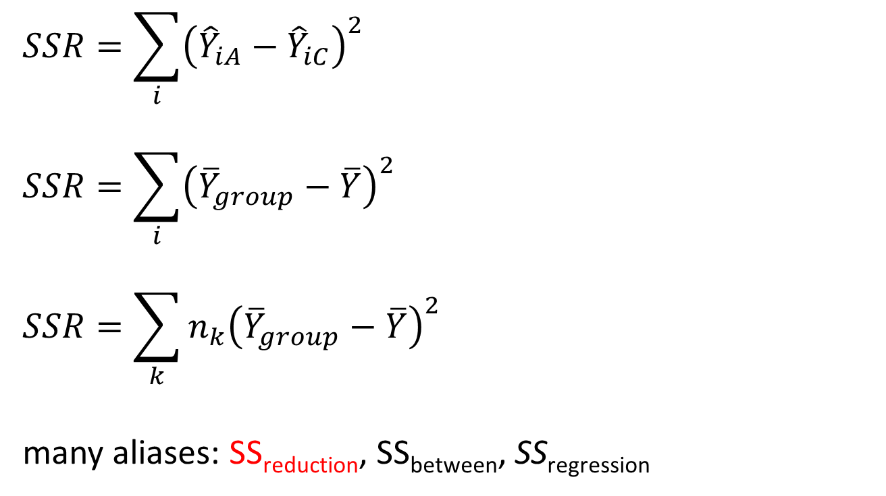
building an ANOVA summary table
$$SSR=\sum_{i}{{\left({\hat{Y}}_{iA}−{\hat{Y}}_{iC}\right)}^{2}}$$
$$SSR=\sum_{i}{{\left({\overline{Y}}_{group}−\overline{Y}\right)}^{2}}$$
$$SSR=\sum_{k}{n_{k}{\left({\overline{Y}}_{group}−\overline{Y}\right)}^{2}}$$
many aliases: SS_{reduction}, SS_{between}, SS_{regression}

Slide 11
the ANOVA table
source | SS | df | MS | F | PRE
reduction | SSR | PA – PC | MSR | MSR/MSE(A) | SSR/SSE(C)
error | SSE(A) | n – PA | MSE(A)
total | SSE(C) | n – 1 | MSE(C)
reduction | 72 | 1 | 72 | 8.18 | .214
error | 264 | 30 | 8.8
total | 336 | 31

Slide 12
the ANOVA table
source | SS | df | MS | F | PRE
reduction | SSR | PA – PC | MSR | MSR/MSE(A) | SSR/SSE(C)
error | SSE(A) | n – PA | MSE(A)
total | SSE(C) | n – 1 | MSE(C)
reduction | 72 | 1 | 72 | 8.18 | .214
error | 264 | 30 | 8.8
total | 336 | 31

Slide 13
the ANOVA table
source | SS | df | MS | F | PRE
reduction | SSR | PA – PC | MSR | MSR/MSE(A) | SSR/SSE(C)
error | SSE(A) | n – PA | MSE(A)
total | SSE(C) | n – 1 | MSE(C)
reduction | 72 | 1 | 72 | 8.18 | .214
error | 264 | 30 | 8.8
total | 336 | 31

Slide 14
the SS values, graphically

Slide 15
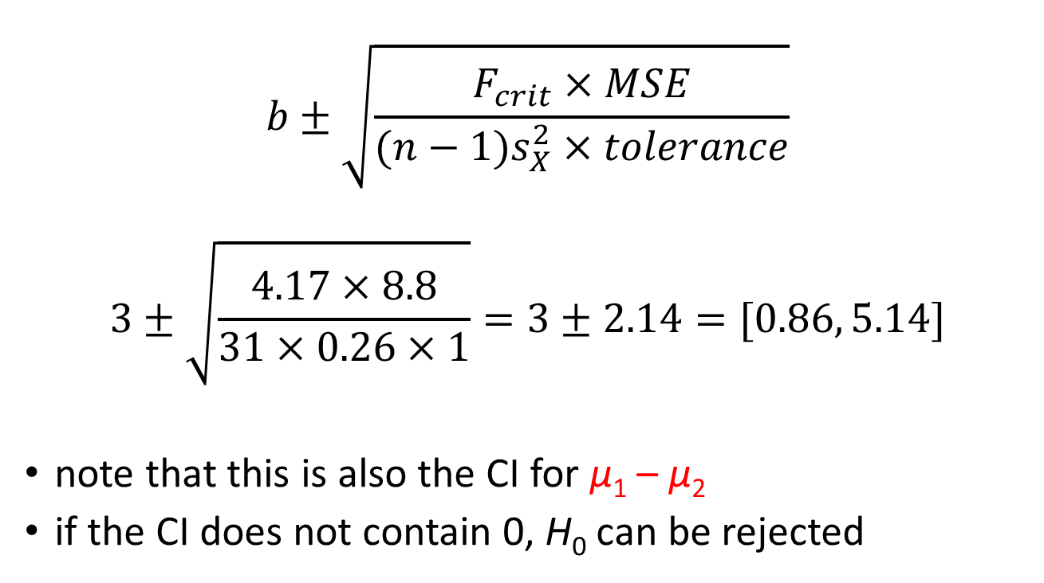
a confidence interval for β₁
$$b±\sqrt{\frac{F_{crit}×MSE}{(n−1)s_{X}^{2}×tolerance}}$$
$$3±\sqrt{\frac{4.17×8.8}{31×0.26×1}}=3±2.14=[0.86, 5.14]$$
note that this is also the CI for μ₁ – μ₂
if the CI does not contain 0, H₀ can be rejected

Slide 16
digression: the independent-samples t-test
to test the null hypothesis
H₀: μ₁ = μ₂
we can calculate t via the following steps
find pooled variance
find SE of the difference between two independent means
find t

Slide 17

pooled variance
$$s_{p}^{2}=\frac{\left(n_{1}−1\right)s_{1}^{2}+(n_{2}−1)s_{1}^{2}}{n_{1}+n_{2}−2}$$
$$\frac{15×10.667+15×6.933}{30}=8.8$$

Slide 18

SE
$$SE=\sqrt{\frac{s_{p}^{2}}{n_{1}}+\frac{s_{p}^{2}}{n_{2}}}$$
$$SE= \sqrt{\frac{8.815}{16}+\frac{8.815}{16}}≈1.05$$

Slide 19

t
$$t=\frac{{\overline{Y}}_{1}−{\overline{Y}}_{2}}{SE}$$
$$t=\frac{23−20}{1.05}=2.86$$

Slide 20
an alternative (and popular) effect-size measure: Cohen’s d
R² (PRE) measures proportion of variance accounted for by Model A not accounted for by Model C
Cohen’s d is a measure of the difference between two means, standardized
$$d=\frac{{\overline{Y}}_{1}−{\overline{Y}}_{2}}{\sqrt{s_{p}^{2}}}$$
$$d=\frac{23−20}{\sqrt{8.815}}=1.01$$

Slide 21
what does Cohen’s d indicate?
how much difference there is between two group means, counting in SDs
(very much like a z-score)
alternatively, it’s an estimate of how different the average individual in one population is from an average individual in another population (in SDs)
$$d\hat{=}δ$$
under duress, Cohen suggested using .2, .5, and .8 as guidelines for small, medium, and large effects

Slide 22
getting ready for >2 groups
the first lesson to learn: creating one X won’t suffice
let’s try
I have a data set with 3 groups, and I assigned values of X = 1, 2, and 3 to them, respectively

Slide 23
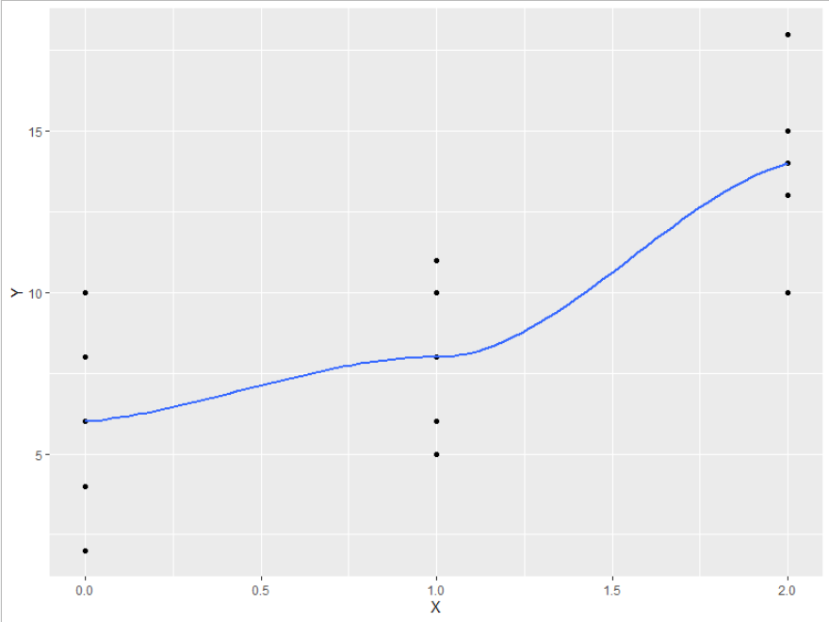

Slide 24
using one X for >2 groups will usually induce nonlinearity
we will need m – 1 new variables to numerically code our m groups
the numbers we choose to indicate group membership will depend on what we want our slopes to tell us (among other constraints)

Slide 25
we need more Xs
if we have m groups, we need m – 1 predictors (Xs), no more, no less
the predictors should be contrast codes
$$\sum{λ_{k}=0}$$
in addition to using contrasts codes, the contrasts should be orthogonal (independent)

Slide 26
orthogonality
defined mathematically
$$\sum{λ_{1k}λ_{2k}=0}$$
what?!
let’s look at some Xs for a three-group design and check for orthogonality

Slide 27
three (m = 3) groups → two Xs, with the value of $λ$ assigned to each
group | $$λ_{1}$$ | $$λ_{2}$$ | $$λ_{1}λ_{2}$$
A | 1 | 0
B | 0 | 1
C | 0 | 0

Slide 28
three (m = 3) groups → two Xs, with the value of $λ$ assigned to each
group | $$λ_{1}$$ | $$λ_{2}$$ | $$λ_{1}λ_{2}$$
A | 1 | 0
B | 0 | 1
C | -1 | -1

Slide 29
three (m = 3) groups → two Xs, with the value of $λ$ assigned to each
group | $$λ_{1}$$ | $$λ_{2}$$ | $$λ_{1}λ_{2}$$
A | 2 | 0
B | -1 | 1
C | -1 | -1

