Slide 1
introduction to ANCOVA
March 11, 2024

Slide 2
back to some basics! what is PRE? what makes it bigger?
in a two-group design (i.e., two parameters: one intercept, one slope), what is PRE for the grouping variable (X₁)?
Y
X₁
e
a

Slide 3
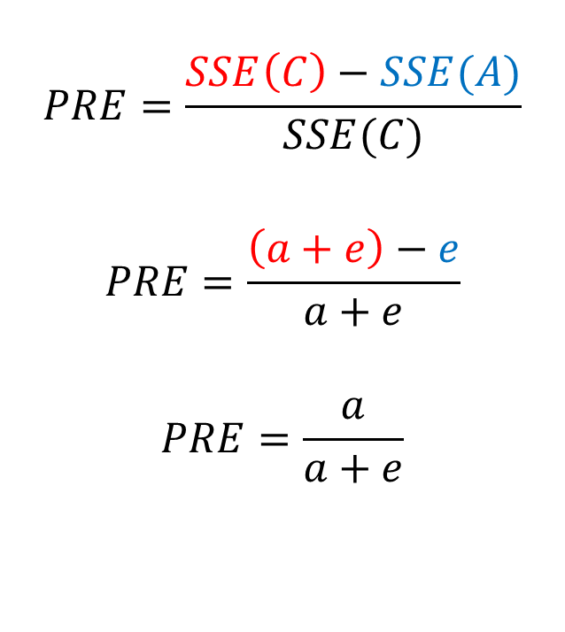
back to some basics! what is PRE? what makes it bigger?
$$PRE=\frac{SSE\left(C\right)−SSE(A)}{SSE(C)}$$
$$PRE=\frac{\left(a+e\right)−e}{a+e}$$
$$PRE=\frac{a}{a+e}$$
Y
X₁
e
a

Slide 4
back to some basics! what is PRE? what makes it bigger?
if we can add a predictor (i.e., a covariate) that turns some of e into explained variability ...
... SSE(C) for X₁ will become smaller by b
Y
cov
X₁
e
b
a

Slide 5
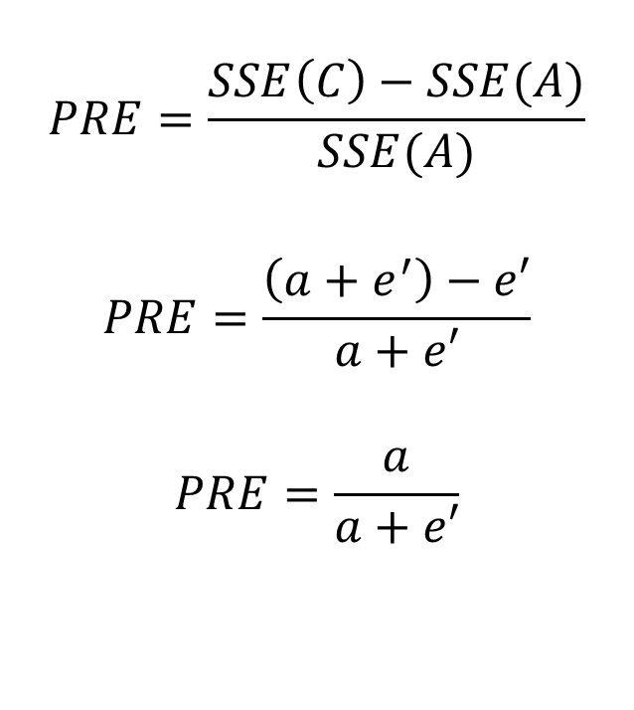
back to some basics! what is PRE? what makes it bigger?
$$PRE=\frac{SSE\left(C\right)−SSE(A)}{SSE(A)}$$
$$PRE=\frac{\left(a+e^{′}\right)−e′}{a+e′}$$
$$PRE=\frac{a}{a+e′}$$
Y
X₁
e’
a

Slide 6
this is “ANCOVA”
the goal is typically to examine group differences
by using a covariate (or more than one), power for the group comparisons can be increased
a good covariate is one that is independent of group differences (i.e., orthogonal)
a good covariate is one that reduces SSE for the compact model for group comparisons, i.e., it’s related to the outcome
often, the covariate itself is not of theoretical interest (but not always)

Slide 7
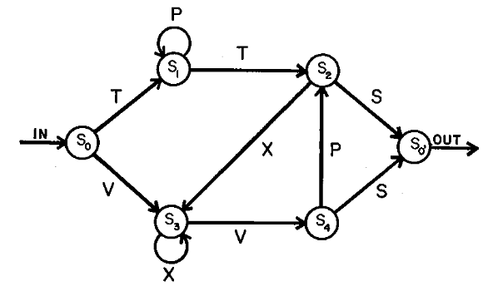
let’s start simple (and idealistic)
imagine that we are interested in examining the learning of artificial grammars
one group learns implicitly by exposure to grammatical strings; a control group is exposed to random strings
at test, each participant is presented with 20 strings ( ½ grammatical, ½ non) and they have to determine for each whether it is grammatical according to the rules

Slide 8
hypothetical results
treatment group M = 12.4
control group M = 10.4
independent-samples t-test results: t(18) = 2.09, p = .051
sadness!

Slide 9
but what if we had a covariate?
let’s hypothesize that acquiring a new grammar might be related to one’s experience with second (or third, etc.) languages
so we measure foreign-language experience (FLE) and include it in the model
if it’s related to grammar acquisition (the DV), it’s a good covariate
because of random assignment to groups, it should be (mostly) independent of group membership

Slide 10
the ANCOVA
in one model: lm(correct ~ con1 + FLE)
Estimate SE F Pr(>F)
(Intercept) 8.40878 2.48013 11.495 0.00348
con1 2.25261 0.96796 5.416 0.03257
FLE 0.06161 0.05015 1.510 0.23595

Slide 11
the ANCOVA
via sequential models
step1 <- lm(correct ~ FLE, d)
step2 <- lm(correct ~ con1 + FLE, d)
modelCompare(step1, step2)
SSE (Compact) = 100.2739
SSE (Augmented) = 76.04742
Delta R-Squared = 0.2356663
Partial Eta-Squared (PRE) = 0.2416032
F(1,17) = 5.415706, p = 0.03256853

Slide 12
what is the slope in the ANCOVA model?
the slope ≈ 2.25
the group means are 10.4 and 12.4; these do not differ by 2.25
the regression equation is
$$\hat{Y}=11.4+2.25×{con}_{1}+0.06×{FLE}_{C}$$
$$\hat{Y}=11.4+2.25×\frac{1}{2}+0.06×0=12.52$$
$$\hat{Y}=11.4+2.25×−\frac{1}{2}+0.06×0=10.27$$

Slide 13
these are “adjusted means”
the slope(s) associated with the grouping variable(s) changes from being about group means to ...
... being about “adjusted means”
what are adjusted means?
predicted scores for groups if the covariate = its mean
adjusted means will be similar to actual means if the covariate and grouping variable are mostly unrelated

Slide 14
what are we assuming when we do an ANCOVA?
the usual assumptions AND
homogeneity of slopes
the covariate-outcome relationship is the same for each group
the covariate is unrelated to the grouping variable
more a convenience than an assumption

Slide 15
homogeneity of slopes
this is the generic ANCOVA model (for a three-group design) where X₁ and X₂ are orthogonal contrasts and Z is the covariate
$$\hat{Y}=b_{0}+b_{1}X_{1}+b_{2}X_{2}+b_{3}Z$$
because there are no ZX interactions, the effect of Z (its slope) is assumed to be the same for all values of X (i.e., for all groups)

Slide 16
even if the Z-Y slope is in reality different across groups ...

Slide 17
this is what the model does

Slide 18
this assumption is easily tested
include interaction terms in your model between the grouping factor and the covariate
$$\hat{Y}=b_{0}+b_{1}X_{1}+b_{2}X_{2}+b_{3}Z+b_{4}X_{1}Z+b_{5}X_{2}Z$$
if one or more are significant, then this complicates interpretation (like interactions tend to do)
if you don’t care about specific interaction slopes, use the following Model A
$$\hat{Y}=b_{0}+b_{1}X_{1}+b_{2}X_{2}+b_{3}Z+0X_{1}Z+0X_{2}Z$$

Slide 19
what about the independence of covariate and groups?
this is all but guaranteed with random assignment
how to test? model the covariate as the outcome and group(s) as the predictor, i.e.,
$$\hat{Z}=b_{0}+b_{1}X_{1}+b_{2}X_{2}$$
you want this to be non-significant!
if you don’t care about specific group differences, use the following Model A
$$\hat{Z}=b_{0}+0X_{1}+0X_{2}$$

Slide 20
what if the covariate and groups are related?
what if you don’t have random assignment (or if you have bad luck)?
interpretation is complicated!
please read Miller & Chapman (2001)
(I can’t believe I didn’t assign this; it’s on the class website now; it’s such a clear article)

Slide 21
AX related: complications
an example
Y = yield in corn plants
A = two varieties of corn (blue vs white)
result: white > blue
but white is taller than blue (X = height)
regress Y on X than A, no effect of A
what should we conclude?

Slide 22
conceptually
Y
Z/cov
groups

Slide 23
conceptually
Y
groups

Slide 24
what is the problem?
with correlated predictors (i.e., tolerance < 1), giving credit for overlapping variance explained is complicated
it depends on causal priority; which predictor influences the outcome first
recall that the ANCOVA can be done as a sequential analysis
but this assumes that the covariate influences the outcome before the grouping variable does
if this assumption is incorrect, interpreting group differences after controlling for the covariate is fraught with difficulty

