Slide 1
more about ANCOVA
March 13, 2024

Slide 2
ANCOVA comes w/baggage
the typical ANCOVA model does not include a group-by-covariate interaction
that is, it assumes the covariate-outcome relationship (i.e., slope) is the same for every group
the typical ANCOVA is easier to interpret if the covariate and groups are independent
interpretation is more difficult if not

Slide 3
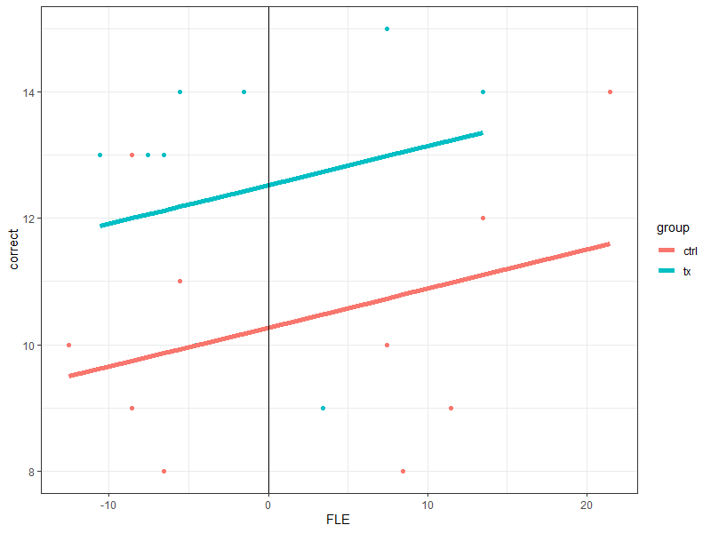
homogeneity of slopes
lm(correct ~ 1 + groupF + FLE_{c})
intercept = 10.28
group slope = 2.25
covariate slope = 0.062

Slide 4
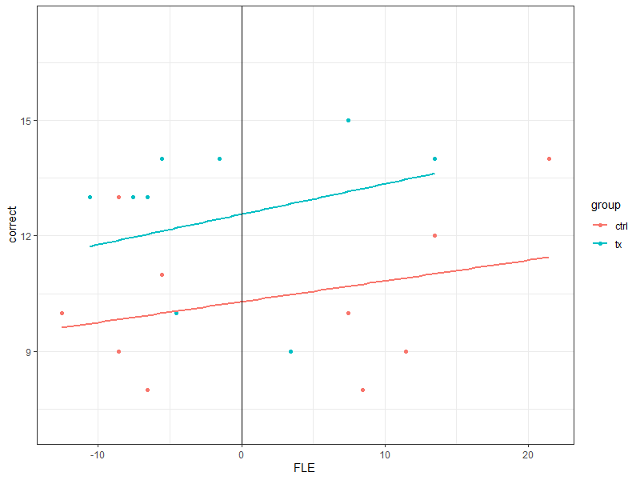
allowing slope to vary
lm(correct ~ 1 + groupF + FLE_{c} + group:FLE_{c})
intercept = 10.29
group slope = 2.27
covariate slope = 0.054
interaction slope = 0.025

Slide 5
what about the independence of covariate and groups?
this is all but guaranteed with random assignment
how to test? model the covariate as the outcome and group(s) as the predictor
you want this to be non-significant!

Slide 6
what if the covariate and groups are related?
what if you don’t have random assignment (or if you have bad luck)?
interpretation is complicated!
please read Miller & Chapman (2001); it’s so good

Slide 7
group (A) – covariate (Z) related: complications
an example
Y = yield in corn plants
A = two varieties of corn (blue vs white)
result: white > blue
but white is taller than blue (Z = height)
regress Y on Z, then include A, no effect of A
what should we conclude?

Slide 8
conceptually
Y
Z/cov
groups

Slide 9
conceptually
Y
groups

Slide 10
what is the problem?
with correlated predictors (i.e., tolerance < 1), giving credit for overlapping variance explained is complicated
it depends on causal priority; which predictor influences the outcome first
recall that the ANCOVA can be done as a sequential analysis
but this assumes that the covariate influences the outcome before the grouping variable does
if this assumption is incorrect, interpreting group differences after controlling for the covariate is fraught with difficulty

Slide 11
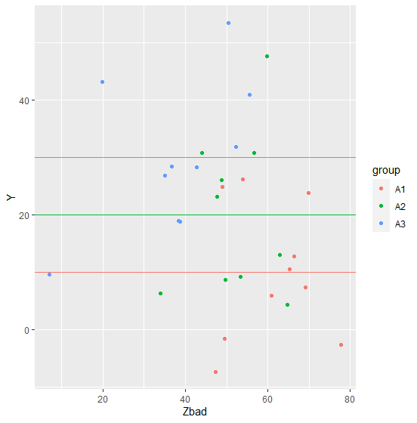
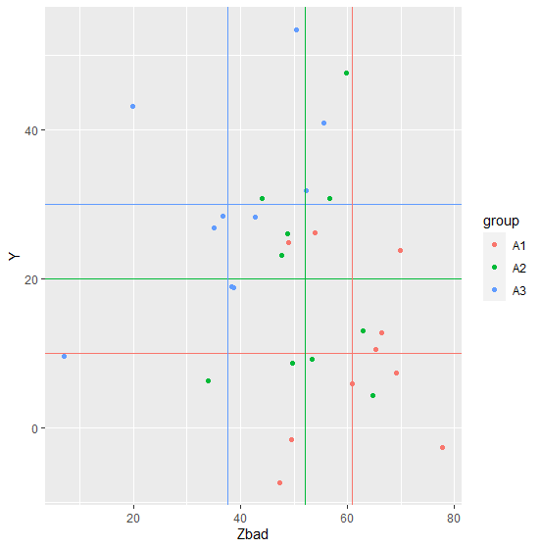
problematic data w/actual Ms
these groups differ
with respect to Y
M_{A1} = 10
M_{A2} = 20
M_{A3} = 30
these groups also differ
with respect to Zbad
M_{A1} = 60.9
M_{A2} = 52.2
M_{A3} = 37.7

Slide 12
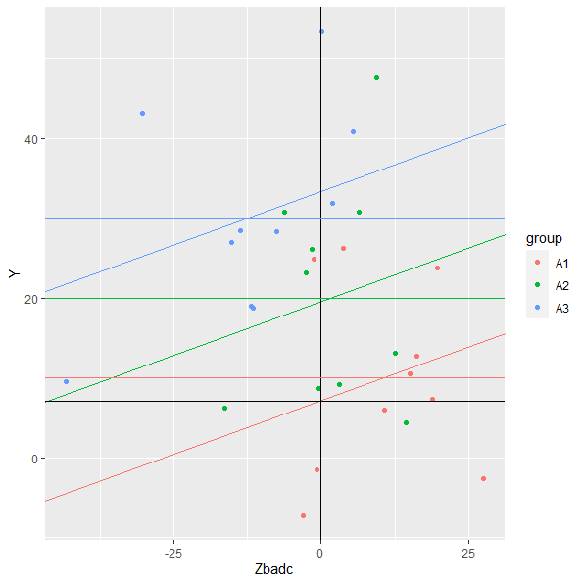
problematic data w/actual Ms
adjusted means
M_{A1} = 7.1
M_{A2} = 19.5
M_{A3} = 33.4

Slide 13
if the covariate interacts w/the predictor of interest
try to understand why!
in the words of one textbook: “One would simply live with the more complex model and interpret the resulting significant covariate × condition interactions.” 😂

Slide 14
sometimes the cov × group interaction is of interest
that is, the goal of using the covariate is not to gain power for comparing groups
instead, one might expect the covariate to interact with a grouping variable (whether in an experiment or in a quasi-experiment)
in this case, the interaction is of theoretical interest and should be modeled to estimate the parameter(s) of interest

Slide 15
an example (from my research; sorry)
we hypothesized that spoilers given before reading a short story would generally reduce enjoyment
but we thought that the effect of spoilers would be different among those low vs high in “need for closure”
those low in need for closure might be bothered by the spoilers
those high in need for closure might appreciate the spoilers
this is a grouping (spoiler) × covariate interaction

Slide 16
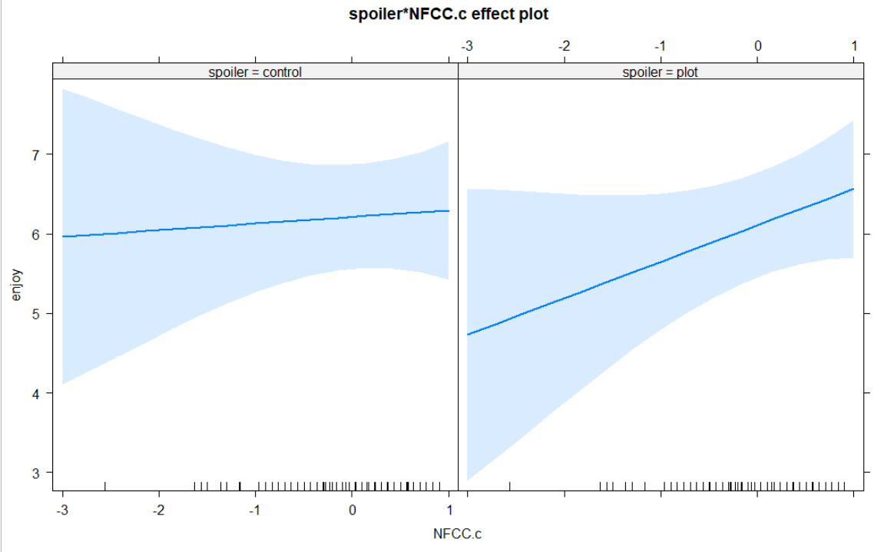

Slide 17
special design issue: pretest-postest
imagine we’re interested in comparing the effectiveness of two methods of teaching reading
at the beginning of a school year, we give students a standardized test; call this variable Z
students are randomly assigned to learn to read by one of the two methods; call this variable X
at the end of the year, the students take the same standardized test; call this variable Y
how should we analyze this?

Slide 18
we have options: first, change scores (Y – Z)
the model for this would be
$$Y_{i}−Z_{i}=β_{0}+β_{1}X_{1}+ε_{i}$$
rearranging this by moving Z to the right side
$$Y_{i}=β_{0}+β_{1}X_{1}+Z_{i}+ε_{i}$$
this implies that the slope of Z is 1; it’s not an estimated parameter
$$Y_{i}=β_{0}+β_{1}X_{1}+{1Z}_{i}+ε_{i}$$

Slide 19
we have options: second, an ANCOVA
the model for this would be
$$Y_{i}=β_{0}+β_{1}X_{1}+β_{2}Z_{i}+ε_{i}$$
because we’ve added a parameter ($β_{2}$) instead of setting it equal to 1, this will give us a better fit
if you have change scores, do an ANCOVA w/pretest scores as a covariate
the main exception is if the $β_{2}$ estimate is ≈ 1, then the 1 df cost to estimate it might not be worth it

