Slide 1
announcements
welcome back!
Problem Set 7 is due on Wednesday
there will be drill this week
it will cover analysis of continuous-by-group interactions and basic mediation analysis

Slide 2
general exam feedback
be thorough in interpreting interactions
be informative in interpreting statistical significance: don’t simply say that something is/ isn’t significant ... note the direction, which group is higher, etc.
power analysis is hard; please check the answer key re: 3g & ask questions if you have them
 | trash | control
positive | 5.5 | 6.4
negative | 5.6 | 5.4

Slide 3
announcements
Problem Set 7 is due on Wednesday
there will be drill this week
it will cover analysis of continuous-by-group interactions and basic mediation analysis

Slide 4
ANCOVA: last words
March 25, 2024

Slide 5
first: problems with overlap between covariate & groups

Slide 6
conceptually
Y
Z/cov
groups

Slide 7
conceptually
Y
groups

Slide 8
what is the problem?
with correlated predictors (i.e., tolerance < 1), giving credit for overlapping variance explained is complicated
depends on causal priority; which predictor influences the outcome first
ANCOVA, when done sequentially, assumes the covariate influences the outcome before the grouping variable does
if this is incorrect, interpreting group differences controlling for a covariate is fraught w/difficulty
as Cohen & Cohen put it (with my slight edits for provinciality), the difference in mean height between the Himalayan and Ozark mountains, adjusting for differences in atmospheric pressure, is about zero

Slide 9
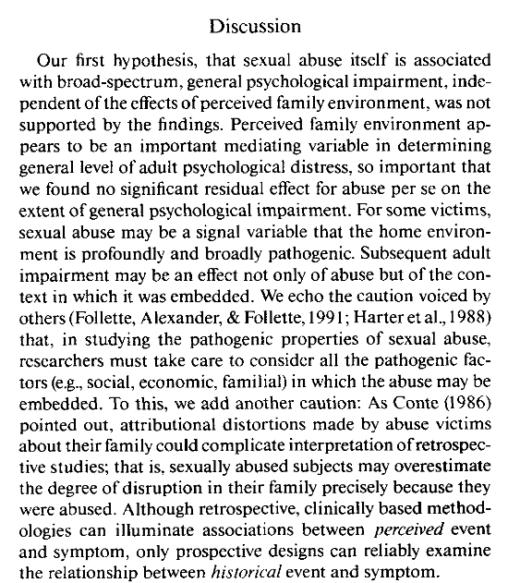
sensitive content: CSA

Slide 10
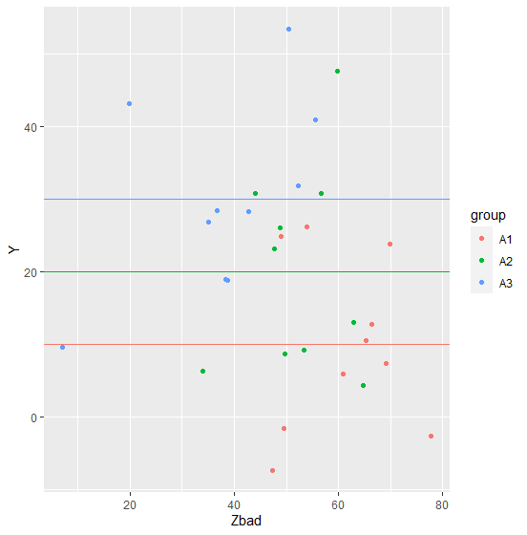
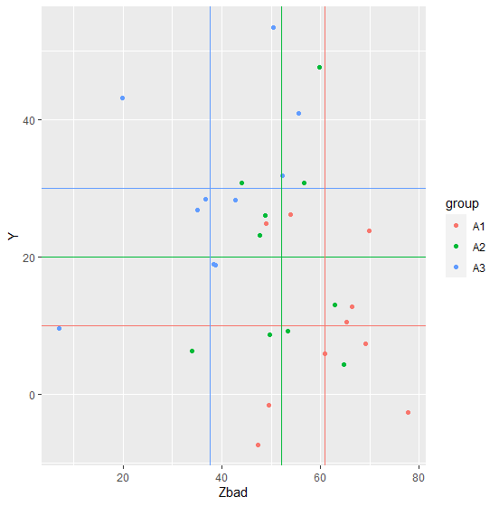
problematic data w/actual Ms
these groups differ
with respect to Y
M_{A1} = 10
M_{A2} = 20
M_{A3} = 30
these groups also differ
with respect to Zbad
M_{A1} = 60.9
M_{A2} = 52.2
M_{A3} = 37.7

Slide 11
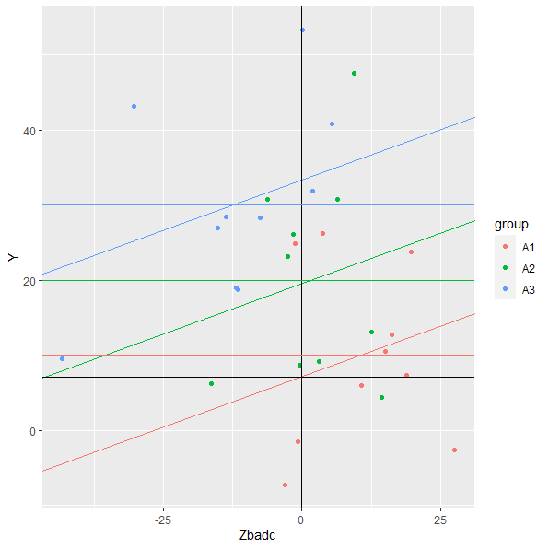
problematic data w/actual Ms
adjusted means
M_{A1} = 7.1
M_{A2} = 19.5
M_{A3} = 33.4

Slide 12
special design issue: pretest-posttest
imagine we’re interested in comparing the effectiveness of two methods of teaching reading
at the beginning of a school year, we give students a standardized test; call this variable Z
students are randomly assigned to learn to read by one of the two methods; call this variable X
at the end of the year, the students take the same standardized test; call this variable Y
how should we analyze this?

Slide 13
we have options: first, change scores (Y – Z)
the model for this would be
$$Y_{i}−Z_{i}=β_{0}+β_{1}X_{1}+ε_{i}$$
rearranging this by moving Z to the right side
$$Y_{i}=β_{0}+β_{1}X_{1}+Z_{i}+ε_{i}$$
this implies that the slope of Z is 1; it’s not an estimated parameter
$$Y_{i}=β_{0}+β_{1}X_{1}+{1Z}_{i}+ε_{i}$$

Slide 14
we have options: second, an ANCOVA
the model for this would be
$$Y_{i}=β_{0}+β_{1}X_{1}+β_{2}Z_{i}+ε_{i}$$
because we’ve added a parameter ($β_{2}$) instead of setting it equal to 1, this will give us a better fit
if you have change scores, do an ANCOVA w/pretest scores as a covariate
the main exception is if the $β_{2}$ estimate is ≈ 1, then the 1 df cost to estimate it might not be worth it
if you work in an area where change scores are commonly used, read around to see how others handle them

Slide 15
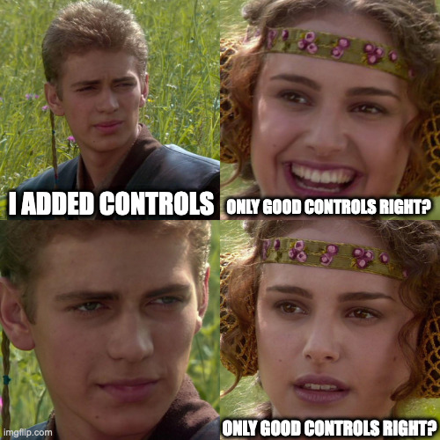
other third-variable patterns (covariates, confounds, mediators, etc.)
https://papers.ssrn.com/sol3/papers.cfm?abstract_id=3689437

Slide 16
covariates, confounds, mediators
X1
Y
X2
https://journals.sagepub.com/doi/full/10.1177/2515245917745629

Slide 17
X2 is a “covariate”
Y
X1
X2

Slide 18
covariates, confounds, mediators
X1
Y
X2

Slide 19
X2 is a (partial) confound
Y
X1
X2

Slide 20
covariates, confounds, mediators
X1
Y
X2

Slide 21
mediation (Baron & Kenny, 1986; Hayes, 2009; Rucker et al., 2011)
if one variable influences another through an intervening variable, the intervening variable is typically called a mediator
X1
Y
c

Slide 22
mediation
if one variable influences another through an intervening variable, the intervening variable is typically called a mediator
M
a
b
X1
Y
c’

Slide 23
Y
X
M
c

Slide 24
M is a mediator
Y
X
M
c’

Slide 25
total = direct + indirect
total effect of X on Y = c
direct effect of X on Y = c’
indirect effect of X on Y via M = ab
c = c’ + ab
ab = c – c’ (the indirect effect = total – direct)

Slide 26
Baron & Kenny’s causal steps approach
regress Y on X: c must be significant
regress M on X: a must be significant
regress Y on X & M: b must be significant
if c > c’ and c’ is significant → “partial mediation”
if c > c’ and c’ is NS → “full mediation”
But this approach has low power!

Slide 27
an example
adolescents diagnosed with bipolar disorder are randomly assigned to a treatment group (a family counseling intervention + the usual pharmaceutical regimen) or a control group (only the pharmaceutical)
the outcome is a measure of symptoms taken at 8 weeks after treatment begins
we suspect that the counseling will be effective by reducing criticism; this is measured at 7 weeks

Slide 28
model 1: symptoms ~ treatment
Estimate Std. Error t value Pr(>|t|)
(Intercept) 5.1000 0.2739 18.623 3.29e-13
X 1.6000 0.5477 2.921 0.00912
M
a
b
IV
DV
c = 1.6

Slide 29
model 2: criticism ~ treatment
Estimate Std. Error t value Pr(>|t|)
(Intercept) 3.1000 0.1871 16.570 2.41e-12
X 1.2000 0.3742 3.207 0.00489
M
a = 1.2
b
IV
Y
c’

Slide 30
model 3: symptoms ~ tx + crit
Estimate Std. Error t value Pr(>|t|)
(Intercept) 2.8365 0.9847 2.881 0.0104
X 0.7238 0.6123 1.182 0.2535
C 0.7302 0.3077 2.373 0.0297
M
a = 1.2
b = 0.73
a
IV
DV
c’ = 0.72
a*b = 1.2*0.73 = 0.876 = c – c’ = 1.6 – 0.724 = 0.876 

Slide 31
enough
a little more about mediation on Wednesday

