Slide 1
announcements
Problem Set 7 is due right about now
Problem Set 8 will be assigned later and due on Monday
Drill will be happening tomorrow as usual

Slide 2
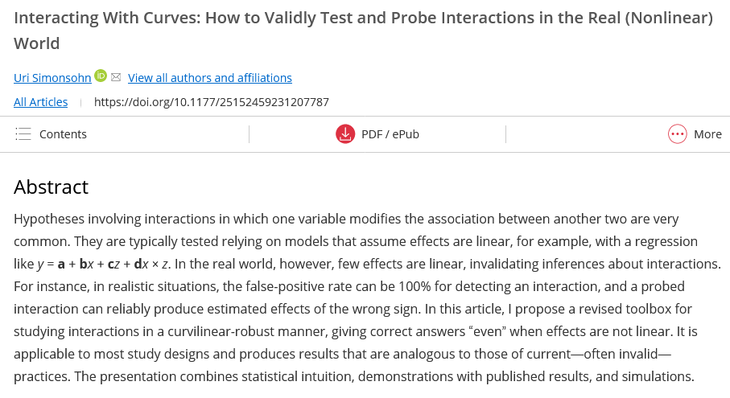
my inbox is full of bad news

Slide 3
mediation analysis
March 27, 2024

Slide 4
an example
adolescents diagnosed with bipolar disorder are randomly assigned to a treatment group (a family counseling intervention + the usual pharmaceutical regimen) or a control group (only the pharmaceutical)
the outcome is a measure of symptoms taken at 8 weeks after treatment begins
we suspect that the counseling will be effective by reducing criticism; this is measured at 7 weeks

Slide 5
model 1: symptoms ~ treatment
Estimate Std. Error t value Pr(>|t|)
(Intercept) 5.1000 0.2739 18.623 3.29e-13
X 1.6000 0.5477 2.921 0.00912
M
a
b
IV
DV
c = 1.6

Slide 6
model 2: criticism ~ treatment
Estimate Std. Error t value Pr(>|t|)
(Intercept) 3.1000 0.1871 16.570 2.41e-12
X 1.2000 0.3742 3.207 0.00489
M
a = 1.2
b
IV
Y
c’

Slide 7
model 3: symptoms ~ tx + crit
Estimate Std. Error t value Pr(>|t|)
(Intercept) 2.8365 0.9847 2.881 0.0104
X 0.7238 0.6123 1.182 0.2535
C 0.7302 0.3077 2.373 0.0297
M
a = 1.2
b = 0.73
a
IV
DV
c’ = 0.72
a*b = 1.2*0.73 = 0.876 = c – c’ = 1.6 – 0.724 = 0.876 

Slide 8
alternative approach: Sobel test
test the ab path’s significance using the Sobel test
$$z= \frac{ab}{\sqrt{a^{2}{SE}_{a}^{2}+b^{2}{SE}_{b}^{2}}}$$
works best with large samples
doesn’t require a and b to both be significant
alternative denominator formulas exist
note that this is also a test of c – c’

Slide 9
alternative approach: bootstrapping
the sampling distribution of ab tends to be non-normal
the original data is sampled (with replacement) at random
this provides estimates of ab assuming H₀ (no mediation) to be true
do this many times (1000s, at least) to generate an empirical sampling distribution, allowing the generation of a CI

Slide 10
please visit quantpsy.org/medn.htm

Slide 11
thinking about mediation
complexities of third-variable control &
other considerations

Slide 12
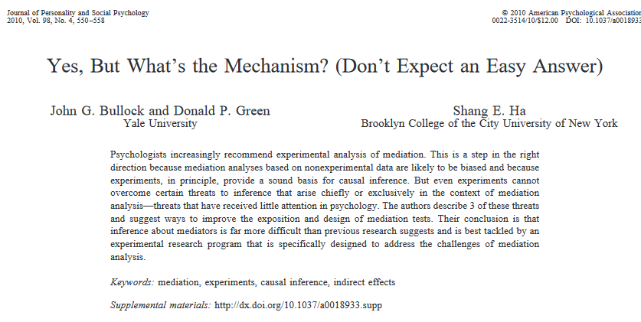
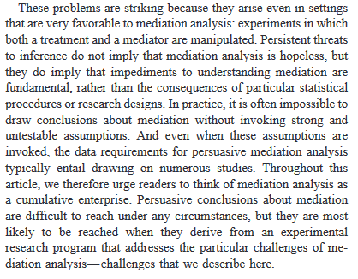
drawing conclusions about mediation is hard

Slide 13
mediation: what we think is happening
if one variable influences another through an intervening variable, the intervening variable is typically called a mediator
M
X
Y

Slide 14
confounds: equivalent mathematically
con
X
Y

Slide 15
an example of a (probable?) confound
intelligence
education
income

Slide 16
colliders: similar mathematically
coll
X
Y

Slide 17
an example of collider bias
imagine you are interested in the relationship between intelligence (indexed by IQ) and conscientiousness
you find a large sample of college students and find ... r = -.37
what?!
http://www.the100.ci/2017/03/14/that-one-weird-third-variable-problem-nobody-ever-mentions-conditioning-on-a-collider/

Slide 18
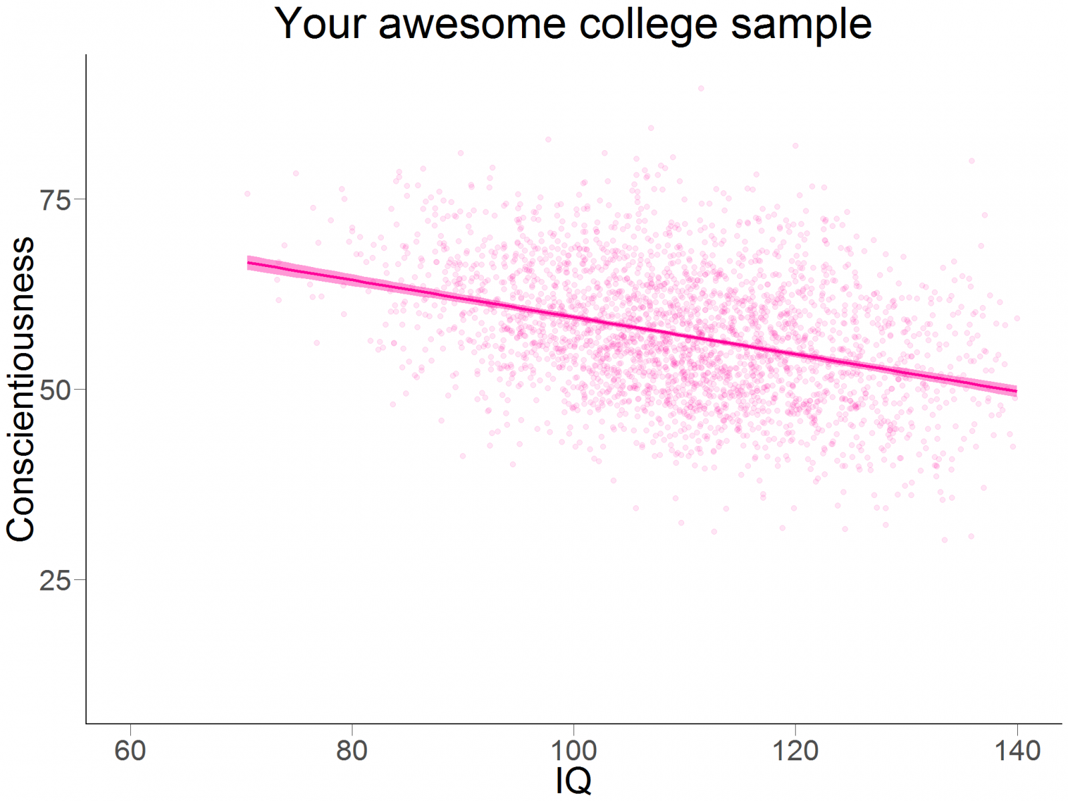

Slide 19
what’s going on?
college students tend to be higher IQ that the general population; they also tend to be higher with respect to conscientiousness
that is, both of these variables are predictors of college-student membership; they “collide”
so selecting from the college-student population “conditions on a collider”, creating a (strange) relationship that doesn’t exist in the whole population

Slide 20
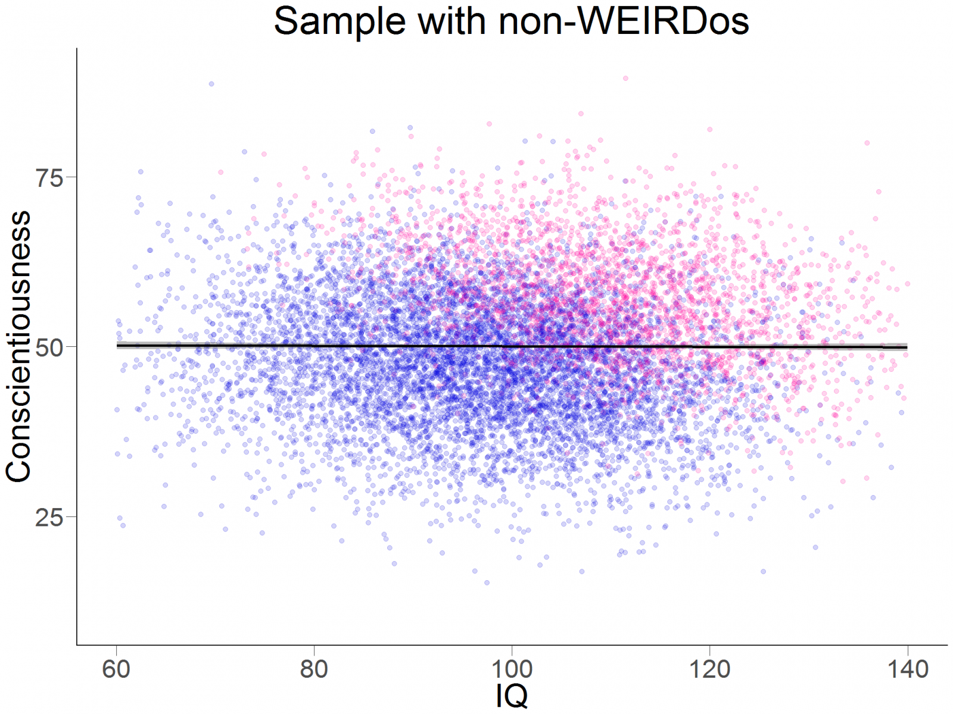

Slide 21
third-variable patterns (problems?), cataloged
confounds
colliders
suppressors
mediators
covariates
https://www.ncbi.nlm.nih.gov/pmc/articles/PMC2819361/
https://www.ncbi.nlm.nih.gov/pubmed/28575894

